Slide 1


Business Case Template Complete PowerPoint template and toolkit for creating high-quality, best-practice business cases

Slide 2
Objectives of this template
Template overview
The Business Case template includes a fully structured storyline complete with ready-to-use slides, as well as frameworks, tools, real-life examples, and best practices to help you:
Create and present a full and compelling business case to convince your stakeholders
Analyze and describe the business need in terms of problem or opportunity which your solution will tackle
Present and discuss different solution options and dive deep on the recommended solution including solution details, tangible and intangible benefits, cost analysis etc.
Analyze potential risks and possible mitigation tactics related to implementing the proposed business case
Present timelines and roadmaps for the proposed solution, including team structure and governance model
Analyze financials and create a detailed Excel business case with ROI and NPV calculations

Slide 3
Content of this template
Template overview
i
Best-practice guide
Business case template slides
Real-life case examples
Business case for purchasing and implementing new software
Business case for three new HR initiatives
Business case for refurbishing an energy plant
Appendix: Checklist and tips for presentations
ii
iii
a
b
c
iv

Slide 4
This business case storyline follows the compelling SCR structure used by McKinsey, BCG, and Bain
Template overview
1
Executive summary
2
Background and context
Situation
Why should we do this?
Create the burning platform that highlights the business need for change
3
What is the problem?
Complication
4
High-level solution and vision
5
Options analysis
What does it look like?
Detail the proposed project/ solution and list all benefits and calculations needed to convince stakeholders
Recommended solution
Solution details
6
Benefits
Resolution
Cost and ROI analysis
7
Implementation plan
8
Risks and mitigations
How will we get there?
Include all relevant details that give stakeholders piece of mind that the plan will work
9
Governance and monitoring
10
Recommendations and next step

Slide 5

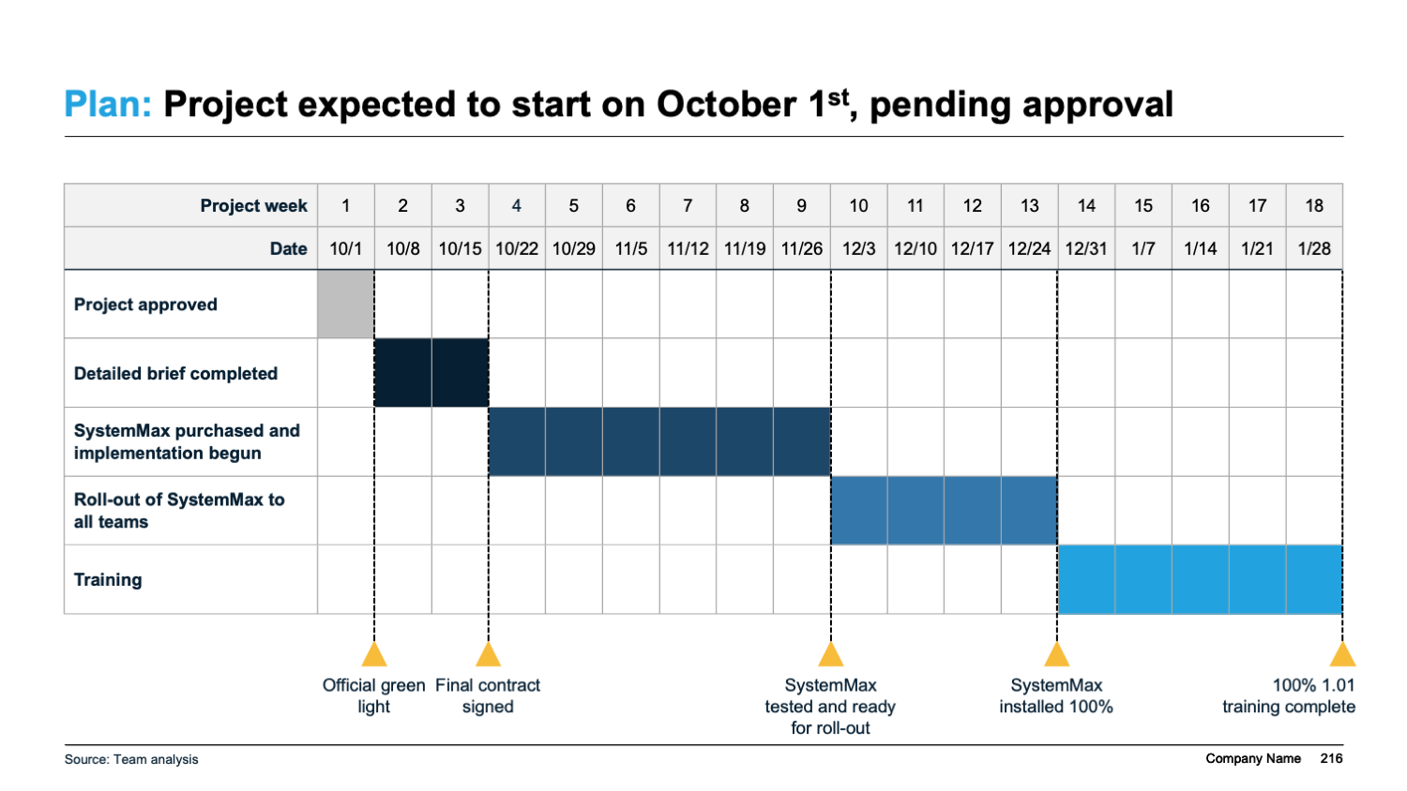
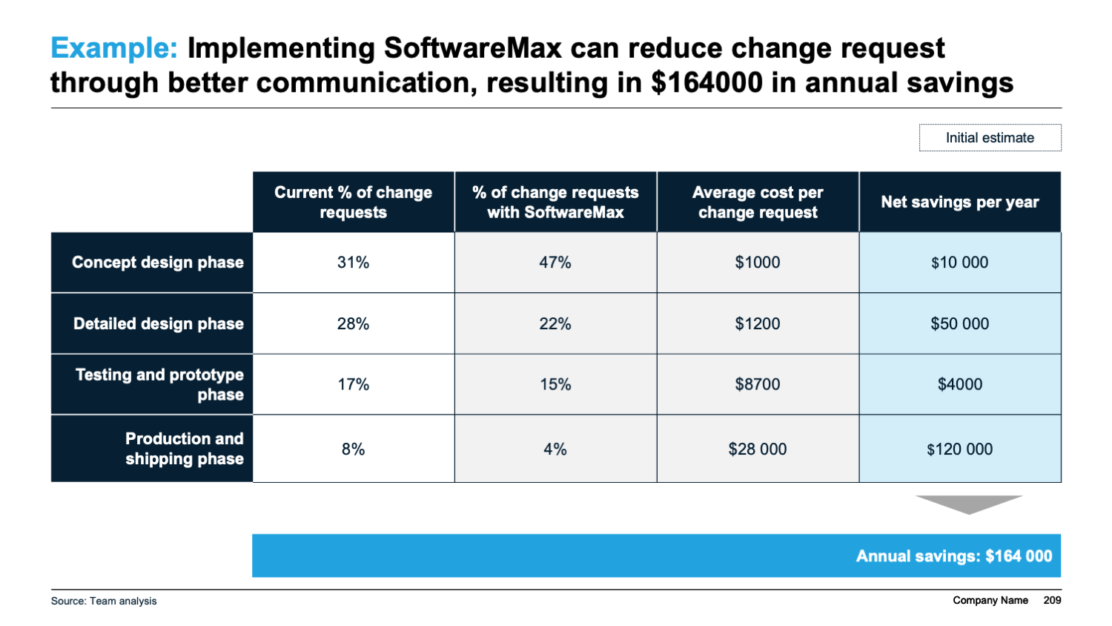

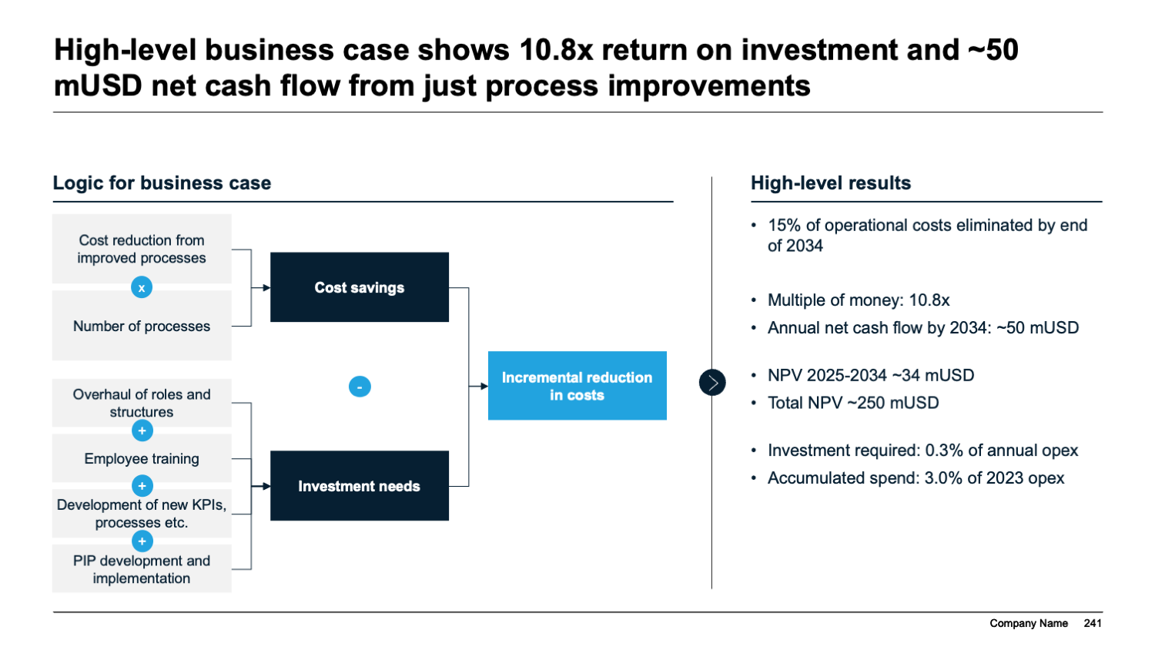
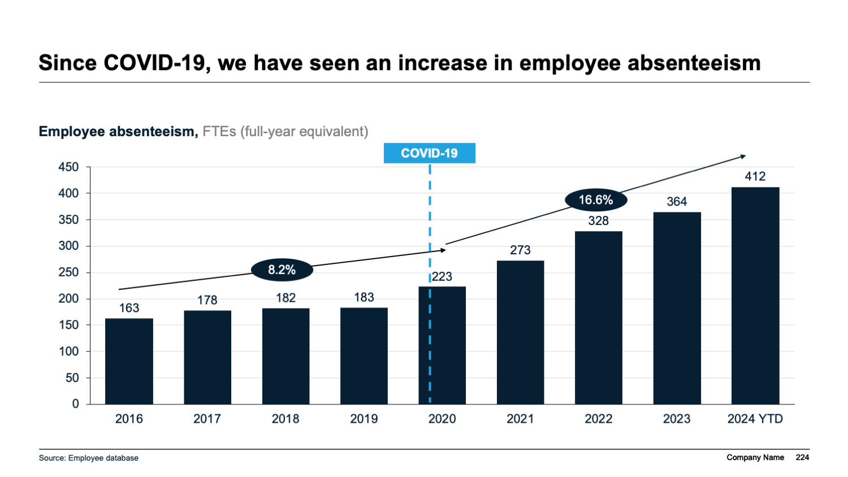

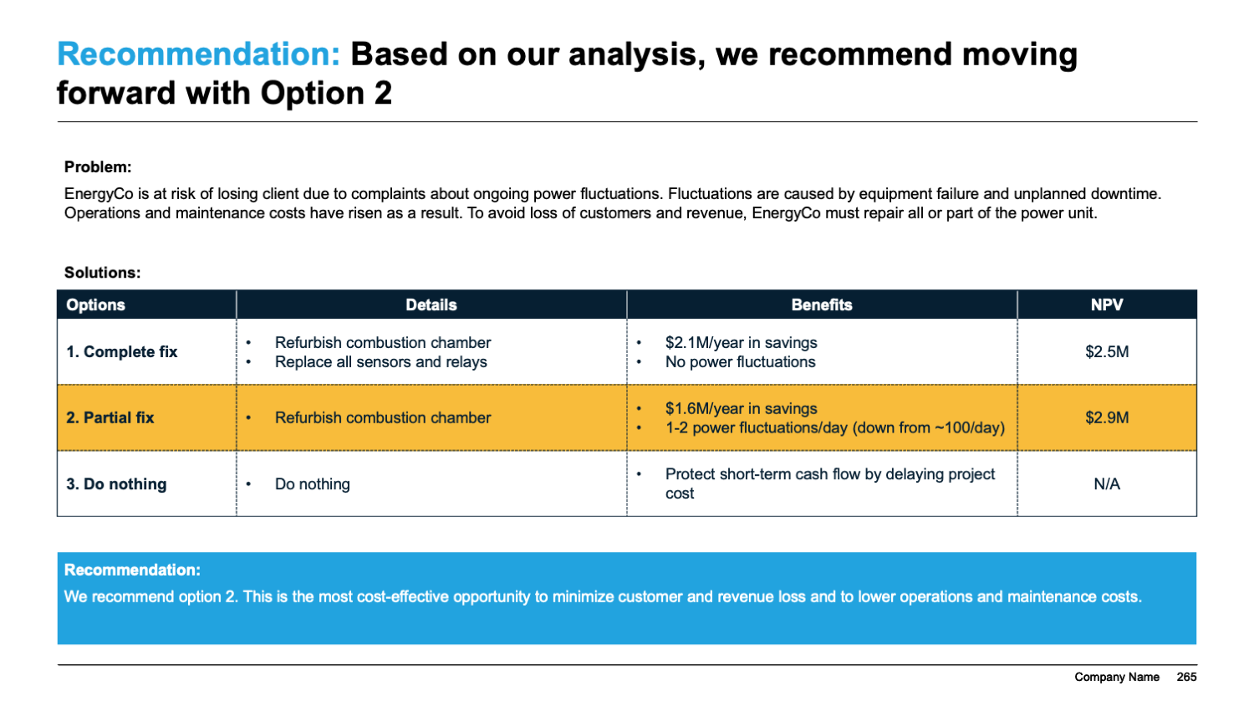
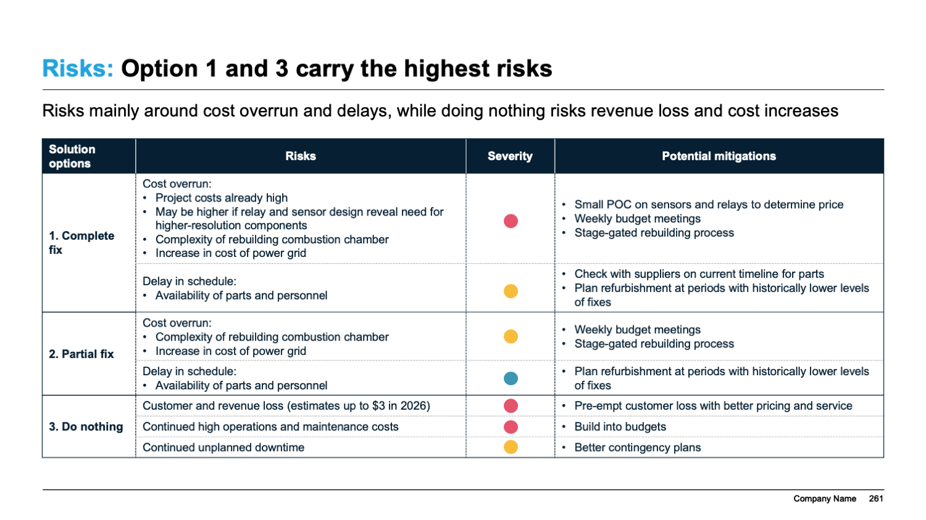
The template includes three full-length sanitized case examples to illustrate how a business case can look like in practice
Template overview
Case
Description
Business case for purchasing and implementing new software
23-page case for purchasing and implementing new software
Compares options for vendor and chooses one to focus on
Gives examples of cost savings and calculates various ROI metrics
Business case for three new HR initiatives
28-page case for combating increased employee absenteeism through three HR initiatives
Focuses on logic for business case, including cost estimates
Data-driven case example
Business case for refurbishing an energy plant*
12-page case example, adapted from ”HBR Tools for Building Your Business Case”
Short and succinct case comparing three options for energy refurbishment
Option comparison carried through all slides
*Adapted from “HBR Tools for Building Your Business Case”

Slide 6

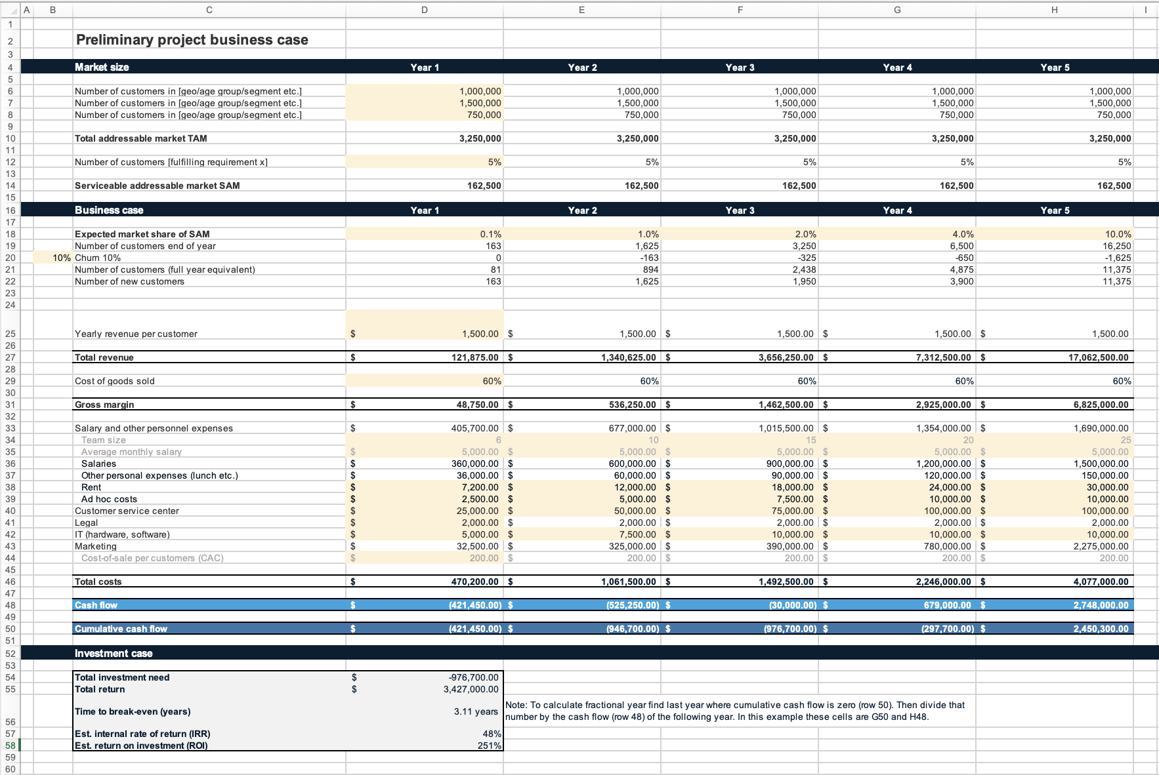
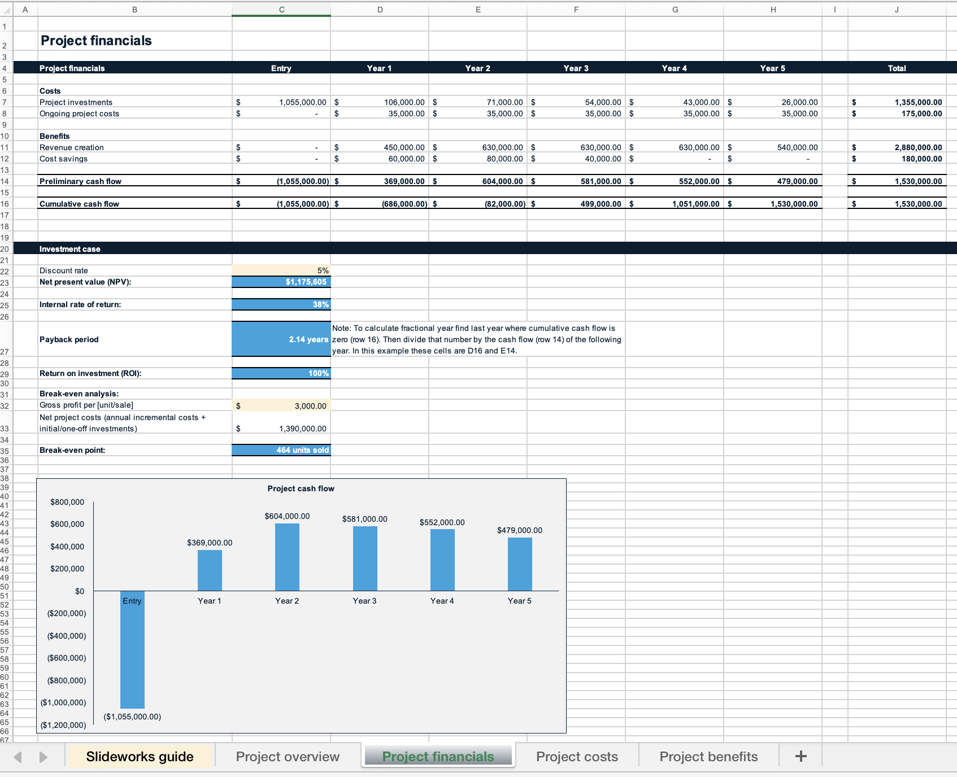
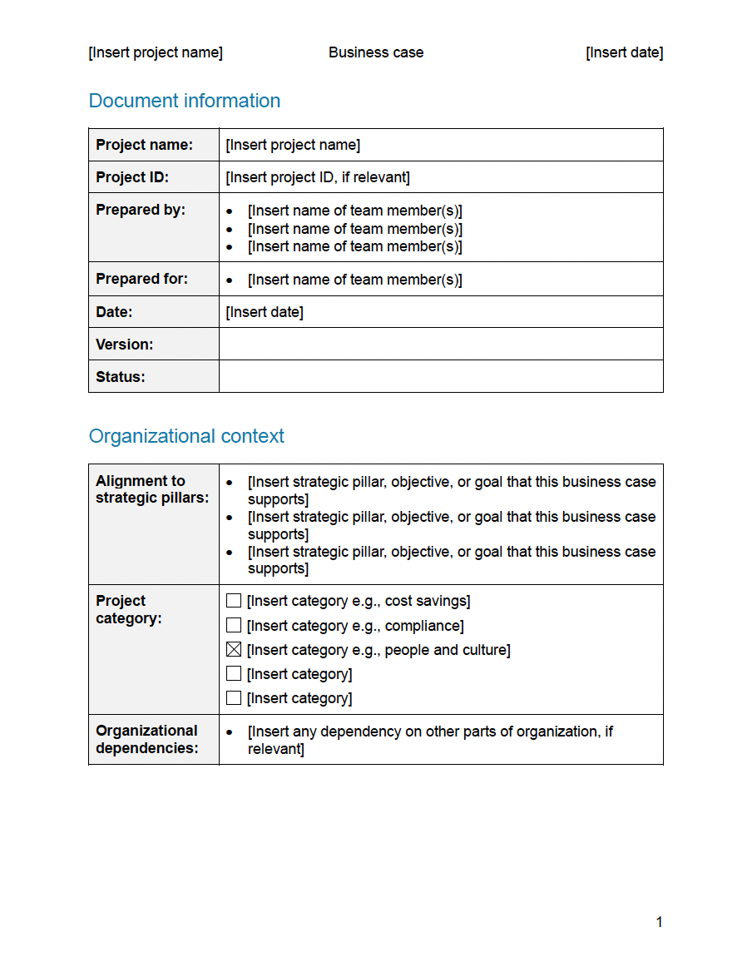

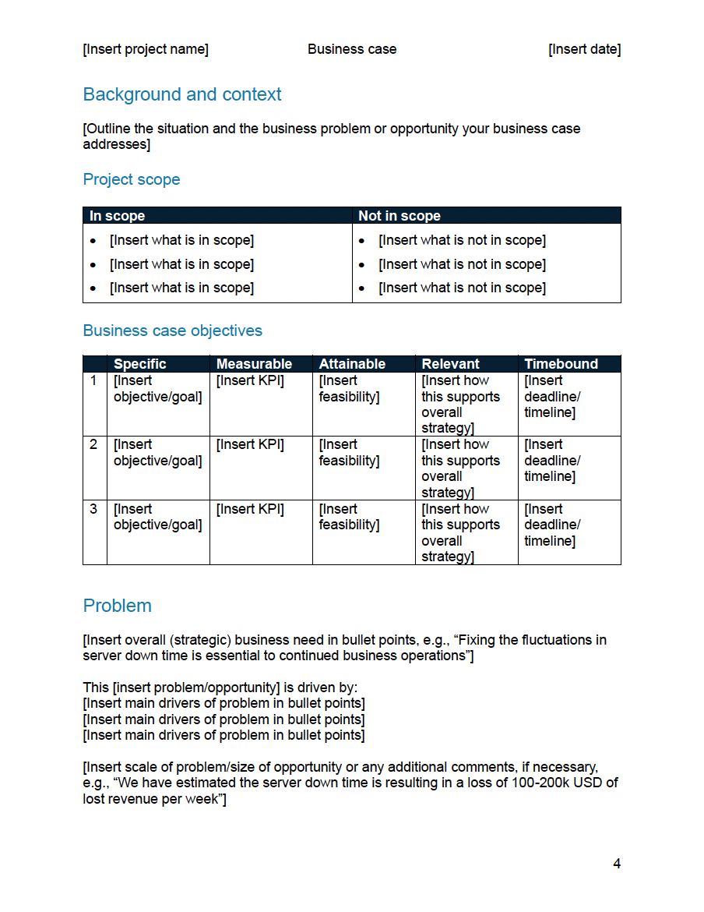
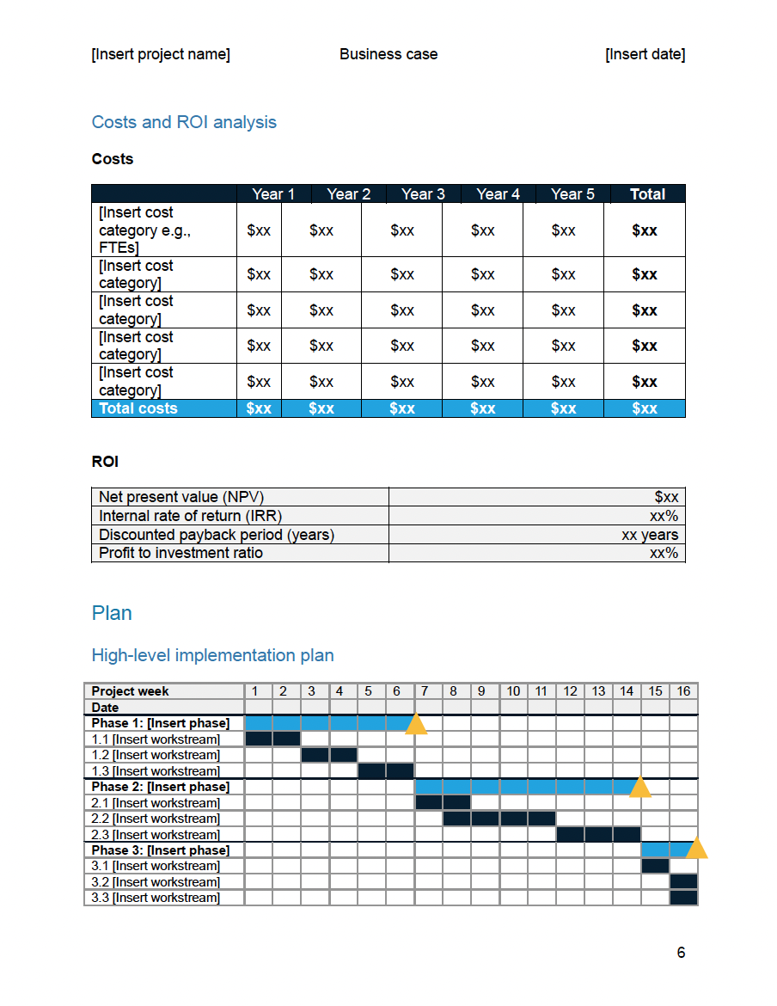
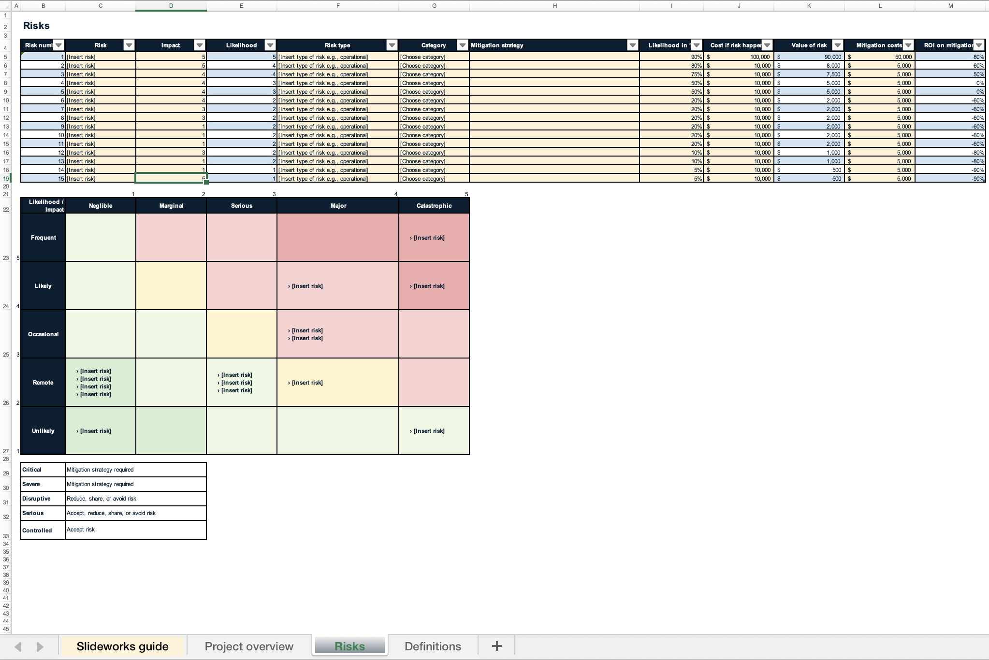
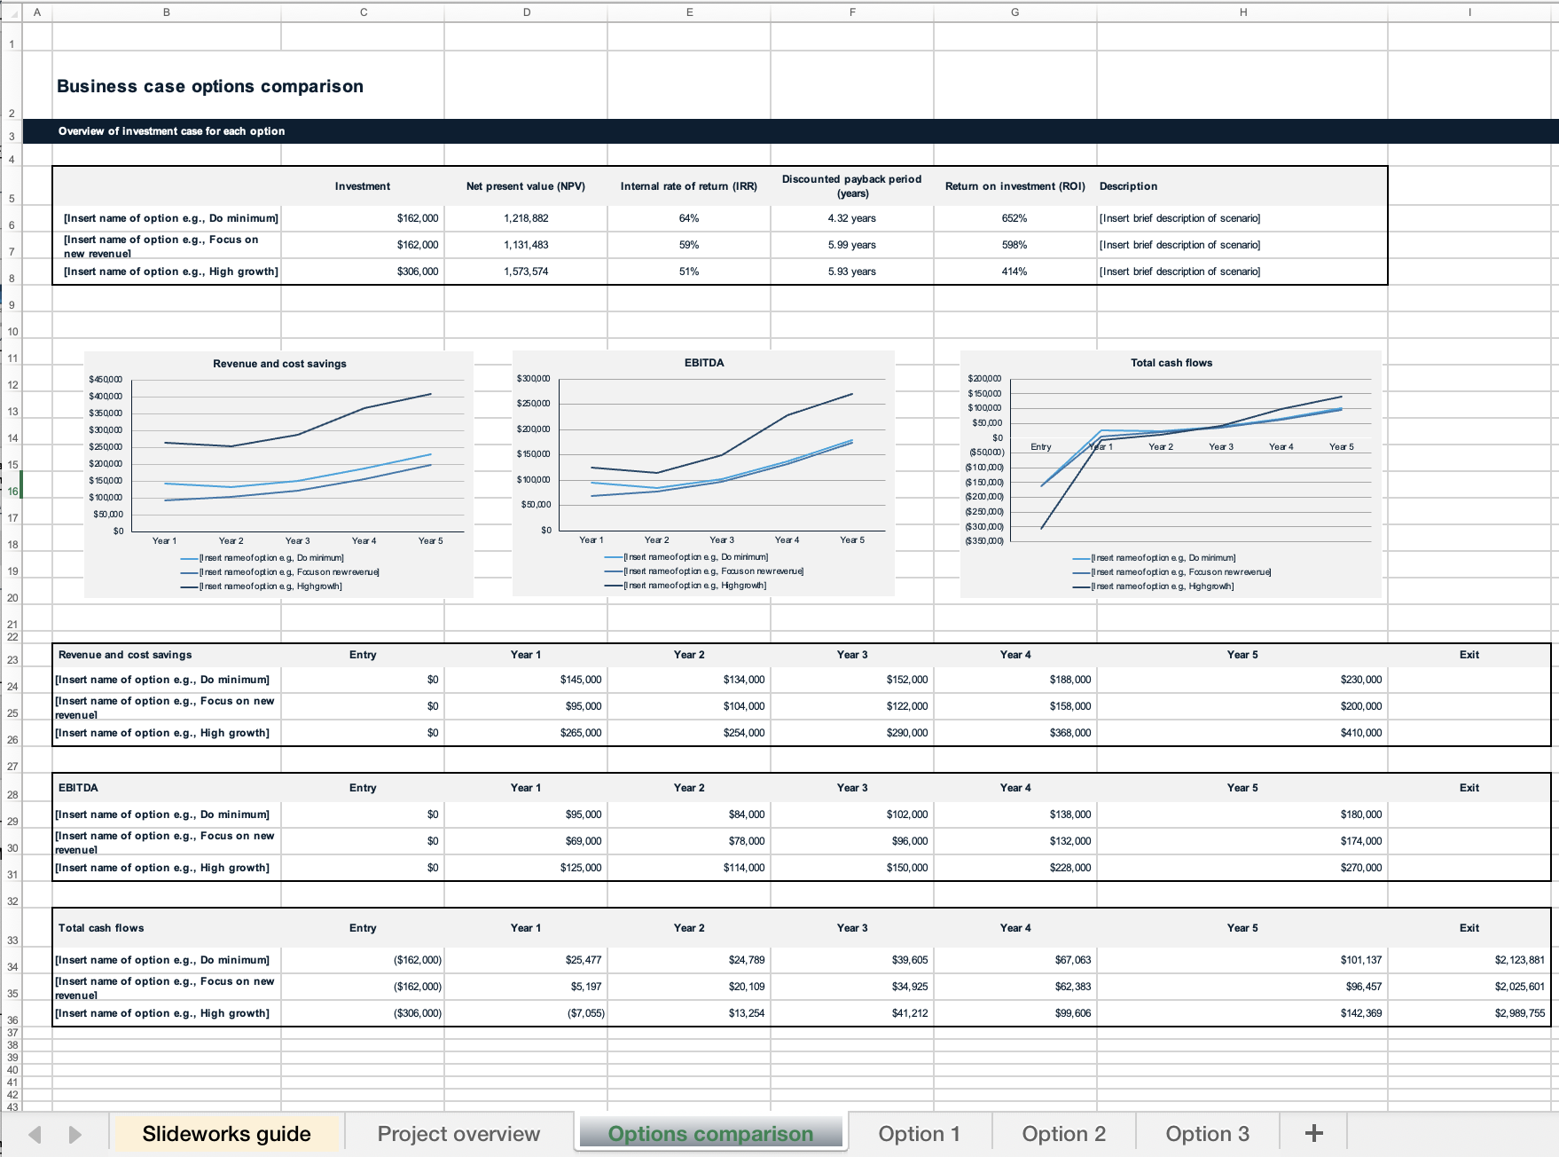
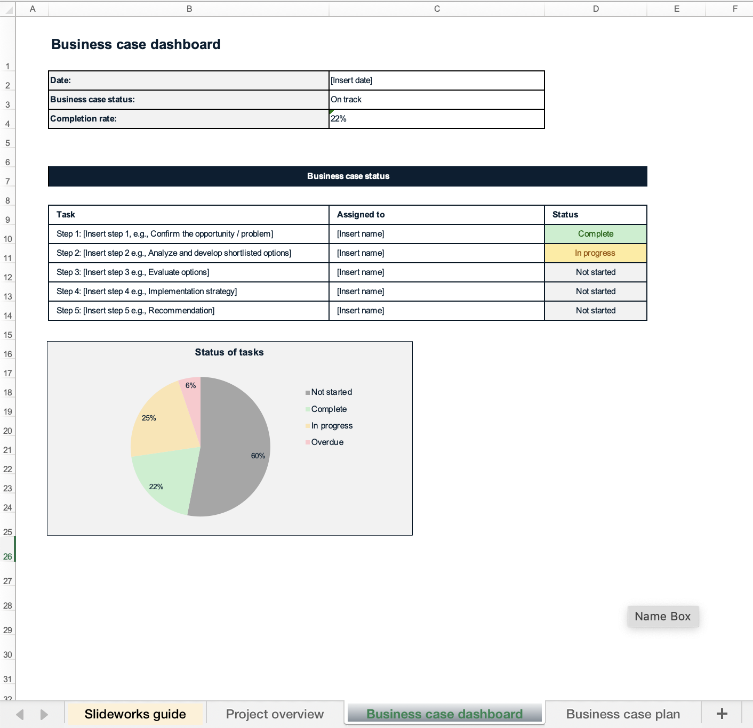
The template also includes 1 Word document and 5 Excel files
Template overview
1 ready-to-use Word document to prepare your business case in .docx format
5 Excel files to support your business case calculations and process
Back-of-the-envelope sheet to get a preliminary view on business case
Comprehensive business case with costs, benefits, cashflow etc.
Risk matrix
Options analysis
Simple status tool

Slide 7
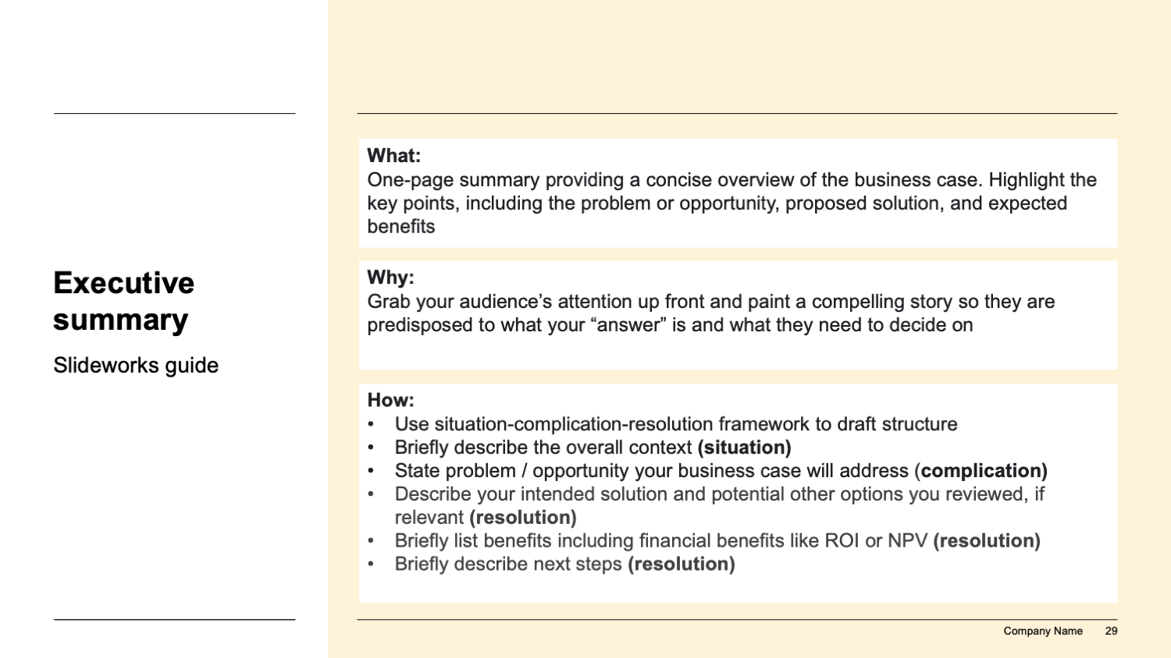
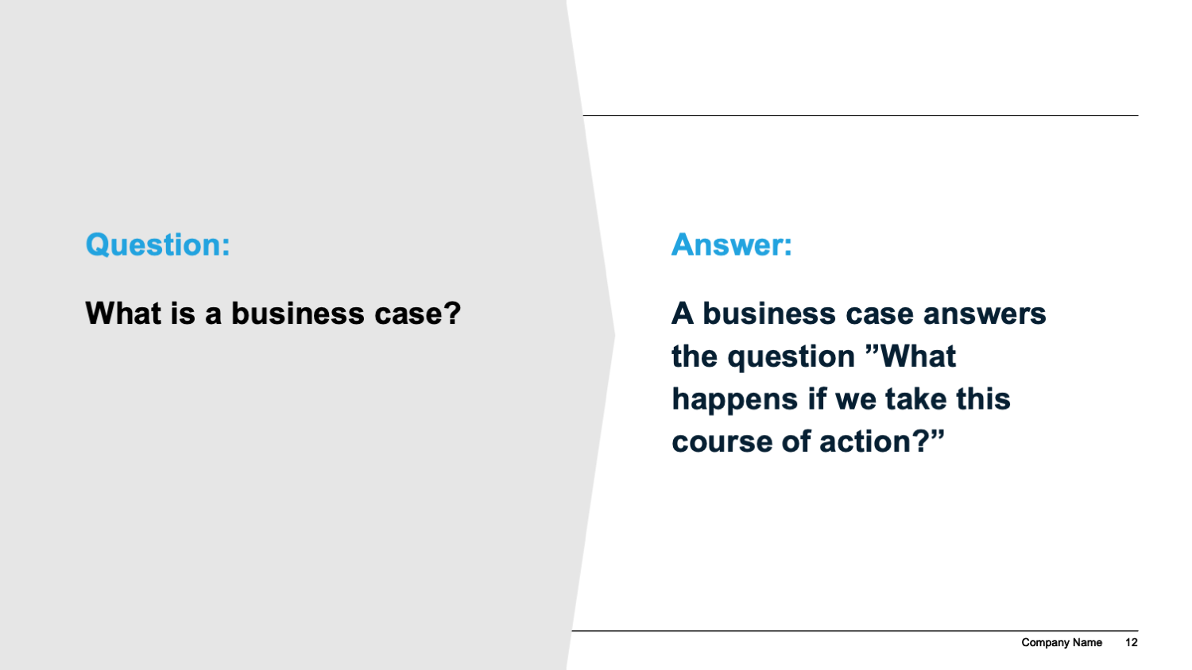
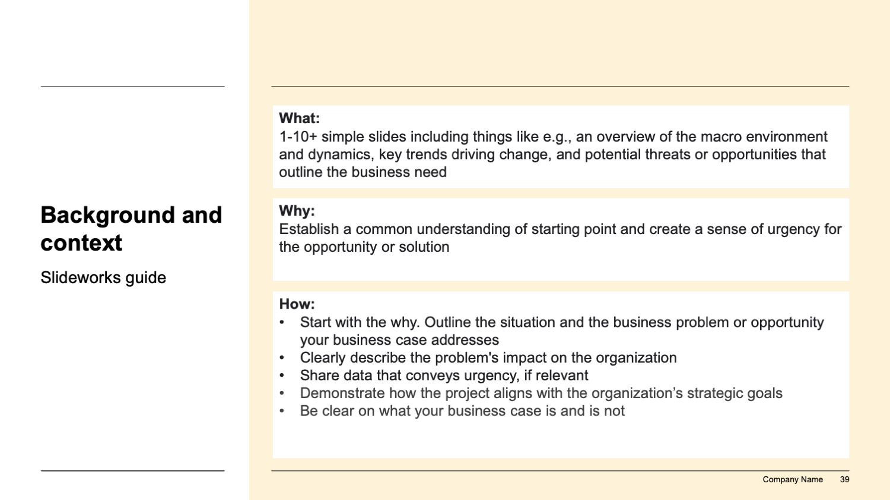
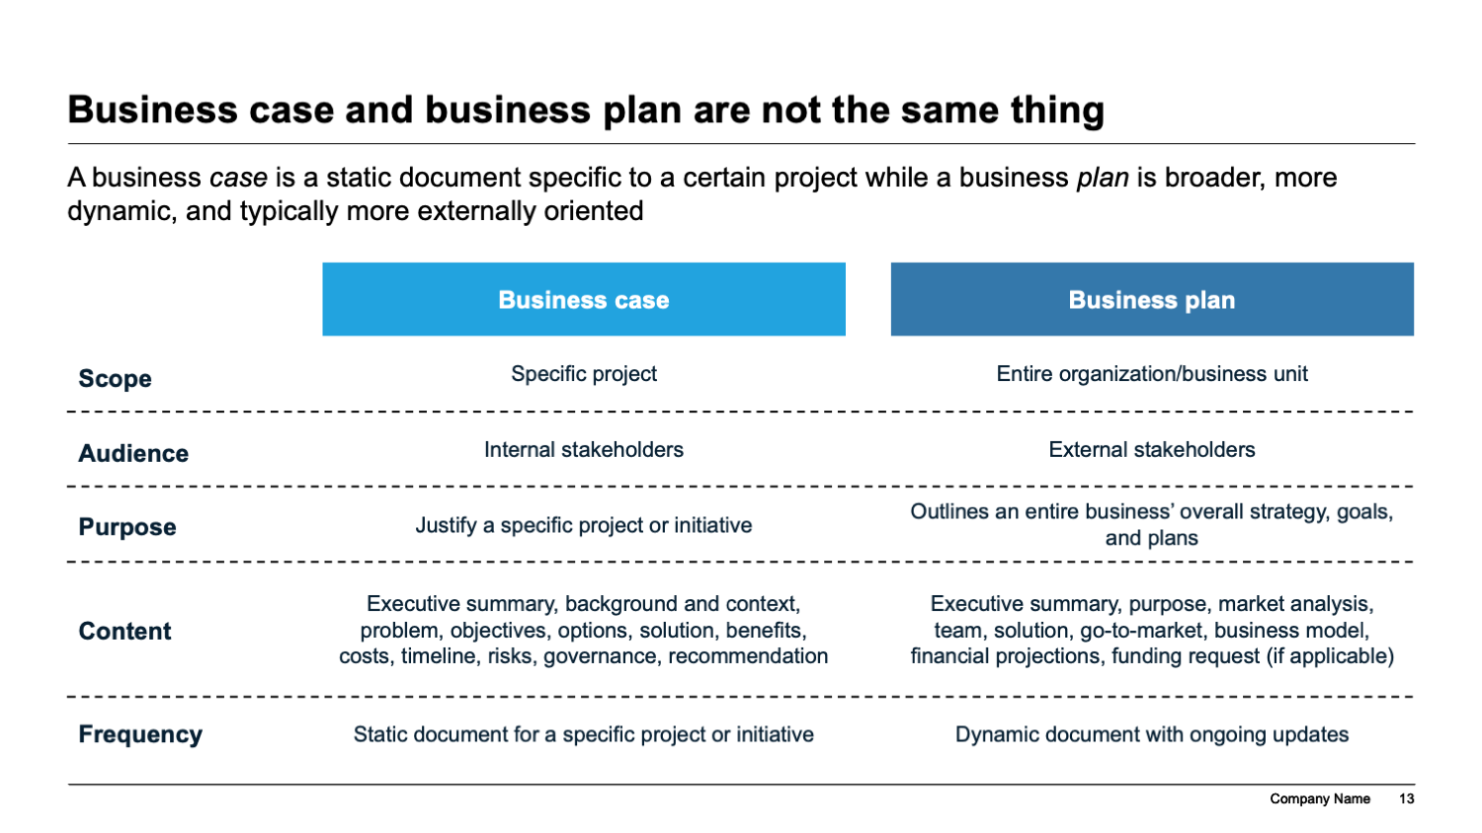
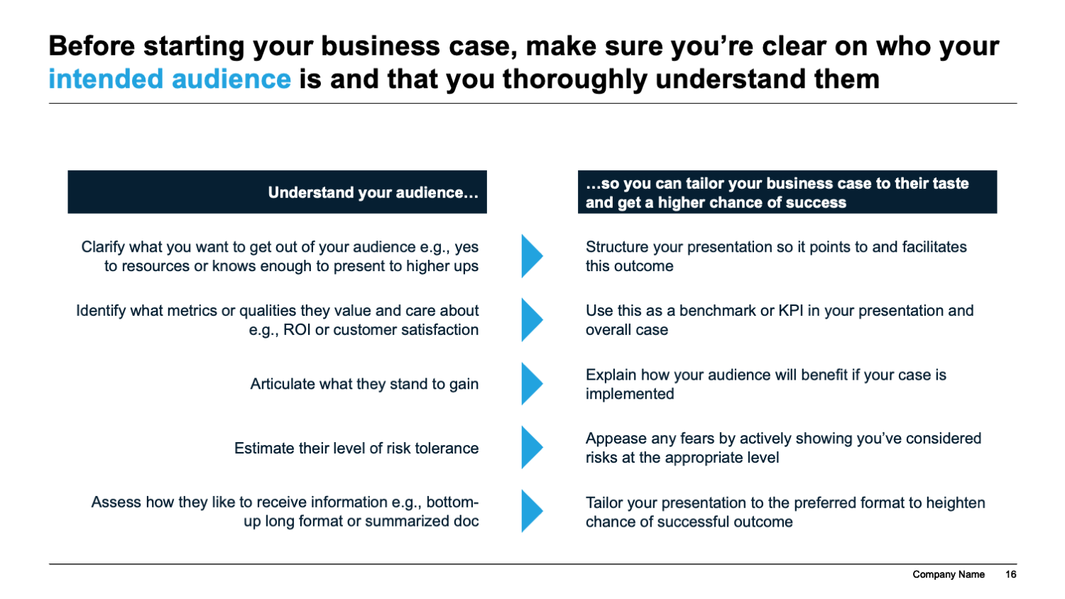
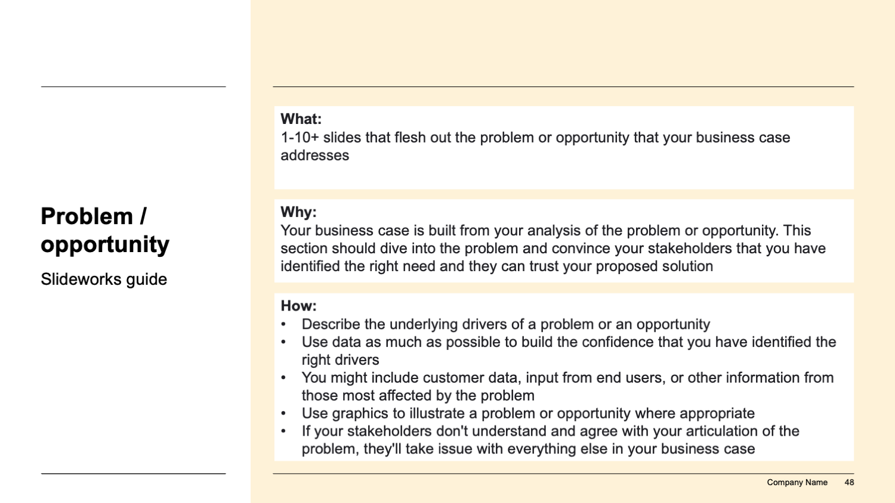
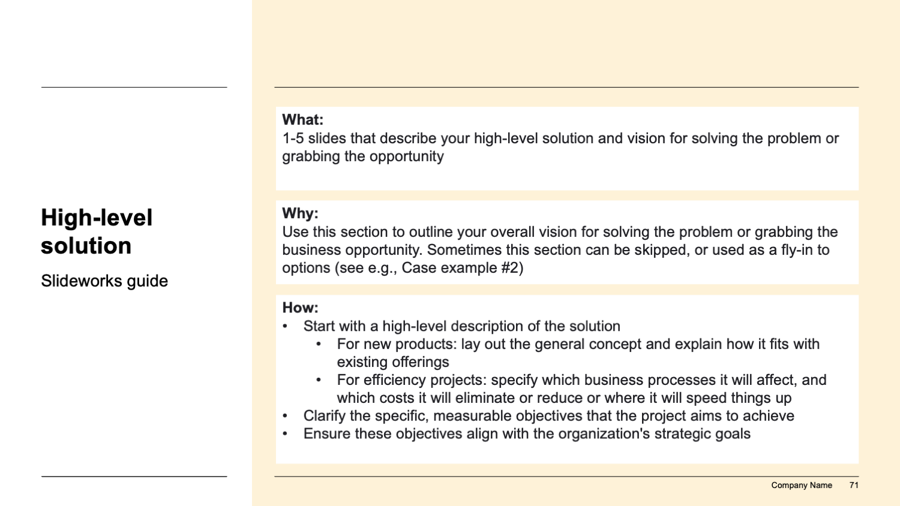
In addition, it includes a best-practice guide to writing a compelling business case, along with guides for each section of the business case
Template overview
A general guide describes what a business case is, when it is used, and how to create a best-practice presentation…
In addition, each section starts with a specific guide on how to complete that section and why it is important
…including tips and tricks and a checklist

Slide 8
How we recommend using the template (I/III)
Template overview
This template consist of four main parts:
Best practice guide on writing effective business cases
Best-practice guide: How to write a compelling business case
Business case template
Real-life case examples
Appendix: Checklist and tips for presentations
i
The template slides themselves that are ready to be filled in
ii
Real-life examples of a business case
iii
Tips and tricks for making your business case even better
iv

Slide 9
How we recommend using the template (II/III)
Template overview
We recommend starting with the best practice guide to understand the basics of how to construct a business case.
Then you can flip through the examples to get inspired and see the framework and storyline in practice.
Then you can pick-and-choose the template slides that fit your needs.
Finally, you can run through the frameworks and tips, if you want to double-check your presentation or need some ideas.
Best-practice guide
Business case template
Real-life case examples
Appendix
Start here
i
Pick-and-choose
ii
Get inspiration
iii
Use if needed
iv
Note: Examples have been sanitized and some numbers have been altered. There may therefore be slight discrepancies between slides

Slide 10
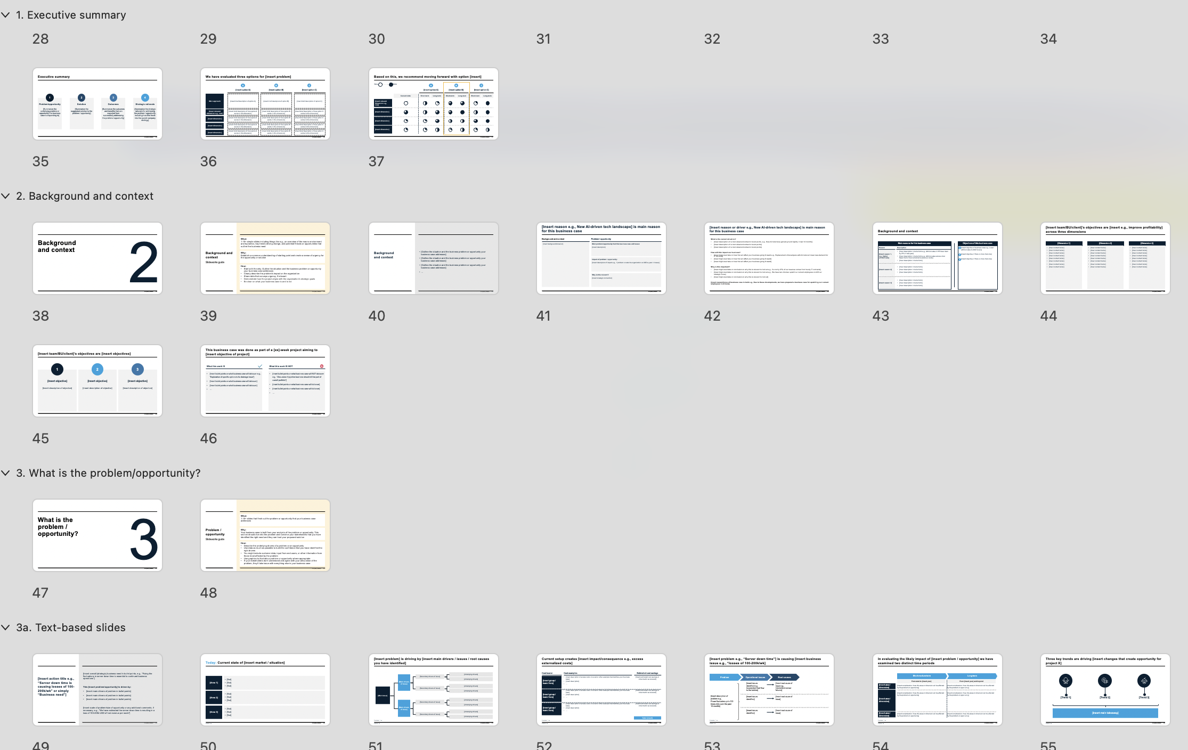

How we recommend using the template (III/III)
Template overview
The template slides themselves have been arranged into sections.
We recommend using the section headers to get an overview and choose the sections that make sense for your needs.
Note: You can view a PowerPoint’s sections by clicking the ”slide sorter” icon at the bottom of the screen:
Business case template
ii

Slide 11
I. Best-practice guide
How to write a compelling business case

Slide 12
Question:
What is a business case?
Answer:
A business case answers the question ”What happens if we take this course of action?”

Slide 13
Business case and business plan are not the same thing
A business case is a static document specific to a certain project while a business plan is broader, more dynamic, and typically more externally oriented
Business case
Business plan
Scope
Specific project
Entire organization/business unit
Audience
Internal stakeholders
External stakeholders
Purpose
Justify a specific project or initiative
Outlines an entire business’ overall strategy, goals, and plans
Content
Executive summary, background and context, problem, objectives, options, solution, benefits, costs, timeline, risks, governance, recommendation
Executive summary, purpose, market analysis, team, solution, go-to-market, business model, financial projections, funding request (if applicable)
Frequency
Static document for a specific project or initiative
Dynamic document with ongoing updates

Slide 14
When should you create a business case?
A business case is typically used when you want to:
Get the go-ahead to start developing a new product or service
Prioritize between projects within your team or organization to decide which to allocate resources to
Obtain additional resources for a new project, initiative, or team member
Invest in a new piece of software or a training program
Decide whether to outsource a particular task or function
Decide between options to alleviate a problem
…
You use a business case whenever you want to say yes or no to a particular well-defined question
Examples of use cases

Slide 15
The structure of a best-practice business case creates a compelling story that effectively guides decision makers towards the solution
1
Executive summary
Background and context
2
Why should we do this?
Create the burning platform that highlights the business need for change
3
What is the problem?
4
High-level solution and vision
5
Options analysis
What does it look like?
Detail the proposed project/ solution and list all benefits and calculations needed to convince stakeholders
Recommended solution
Solution details
6
Benefits
Cost and ROI analysis
7
Implementation plan
8
Risks and mitigations
How will we get there?
Include all relevant details that give stakeholders piece of mind that the plan will work
9
Governance and monitoring
10
Recommendations and next step

Slide 16
Before starting your business case, make sure you’re clear on who your intended audience is and that you thoroughly understand them
Understand your audience…
…so you can tailor your business case to their taste and get a higher chance of success
Clarify what you want to get out of your audience e.g., yes to resources or knows enough to present to higher ups
Structure your presentation so it points to and facilitates this outcome
Identify what metrics or qualities they value and care about e.g., ROI or customer satisfaction
Use this as a benchmark or KPI in your presentation and overall case
Articulate what they stand to gain
Explain how your audience will benefit if your case is implemented
Estimate their level of risk tolerance
Appease any fears by actively showing you’ve considered risks at the appropriate level
Assess how they like to receive information e.g., bottom-up long format or summarized doc
Tailor your presentation to the preferred format to heighten chance of successful outcome

Slide 17
Business case checklist (I/II)
Checklist for a great business case
Have you identified a clear problem that you want to solve or a clear opportunity that you want to seize?
Are you able to formulate that problem / opportunity in a short and concise statement?
Can you link that problem / opportunity to your organization’s overall strategy and business objectives? Where and how will it move the needle if you solve this?
How does it help your stakeholders’ needs and interests if you solve this?
Have you identified metrics that map to each of your business objectives?
Have you generated a full list of alternatives to meet your problem / opportunity by brainstorming with stakeholders and other relevant parties?
Have you narrowed your alternatives to those that best address your objectives and key stakeholder needs?
Have you gathered all the data you’ll need to be able to analyze your alternatives?
Have you estimated a time frame for implementing the initiative and achieving the benefits?

Slide 18
Business case checklist (II/II)
Checklist for a great business case
Have you analyzed your alternatives against relevant business metrics?
Have you compared your alternatives using a pros and cons table or other framework?
Have you selected the best possible solution given your analysis?
Have you considered the risks and developed a mitigation strategy for each risk?
Have you created a high-level implementation plan?
Have you created a tracking plan or other means of tracking project results?
Do you know who will ultimately decide whether to approve your recommended solution?
Do you know the best way to sell your case to the decision makers?
Have you considered ways to keep your final presentation focused and concise?
Do you have all the backup data (including assumptions and calculations) if someone asks?

Slide 19
Tips and tricks
1
Check if your organization has a required format for business cases, or some elements or metrics that must be included
Make sure the metrics you use to measure success and why your business case should be approved align with the metrics your team / your relevant stakeholders use – this will help convince decision makers to say yes
In addition to financial metrics, show how other dimensions like customer satisfaction, team efficiency or similar will improve if your suggested solution is implemented
Remember that a business case is a sales pitch – keep it concise, exciting, and relevant for decision makers
Double-check all numbers
Be clear about what you are asking from your audience and what information they need to come to a decision. You may have gone through many alternatives but if your audience is very senior, they may only be interested in evaluating your chosen option. Conversely, some managers are very detail-oriented and want to see every little calculation and consideration along the way. Spending extra time figuring out how to present to your audience and what they count as important is the best way to ensure your business case hits the mark.
2
3
4
5
6

Slide 20
II. Template slides
Business case

Slide 21
Front pages and content
0

Slide 22

[Title of document]
[Company logo]
Change picture to match company pictures/ industry/project
Business case
[Insert date]

Slide 23

[Title of document]
[Company logo]
[Subtitle]
[Date]

Slide 24
Change picture to match company pictures/ industry/project
[Title of document]
[Subtitle, date]
[Company logo]

Slide 25
Content
Executive summary
Why should we do this?
What does it look like?
How will we get there?
Recommendations and next steps
1
2
3
4
5

Slide 26
Content
1
Executive summary
Background and context
What is the problem?
High-level solution and vision
Options analysis
Recommended solution
Implementation plan
Risks and mitigations
Governance and monitoring
Recommendations and next steps
2
3
4
5
6
7
8
9
10

Slide 27
Content
Executive summary
Why should we do this?
Background and context
What is the problem?
High-level solution and vision
What does it look like?
Options analysis
Recommended solution (details, benefits, cost analysis)
How will we get there?
Implementation plan
Risks and mitigations
Governance and monitoring
Recommendations and next steps

Slide 28
Executive summary
1

Slide 29
Executive summary
What: One-page summary providing a concise overview of the business case. Highlight the key points, including the problem or opportunity, proposed solution, and expected benefits
Why: Grab your audience’s attention up front and paint a compelling story so they are predisposed to what your “answer” is and what they need to decide on
Slideworks guide
How:
Use situation-complication-resolution framework to draft structure
Briefly describe the overall context (situation)
State problem / opportunity your business case will address (complication)
Describe your intended solution and potential other options you reviewed, if relevant (resolution)
Briefly list benefits including financial benefits like ROI or NPV (resolution)
Briefly describe next steps (resolution)

Slide 30
Executive summary
Vision
[Insert vision for proposed project including qualitative and quantitative benefits]
Strategic objective
[Insert strategic objective of project and how it fits into overall company or BU/team strategy. This can also be business need]
Solution
[Insert brief description of suggested solution]
Sponsor
[Insert person, team, department, BU or similar who will sponsor the business case]

Slide 31
Executive summary
Business need: [Insert main business problem or opportunity]
[Supporting information in bullet points]
[Supporting information in bullet points]
[Supporting information in bullet points]
Suggested solution: [Insert high-level solution]
[Supporting information in bullet points]
[Supporting information in bullet points]
[Supporting information in bullet points]
Path forward: [Insert main timeframe for implementation e.g., “Project expected to take 7 months”]
[Supporting information in bullet points]
[Supporting information in bullet points]
[Supporting information in bullet points]
Immediate next steps: [Insert next steps or to-dos]

Slide 32
Executive summary
Problem
Solution
Recommendation and next steps
[Insert background/reasons for starting project]
[Insert bullet points on business need/opportunity/problem]
[Insert bullet points on business need/opportunity/problem]
…
We have identified three possible options:
[Insert option 1]:
[Insert description and main stats in bullet points]
[Insert description and main stats in bullet points]
[Insert option 2]:
[Insert description and main stats in bullet points]
[Insert description and main stats in bullet points]
[Insert option 3]:
[Insert description and main stats in bullet points]
[Insert description and main stats in bullet points]
We recommend option [insert]
[Insert reason(s) why]
[Insert reason(s) why]
[Insert reason(s) why]
Project can be implemented over [xx] months
[Insert more details e.g., start date, teams or what needs to be clarified further]
[Insert more details e.g., start date, teams or what needs to be clarified further]
[Insert more details e.g., start date, teams or what needs to be clarified further]
Immediate next steps:
[Insert next steps]

Slide 33
Executive summary
Problem:
[Insert brief description of problem, 2-3 lines max]
Solutions:
Options | Details | Benefits | NPV / ROI
Option 1: [Insert name of option 1 e.g., “Fully outsourced”] | [Insert description of solution in bullet points] [Insert description of solution in bullet points] [Insert description of solution in bullet points] | [Insert description of financial and other benefits in bullet points] [Insert description of benefits in bullet points] [Insert description of benefits in bullet points] | [Insert estimated NPV and/or ROI, if relevant]
Option 2: [Insert name of option 2] | [Insert description of solution in bullet points] [Insert description of solution in bullet points] [Insert description of solution in bullet points] | [Insert description of financial and other benefits in bullet points] [Insert description of benefits in bullet points] [Insert description of benefits in bullet points] | [Insert estimated NPV and/or ROI, if relevant]
Option 3: [Insert name of option 3] | [Insert description of solution in bullet points] [Insert description of solution in bullet points] [Insert description of solution in bullet points] | [Insert description of financial and other benefits in bullet points] [Insert description of benefits in bullet points] [Insert description of benefits in bullet points] | [Insert estimated NPV and/or ROI, if relevant]
Recommendation:
[Insert recommendation and highlight next steps]

Slide 34
Executive summary
Project background and benefits
[Insert brief description of context and business need]
[Insert expected tangible and intangible benefits of implementing project]
[Insert expected tangible and intangible benefits of implementing project]
[Insert expected tangible and intangible benefits of implementing project]
Expected outcome
Revenue generated, [unit]
Costs, team, and setup
Project costs:
[Insert expected costs]
Project sponsor:
[Insert name]
Net present value (NPV):
[Insert NPV]
Number of FTEs needed:
[Insert number]
Project manager:
[Insert name]
Return on investment (ROI):
[Insert ROI]

Slide 35
Executive summary
1
2
3
4
Problem/opportunity
[Summarize the underlying problem or opportunity this business case is responding to]
Solution
[Summarize the suggested solution to the problem / opportunity]
Outcomes
[Summarize the outcomes and benefits that can expected from successfully addressing the problem / opportunity]
Strategic rationale
[Summarize the strategic rationale for addressing the problem / opportunity, including how this feeds into the overall company strategy]

Slide 36
We have evaluated three options for [insert problem]
A
B
C
[Insert option A]
[Insert option B]
[Insert option C]
Main approach
[Insert brief description of option A]
[Insert brief description of option B]
[Insert brief description of option C]
[Insert relevant dimension e.g., cost]
[Insert brief description of how option A works in this dimension]
[Insert brief description of how option B works in this dimension]
[Insert brief description of how option C works in this dimension]
[Insert dimension]
[Insert brief description of how option A works in this dimension]
[Insert brief description of how option B works in this dimension]
[Insert brief description of how option C works in this dimension]
[Insert dimension]
[Insert brief description of how option A works in this dimension]
[Insert brief description of how option B works in this dimension]
[Insert brief description of how option C works in this dimension]
[Insert dimension]
[Insert brief description of how option A works in this dimension]
[Insert brief description of how option B works in this dimension]
[Insert brief description of how option C works in this dimension]

Slide 37
Based on this, we recommend moving forward with option [insert]
Worse
Better
A
B
C
[Insert option A]
[Insert option B]
[Insert option C]
Current state
Short-term
Long-term
Short-term
Long-term
Short-term
Long-term
[Insert relevant dimension e.g., cost]
[Insert dimension]
[Insert dimension]
[Insert dimension]

Slide 38
Background and context
2

Slide 39
Background and context
What: 1-10+ simple slides including things like e.g., an overview of the macro environment and dynamics, key trends driving change, and potential threats or opportunities that outline the business need
Why: Establish a common understanding of starting point and create a sense of urgency for the opportunity or solution
Slideworks guide
How:
Start with the why. Outline the situation and the business problem or opportunity your business case addresses
Clearly describe the problem's impact on the organization
Share data that conveys urgency, if relevant
Demonstrate how the project aligns with the organization’s strategic goals
Be clear on what your business case is and is not

Slide 40
Background and context
[Outline the situation and the business problem or opportunity your business case addresses]
[Outline the situation and the business problem or opportunity your business case addresses]
[Outline the situation and the business problem or opportunity your business case addresses]
…
Source: xx

Slide 41
[Insert reason e.g., New AI-driven tech landscape] is main reason for this business case
Background and context
Problem / opportunity
[Insert background/situation]
Main problem/opportunity that this business case addresses:
[Insert description]
Impact of problem / opportunity:
[Insert description of impact e.g., if problem x costs the organization xx USD a year in losses]
Why is this relevant?:
[Insert strategic connection]
Footnote: 1. xx
Source: xx

Slide 42
[Insert reason or driver e.g., New AI-driven tech landscape] is main reason for this business case
What is the current situation?
[Insert description of current situation/context in bullet points, e.g., New AI tools have gained ground rapidly in last 12 months]
[Insert description of current situation/context in bullet points]
[Insert description of current situation/context in bullet points]
How will this impact our business?
[Insert high-level take on how this will affect your business going forward e.g., Replacement of developers with AI tools will mean less demand for IT services]
[Insert high-level take on how this will affect your business going forward]
[Insert high-level take on how this will affect your business going forward]
Why is this important?
[Insert high-level data or conclusion on why this is relevant to look at e.g., Currently 27% of our revenue comes from hourly IT contracts]
[Insert high-level data or conclusion on why this is relevant to look at e.g., We have two choices: upskill our current employees or shift our strategic focus]
[Insert high-level data or conclusion on why this is relevant to look at]
[Insert reason/focus of business case in bold e.g., Due to these developments, we have prepared a business case for upskilling our current employees in AI tools]
Footnote: 1. xx
Source: xx

Slide 43
Background and context
Main reasons for this business case
Objectives of this business case
Reason
Description
[Insert objective of business case e.g., Lower attrition rates to 2023 levels]
[Insert objective, if there is more than one]
[Insert objective, if there is more than one]
1
[Insert reason 1, e.g., higher attrition rate]
[Insert description in bullet form e.g., Attrition rates in HR have risen by 27% in last year]
[Insert description in bullet form e.g., Attrition rates across other departments have remained at previous levels]
[Insert description in bullet form]
2
3
[Insert reason 2]
[Insert description in bullet form]
[Insert description in bullet form]
[Insert description in bullet form]
[Insert reason 3]
[Insert description in bullet form]
[Insert description in bullet form]
[Insert description in bullet form]
Source: xx

Slide 44
[Insert team/BU/client]’s objectives are [insert e.g., improve profitability] across three dimensions
[Dimension 1]
[Dimension 2]
[Dimension 3]
[Insert content bullet]
[Insert content bullet]
[Insert content bullet]
[Insert content bullet]
[Insert content bullet]
[Insert content bullet]
[Insert content bullet]
[Insert content bullet]
[Insert content bullet]
[Insert content bullet]
[Insert content bullet]
[Insert content bullet]
[Insert content bullet]
[Insert content bullet]
[Insert content bullet]
[Insert content bullet]
[Insert content bullet]
[Insert content bullet]
[Insert content bullet]
[Insert content bullet]
[Insert content bullet]
[Insert content bullet]
[Insert content bullet]
[Insert content bullet]
Source: xx

Slide 45
[Insert team/BU/client]’s objectives are [insert objectives]
1
2
3
[Insert objective]
[Insert objective]
[Insert objective]
[Insert description of objective]
[Insert description of objective]
[Insert description of objective]
Source: xx

Slide 46


This business case was done as part of a [xx]-week project aiming to [insert objective of project]
What this work IS
What this work IS NOT
[Insert bullet points on what business case will do/cover e.g., “Exploration of specific options to fix drainage issue”]
[Insert bullet points on what business case will do/cover]
[Insert bullet points on what business case will do/cover]
…
[Insert bullet points on what business case will NOT do/cover e.g., “Discussion if pipeline business should still be part of overall portfolio”]
[Insert bullet points on what business case will do/cover]
[Insert bullet points on what business case will do/cover]
…
Source: xx

Slide 47
What is the problem / opportunity?
3

Slide 48
Problem / opportunity
What: 1-10+ slides that flesh out the problem or opportunity that your business case addresses
Why: Your business case is built from your analysis of the problem or opportunity. This section should dive into the problem and convince your stakeholders that you have identified the right need, and they can trust your proposed solution
Slideworks guide
How:
Describe the underlying drivers of a problem or an opportunity
Use data as much as possible to build the confidence that you have identified the right drivers
You might include customer data, input from end users, or other information from those most affected by the problem
Use graphics to illustrate a problem or opportunity where appropriate
If your stakeholders don't understand and agree with your articulation of the problem, they'll take issue with everything else in your business case

Slide 49
[Insert action title e.g., “Server down time is causing losses of 100-200k/wk” or simply “Business need”]
[Insert overall (strategic) business need in bullet points, e.g., “Fixing the fluctuations in server down time is essential to continued business operations”]
This [insert problem/opportunity] is driven by:
[Insert main drivers of problem in bullet points]
[Insert main drivers of problem in bullet points]
[Insert main drivers of problem in bullet points]
[Insert scale of problem/size of opportunity or any additional comments, if necessary, e.g., “We have estimated the server down time is resulting in a loss of 100-200k USD of lost revenue per week”]
Source: xx

Slide 50
Today: Current state of [insert market / situation]
[Area 1]
[Text]
[Text]
[Text]
[Area 2]
[Text]
[Text]
[Text]
[Area 3]
[Text]
[Text]
[Text]
Source: xx

Slide 51
[Insert problem] is driving by [insert main drivers / issues / root causes you have identified]
[Underlying drivers]
[Main drivers of issue]
[Secondary drivers of issue]
[Underlying drivers]
[Underlying drivers]
[Main issue]
[Secondary drivers of issue]
[Underlying drivers]
[Underlying drivers]
[Main drivers of issue]
[Secondary drivers of issue]
[Underlying drivers]
[Underlying drivers]
[Secondary drivers of issue]
[Underlying drivers]
Footnote: 1. xx
Source: xx

Slide 52
Current setup creates [insert impact/consequence e.g., excess externalized costs]
Cost bearer
Cost examples
Estimated cost savings
[Insert group / team / item]
[Insert description of excess costs incurred or other example that matches your business case]
[Insert description]
…
[Insert estimated cost savings or another metric as relevant]
[Insert group / team / item]
[Insert description of excess costs incurred or other example that matches your business case]
[Insert description]
…
[Insert estimated cost savings or another metric as relevant]
[Insert group / team / item]
[Insert description of excess costs incurred or other example that matches your business case]
[Insert description]
…
[Insert estimated cost savings or another metric as relevant]
Total: [insert]
Footnote: 1. xx
Source: xx

Slide 53
[Insert problem e.g., “Server down time”] is causing [insert business issue e.g., “losses of 100-200k/wk]
Problem
Operational issues
Root causes
[Insert issues identified e.g., Inconsistent fuel flow to the turbine]
[Insert root cause of issue e.g., Intermittent sensor failures]
[Insert description of problem e.g.,
Power fluctuates up to 100 times daily over the past 12 months]
[Insert issues identified]
[Insert root cause of issue]
[Insert issues identified]
[Insert root cause of issue]
Footnote: 1. xx
Source: xx

Slide 54
In evaluating the likely impact of [insert problem / opportunity] we have examined two distinct time periods
Short-medium-term
Long-term
From start to [insert year]
From [insert year] and beyond
[Insert area / dimension]
[Insert consideration / how this area or dimension will be affected by the problem or opportunity]
[Insert consideration / how this area or dimension will be affected by the problem or opportunity]
[Insert area / dimension]
[Insert consideration / how this area or dimension will be affected by the problem or opportunity]
[Insert consideration / how this area or dimension will be affected by the problem or opportunity]
[Insert area / dimension]
[Insert consideration / how this area or dimension will be affected by the problem or opportunity]
[Insert consideration / how this area or dimension will be affected by the problem or opportunity]
Footnote: 1. xx
Source: xx

Slide 55



Three key trends are driving [insert changes that create opportunity for project X]
[Trend 1]
[Trend 2]
[Trend 3]
[Insert main takeaway]
Source: xx

Slide 56
[Insert trend x]
[Insert more in-depth description of trend x]
Share of [insert description]
Share of [insert description]
[Answer 1]
[Answer 2]
[Answer 3]
[Answer 4]
Source: xx

Slide 57
[Insert trend x]
[Insert more in-depth description of trend x]
[Insert description/graph headline]
[Insert screenshot or similar, if relevant]
xx [insert description]
Source: xx

Slide 58

[Insert trend x]
[Insert more in-depth description of trend x]
[Insert description/graph headline]
xx [insert description]
xx [insert description]
[Insert customer quote, if relevant]
[Insert customer bio]
[Insert customer quote, if relevant]
[Insert customer bio]
Source: xx

Slide 59
[Line graph / Insert action title]
[Description/data]
[Unit]
[Series 1]
[Insert key takeaway]
[Series 2]
[Series 3]
Footnote: 1. xx
Source: xx

Slide 60
[Column chart for comparison with takeaways / Insert action title]
[Description]
[Key takeaways/main conclusion]
[Data], [Unit]
[Data], [Unit]
[Short description and most important takeaways]
[Short description and most important takeaways]
[Short description and most important takeaways]
…
Footnote: 1. xx
Source: xx

Slide 61
[Column chart with simple growth and takeaways / Insert action title]
[Description]
[Key takeaways/main conclusion]
[Data], [Unit]
Actuals
[Short description and most important takeaways]
[Short description and most important takeaways]
[Short description and most important takeaways]
…
xx%
Footnote: 1. xx
Source: xx

Slide 62
[Column chart with split growth and takeaways / Insert action title]
[Description]
[Key takeaways/main conclusion]
[Data], [Unit]
Actuals
[Short description and most important takeaways]
[Short description and most important takeaways]
[Short description and most important takeaways]
…
xx%
xx%
Footnote: 1. xx
Source: xx

Slide 63
[Column chart with historic and forecast figures / Insert action title]
[Description]
[Key takeaways/main conclusion]
[Data], [Unit]
[Data], [Unit]
Actuals
Forecast
[Short description and most important takeaways]
[Short description and most important takeaways]
[Short description and most important takeaways]
…
xx%
xx%
Footnote: 1. xx
Source: xx

Slide 64
In past five years, market dominance has shifted from [xx] to [xx]
[x] has caused [parameter 2] to grow aggressively but this is expected to decline going forward
Due to [x] [Group 1] have been gaining market share from [Group 2] over the past [x] years
[Parameter 2], [unit]
[Parameter 3, e.g. sales], [unit]
Forecasted growth
-x%
% of market
-x%
% of market
xx
+x%
xx
~xx%
~xx%
~xx%
~xx%
2015
2016
2017
2018
2019
2020
2021
2022
2023
2024
2025
202x
202x
[Key takeaways on market development, ideally 2-3 points]
[Key takeaways on market development, ideally 2-3 points]
Footnote: 1. xx
Source: xx

Slide 65
[Insert action title]
[Insert main conclusion/takeaway from graph]
[Insert main conclusion/takeaway from graph]
[Insert main conclusion/takeaway from graph]
[Data], [Unit]
[Data], [Unit]
[Data], [Unit]
CAGR
-25%
+2%
-11%
Footnote: 1. xx
Source: xx

Slide 66
[Insert action title]
[Insert main conclusion/ takeaway from graph]
[Insert main conclusion/ takeaway from graph]
[Insert main conclusion/ takeaway from graph]
[Insert main conclusion/ takeaway from graph]
[Data], [Unit]
[Data], [Unit]
[Data], [Unit]
[Data], [Unit]
[Insert comments, if relevant]
[Insert comments, if relevant]
[Insert comments, if relevant]
[Insert comments, if relevant]
[Insert comments, if relevant]
[Insert comments, if relevant]
[Insert comments, if relevant]
[Insert comments, if relevant]
[Insert comments, if relevant]
[Insert comments, if relevant]
[Insert comments, if relevant]
[Insert comments, if relevant]
Footnote: 1. xx
Source: xx

Slide 67
[Insert action title]
[Description]
[Key takeaways/main conclusion]
xx%
[Short description and most important takeaways]
[Short description and most important takeaways]
[Short description and most important takeaways]
…
Footnote: 1. xx
Source: xx

Slide 68
Industry is fragmented with many [players 1], [players 2], and [players 3] dominating different parts of the customer landscape
Broad
Group 3 [players 3]
[logo]
[logo]
[logo]
Group 2 [players 2]
[logo]
Extent of product range
[logo]
[logo]
[logo]
Group 1 [players 1]
[logo]
[logo]
[logo]
[logo]
Narrow
Low
Typical customer [parameter] profile¹
High
Footnote: 1. Defined as [xx]
Source: xx

Slide 69
High-level solution and vision
4

Slide 70
High-level solution
What: 1-5 slides that describe your high-level solution and vision for solving the problem or grabbing the opportunity
Why: Use this section to outline your overall vision for solving the problem or grabbing the business opportunity. Sometimes this section can be skipped, or used as a fly-in to options (see e.g., Case example #2)
Slideworks guide
How:
Start with a high-level description of the solution
For new products: lay out the general concept and explain how it fits with existing offerings
For efficiency projects: specify which business processes it will affect, and which costs it will eliminate or reduce or where it will speed things up
Clarify the specific, measurable objectives that the project aims to achieve
Ensure these objectives align with the organization's strategic goals

Slide 71

Vision
[Insert vision of project/new business]

Slide 72
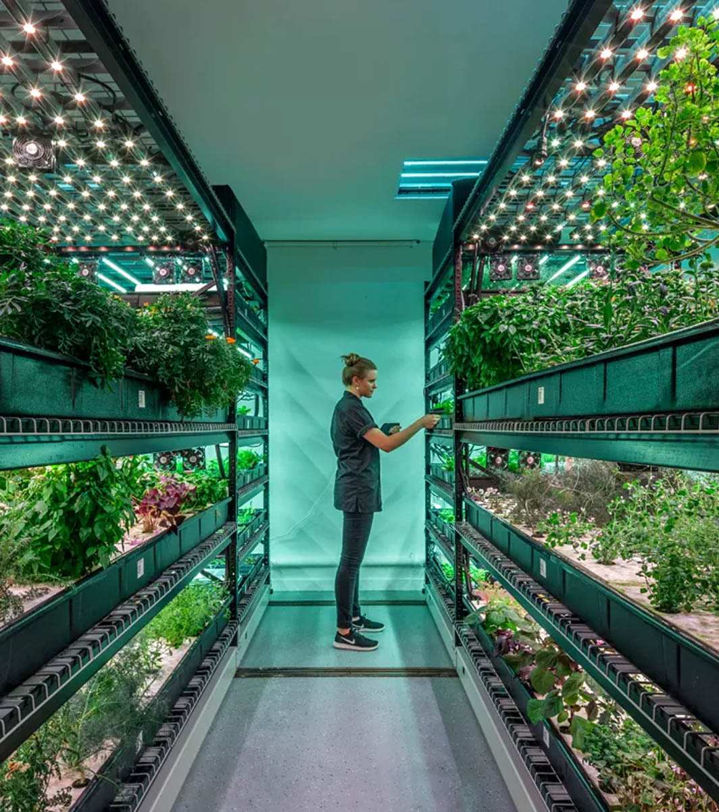
Vision
[Insert description of vision]

Slide 73
We suggest [insert solution]
Business [opportunity/problem]
Suggested solution
[Insert description of business problem or opportunity in bullet points]
[Insert description of business problem or opportunity in bullet points]
[Insert description of business problem or opportunity in bullet points]
…
[Insert high-level solution in bullet points]
[Insert high-level solution in bullet points]
[Insert high-level solution in bullet points]
…
Source: xx

Slide 74
Our vision and ambition with [project/business x]
Vision
Ambition
[Insert vision with creating a new business/project]
[Insert quantitative ambition, if possible]
Footnote: 1. xx
Source: xx

Slide 75




The overall vision and strategy for the project
What are we trying to accomplish?
[Insert description of vision and ambition]
Customer segmentation and value chain prioritization
[Insert description of which customer segments you are going after and, if relevant, which part of the value chain]
Who should we target?
What is our distinctive proposition?
[Insert description of value propositions and key product features, if relevant]
Value proposition
[Insert description of channels, distribution strategy, team etc.]
How will we deliver it?
Go-to-market model
Source: xx

Slide 76
[Insert current state]
[Insert future vision]
[Insert keyword e.g. Products first] [Insert keyword e.g. Static and standard] [Insert keyword e.g. Optimized for certainty] [Insert keyword] [Insert keyword] [Insert keyword] [Insert keyword]
[Insert keyword e.g. Users first] [Insert keyword e.g. Dynamic and bespoke]
[Insert keyword e.g. Optimized for change]
[Insert keyword] [Insert keyword] [Insert keyword] [Insert keyword]

Slide 77
Ambition is threefold with an overall goal of [insert]
[Priority/goal #1]
[Insert description]
[Priority/goal #2]
[Insert description]
[Priority/goal #3]
[Insert description]
Achieve [insert overall goal or competitive advantage achieved]
Source: xx

Slide 78
There are several potential solutions to [insert problem]
Problem
Operational issues
Root causes
Solutions
[Insert issues identified e.g., Inconsistent fuel flow to the turbine]
[Insert root cause of issue e.g., Intermittent sensor failures]
[Insert potential solution e.g., Replace all sensors]
[Insert description of problem e.g.,
Power fluctuates up to 100 times daily over the past 12 months]
[Insert issues identified]
[Insert root cause of issue]
[Insert potential solution]
[Insert issues identified]
[Insert root cause of issue]
[Insert potential solution]
Footnote: 1. xx
Source: xx

Slide 79



We see a strong fit to our overall [insert strategy]
[Insert how project/business x complements current strategy]
[Insert description]
[Insert description]
[Insert description]
[Insert how project/business x complements current strategy]
[Insert description]
[Insert description]
[Insert description]
[Insert how project/business x complements current strategy]
[Insert description]
[Insert description]
[Insert description]
Source: xx

Slide 80
[Project/business x] will allow [insert company] to be [insert how this will give you a competitive advantage]
[Insert strategic benefit] [Insert description of benefit]
[Insert strategic benefit] [Insert description of benefit]
[Insert strategic benefit] [Insert description of benefit]
[Insert strategic benefit] [Insert description of benefit]
[Insert strategic benefit] [Insert description of benefit]
[Insert strategic benefit] [Insert description of benefit]
Source: xx

Slide 81
This solution fits into our overall strategy
Slideworks note: Use color to highlight which strategic objective the solution fits into
Mission
[Insert company mission statement]
Vision
[Insert company vision statement]
Strategic objectives
[Insert strategic pillar]
[Insert strategic pillar]
[Insert strategic pillar]
[Insert strategic pillar]
[Insert strategic objective]
[Insert strategic objective]
[Insert strategic objective]
[Insert strategic objective]
[Insert strategic objective]
[Insert strategic objective]
[Insert strategic objective]
[Insert strategic objective]
[Insert strategic objective]
[Insert strategic objective]
[Insert strategic objective]
[Insert strategic objective]
Source: xx

Slide 82
Options analysis
5

Slide 83
Options analysis
What: 1-5 slides that describe your high-level solution and vision for solving the problem or grabbing the opportunity
Why: Identify and evaluate different options for addressing the problem, including a "do nothing" option as a baseline for comparison. This section can sometimes be skipped if there is no more than one option (e.g., for a new product)
Slideworks guide
How:
Describe each option
Assess the pros and cons of each option, considering factors like cost, feasibility, risk, and potential benefits (make sure these evaluation criteria align with what your stakeholders feel is important to measure on)
Highlight key differences between options to make it easier for your stakeholders to compare
This section can also overlap with section 6 if you choose to do a deeper description of each option

Slide 84
There are three options to [insert objective of business case]
A
B
C
[Insert “name” of option A e.g., “Complete fix”]
[Insert “name” of option B]
[Insert “name” of option C]
[Insert brief description of option e.g., “100% fix of all leakage”]
[Insert brief description of option]
[Insert brief description of option]
…
[Insert brief description of option]
[Insert brief description of option]
[Insert brief description of option]
…
[Insert brief description of option]
[Insert brief description of option]
[Insert brief description of option]
…
Source: xx

Slide 85
We have evaluated three options for [insert objective]
1: [Insert “name” of option]
2: [Insert “name” of option]
3: [Insert “name” of option]
Pros
[Insert pros]
[Insert pros]
[Insert pros]
[Insert pros]
[Insert pros]
[Insert pros]
[Insert pros]
[Insert pros]
[Insert pros]
Cons
[Insert cons]
[Insert cons]
[Insert cons]
[Insert cons]
[Insert cons]
[Insert cons]
[Insert cons]
[Insert cons]
[Insert cons]
Risks
[Insert risk]
[Insert risk]
[Insert risk]
[Insert risk]
[Insert risk]
[Insert risk]
[Insert risk]
[Insert risk]
[Insert risk]
Ease of implementation
[Insert implementation ease]
[Insert implementation ease]
[Insert implementation ease]
Business impact
ROI: [xx]
NPV: [xx]
ROI: [xx]
NPV: [xx]
ROI: [xx]
NPV: [xx]
Cost
One-off: [xx]
Ongoing: [xx]
One-off: [xx]
Ongoing: [xx]
One-off: [xx]
Ongoing: [xx]
Stakeholder score
[xx]
[xx]
[xx]
Source: xx

Slide 86
We have evaluated five options for [insert objective]
[Option 1]
[Option 2]
[Option 3]
[Option 4]
[Option 5]
Option for [insert]
[Insert description]
[Insert description]
[Insert description]
[Insert description]
[Insert description]
Pros
[Insert pros]
[Insert pros]
[Insert pros]
[Insert pros]
[Insert pros]
[Insert pros]
[Insert pros]
[Insert pros]
[Insert pros]
[Insert pros]
[Insert pros]
[Insert pros]
[Insert pros]
[Insert pros]
[Insert pros]
Cons
[Insert cons]
[Insert cons]
[Insert cons]
[Insert cons]
[Insert cons]
[Insert cons]
[Insert cons]
[Insert cons]
[Insert cons]
[Insert cons]
[Insert cons]
[Insert cons]
[Insert cons]
[Insert cons]
[Insert cons]
[Parameter 1]
[Parameter 2]
[Parameter 3]
[Parameter 4]
[Insert description]
[Insert description]
[Insert description]
[Insert description]
[Insert description]
Source: xx

Slide 87
Evaluation of options
A
B
C
D
[Insert option]
[Insert option]
[Insert option]
[Insert option]
[Insert evaluation parameter] | [Insert score, e.g from 1-10] | [Insert score] | [Insert score] | [Insert score]
[Insert evaluation parameter] | [Insert score] | [Insert score] | [Insert score] | [Insert score]
[Insert evaluation parameter] | [Insert score] | [Insert score] | [Insert score] | [Insert score]
[Insert evaluation parameter] | [Insert score] | [Insert score] | [Insert score] | [Insert score]
[Insert evaluation parameter] | [Insert score] | [Insert score] | [Insert score] | [Insert score]
Total score | [Insert score] | [Insert score] | [Insert score] | [Insert score]
Source: xx

Slide 88
There are several options on the build-buy spectrum
[Insert area 1]
[Insert considerations]
[Insert considerations]
[Insert area 2]
[Insert considerations]
[Insert considerations]
[Insert area 3]
[Insert considerations]
[Insert considerations]
[Insert area 4]
[Insert considerations]
[Insert considerations]
Build
Buy
Build
Buy
Build
Buy
Build
Buy
Options:
Options:
Options:
Options:
[Insert vendor logos]
[Insert vendor logos]
[Insert vendor logos]
[Insert vendor logos]
Source: xx

Slide 89
We have evaluated three options for [insert problem]
A
B
C
[Insert option A]
[Insert option B]
[Insert option C]
Main approach
[Insert brief description of option A]
[Insert brief description of option B]
[Insert brief description of option C]
[Insert relevant dimension e.g., cost]
[Insert brief description of how option A works in this dimension]
[Insert brief description of how option B works in this dimension]
[Insert brief description of how option C works in this dimension]
[Insert dimension]
[Insert brief description of how option A works in this dimension]
[Insert brief description of how option B works in this dimension]
[Insert brief description of how option C works in this dimension]
[Insert dimension]
[Insert brief description of how option A works in this dimension]
[Insert brief description of how option B works in this dimension]
[Insert brief description of how option C works in this dimension]
[Insert dimension]
[Insert brief description of how option A works in this dimension]
[Insert brief description of how option B works in this dimension]
[Insert brief description of how option C works in this dimension]
Source: xx

Slide 90
We have evaluated three options for [insert problem]
A
B
C
[Insert option A]
[Insert option B]
[Insert option C]
Main approach
[Insert brief description of option A]
[Insert brief description of option B]
[Insert brief description of option C]
1
[Insert dimension / area]
[Insert how option A will work in this dimension/area]
[Insert how option B and C will work in this dimension/area, if they are the same]
[Insert dimension / area]
[Insert how option A, B, C will work in this dimension/area, if they are all the same]
2
[Insert dimension / area]
[Insert how option A and B will work in this dimension/area, if they are the same]
[Insert how option B will work in this dimension/area]
3
[Insert dimension / area]
[Insert how option A will work in this dimension/area]
[Insert how option B will work in this dimension/area]
[Insert how option B will work in this dimension/area]
4
[Insert dimension / area]
[Insert how option A will work in this dimension/area]
[Insert how option B and C will work in this dimension/area, if they are the same]
5
Source: xx

Slide 91
We considered the benefits and risks for each model in both the near and longer term
A
B
C
[Insert option A]
[Insert option B]
[Insert option C]
[Insert description of benefit e.g., limited change in operations]
[Insert description of benefit]
[Insert description of benefit]
[Insert description of benefit]
[Insert description of benefit]
[Insert description of risk]
[Insert description of risk e.g., increased risk of toxic spillage]
[Insert description of benefit]
[Insert description of benefit]
[Insert description of benefit]
[Insert description of benefit]
[Insert description of risk]
Benefits
Risks

Slide 92
Option [x]: [Insert “name” of option e.g., ”Complete fix”]
Description
Pros
Cons
Risks
[Insert description of option]
[Insert benefit of implementing option]
[Insert benefit of implementing option]
[Insert benefit of implementing option]
…
[Insert disadvantage of implementing option]
[Insert disadvantage of implementing option]
[Insert disadvantage of implementing option]
…
[Insert risk]
[Insert risk]
[Insert risk]
…
Ease of implementation
Business impact
Cost
[Insert how easy or hard it will be to implement]
Potential blockers:
[Insert any large blockers that can occur]
Revenue generated: [xx]
Cost savings: [xx]
Est. ROI: [xx]
Est. NPV: [xx]
One-off costs: [xx]
Ongoing costs: [xx]
Source: xx

Slide 93
Recommended solution
6

Slide 94
Solution details
What: 1-10+ slides describing your proposed solution/option in more detail
Why: Use this section to give your stakeholders a clear picture of what the solution will look like so they understand what they are approving
Slideworks guide
How:
Clearly state your recommended option (note, you may also want to wait until the end of your business case to select an option)
Describe the solution in detail, including scope, deliverables, and key components. Depending on type of business case, this can be anything from a one-pager to a 20-30 slide story
Justify why this solution is the best choice

Slide 95
We recommend moving forward with option [insert]
A
B
C
[Insert “name” of option A e.g., “Complete fix”]
[Insert “name” of option B]
[Insert “name” of option C]
[Insert brief description of option e.g., “100% fix of all leakage”]
[Insert brief description of option]
[Insert brief description of option]
…
[Insert brief description of option]
[Insert brief description of option]
[Insert brief description of option]
…
[Insert brief description of option]
[Insert brief description of option]
[Insert brief description of option]
…
Footnote: 1. xx
Source: xx

Slide 96
We recommend moving forward with option [insert]
1: [Insert “name” of option]
2: [Insert “name” of option]
3: [Insert “name” of option]
Pros
[Insert pros]
[Insert pros]
[Insert pros]
[Insert pros]
[Insert pros]
[Insert pros]
[Insert pros]
[Insert pros]
[Insert pros]
Cons
[Insert cons]
[Insert cons]
[Insert cons]
[Insert cons]
[Insert cons]
[Insert cons]
[Insert cons]
[Insert cons]
[Insert cons]
Risks
[Insert risk]
[Insert risk]
[Insert risk]
[Insert risk]
[Insert risk]
[Insert risk]
[Insert risk]
[Insert risk]
[Insert risk]
Ease of implementation
[Insert implementation ease]
[Insert implementation ease]
[Insert implementation ease]
Business impact
ROI: [xx]
NPV: [xx]
ROI: [xx]
NPV: [xx]
ROI: [xx]
NPV: [xx]
Cost
One-off: [xx]
Ongoing: [xx]
One-off: [xx]
Ongoing: [xx]
One-off: [xx]
Ongoing: [xx]
Stakeholder score
[xx]
[xx]
[xx]
Source: xx

Slide 97
We recommend moving forward with option [insert]
[Option 1]
[Option 2]
[Option 3]
[Option 4]
[Option 5]
Option for [insert]
[Insert description]
[Insert description]
[Insert description]
[Insert description]
[Insert description]
Pros
[Insert pros]
[Insert pros]
[Insert pros]
[Insert pros]
[Insert pros]
[Insert pros]
[Insert pros]
[Insert pros]
[Insert pros]
[Insert pros]
[Insert pros]
[Insert pros]
[Insert pros]
[Insert pros]
[Insert pros]
Cons
[Insert cons]
[Insert cons]
[Insert cons]
[Insert cons]
[Insert cons]
[Insert cons]
[Insert cons]
[Insert cons]
[Insert cons]
[Insert cons]
[Insert cons]
[Insert cons]
[Insert cons]
[Insert cons]
[Insert cons]
[Parameter 1]
[Parameter 2]
[Parameter 3]
[Parameter 4]
[Insert description]
[Insert description]
[Insert description]
[Insert description]
[Insert description]
Source: xx

Slide 98
Based on this, we recommend moving forward with option [insert]
Worse
Better
A
B
C
[Insert option A]
[Insert option B]
[Insert option C]
Current state
Short-term
Long-term
Short-term
Long-term
Short-term
Long-term
[Insert relevant dimension e.g., cost]
[Insert dimension]
[Insert dimension]
[Insert dimension]

Slide 99
This project will primarily focus on [insert in scope areas]
Project scope
Category | In scope | Out of scope
Strategy | [Insert which aspects of this category are in scope] | [Insert which aspects of this category are out of scope]
Products | [Insert which aspects of this category are in scope] | [Insert which aspects of this category are out of scope]
Processes | [Insert which aspects of this category are in scope] | [Insert which aspects of this category are out of scope]
Systems | [Insert which aspects of this category are in scope] | [Insert which aspects of this category are out of scope]
Channels | [Insert which aspects of this category are in scope] | [Insert which aspects of this category are out of scope]
Roles | [Insert which aspects of this category are in scope] | [Insert which aspects of this category are out of scope]
[Insert category] | [Insert which aspects of this category are in scope] | [Insert which aspects of this category are out of scope]
Footnote: 1. xx
Source: xx

Slide 100
[Insert name] most affected by suggested solution
Stakeholder scorecard
Stakeholder | Estimated impact on stakeholder |  |  |  |  |  |  | Rating
 | Very negative(-3) | Negative (-2) | Slightly negative (-1) | No impact (0) | Slightly positive (1) | Positive (2) | Very positive (3)
[Insert name of stakeholder] |  |  |  |  |  |  |  | -2
[Insert name of stakeholder] |  |  |  |  |  |  |  | 1
[Insert name of stakeholder] |  |  |  |  |  |  |  | 0
[Insert name of stakeholder] |  |  |  |  |  |  |  | 2
[Insert name of stakeholder] |  |  |  |  |  |  |  | -3
[Insert name of stakeholder] |  |  |  |  |  |  |  | 2
[Insert name of stakeholder] |  |  |  |  |  |  |  | 2
Total |  |  |  |  |  |  |  | 2
Source: xx

Slide 101
Solution has five main levers
Description
Rationale
[Insert lever]
[Insert description of area/lever]
[Insert description of area/lever]
[Insert description of area/lever]
[Insert rationale for including this]
[Insert rationale for including this]
…
1
[Insert lever]
[Insert description of area/lever]
[Insert description of area/lever]
[Insert description of area/lever]
[Insert rationale for including this]
[Insert rationale for including this]
…
2
[Insert lever]
[Insert description of area/lever]
[Insert description of area/lever]
[Insert description of area/lever]
[Insert rationale for including this]
[Insert rationale for including this]
…
3
[Insert lever]
[Insert description of area/lever]
[Insert description of area/lever]
[Insert description of area/lever]
[Insert rationale for including this]
[Insert rationale for including this]
…
4
[Insert lever]
[Insert description of area/lever]
[Insert description of area/lever]
[Insert description of area/lever]
[Insert rationale for including this]
[Insert rationale for including this]
…
5
Source: xx

Slide 102
Solution will focus on [insert description]
Lever
Rationale
[Insert area e.g., financing]
[Insert lever]
[Insert description]
[Insert description]
[Insert description]
[Insert rationale]
1
[Insert lever]
[Insert description]
[Insert rationale]
[Insert area]
[Insert lever]
[Insert description]
[Insert rationale]
[Insert lever]
[Insert description]
[Insert description]
[Insert description]
[Insert rationale]
2
[Insert lever]
[Insert description]
[Insert description]
[Insert rationale]
[Insert lever]
[Insert description]
[Insert description]
[Insert rationale]
[Insert lever]
[Insert description]
[Insert rationale]
[Insert area]
[Insert lever]
[Insert description]
[Insert description]
[Insert description]
[Insert rationale]
3
[Insert lever]
[Insert description]
[Insert description]
[Insert description]
[Insert rationale]
[Insert lever]
[Insert description]
[Insert description]
[Insert rationale]
Source: xx

Slide 103
There are several benefits and risks associated with [solution/option]
Benefit/risk
What we think will happen...
..and why
[Insert description of what the benefit or risk is]
[Insert reason why this will likely happen]
[Insert description of what the benefit or risk is]
[Insert reason why this will likely happen]
[Insert description of what the benefit or risk is]
[Insert reason why this will likely happen]
Source: xx

Slide 104
Option I: Analytical evaluation shows [insert conclusion]
[Area 1]
[Area 2]
[Area 3]
[Data], [Unit]
[Data], [Unit]
[Data], [Unit]
[Category]
[Category]
[Insert comments/takeaways, if relevant]
[Insert comments/takeaways, if relevant]
…
[Insert comments/takeaways, if relevant]
[Insert comments/takeaways, if relevant]
…
[Insert comments/takeaways, if relevant]
[Insert comments/takeaways, if relevant]
…
[Data], [Unit]
[Data], [Unit]
[Data], [Unit]
[Category]
[Category]
[Category]
[Category]
[Category]
[Category]
[Category]
[Insert comments/takeaways, if relevant]
[Insert comments/takeaways, if relevant]
…
[Insert comments/takeaways, if relevant]
[Insert comments/takeaways, if relevant]
…
[Insert comments/takeaways, if relevant]
[Insert comments/takeaways, if relevant]
…
Source: xx

Slide 105
Option I: [insert description e.g., optimizes for customer satisfaction]
Area
Description
Possible levers
1
[Insert area / dimension]
[Insert description of area/dimension of solution]
[Insert description of area/dimension of solution]
[Insert levers to pull that can be pulled to make changes]
[Insert levers to pull that can be pulled to make changes]
[Insert area / dimension]
[Insert description of area/dimension of solution]
[Insert description of area/dimension of solution]
[Insert description of area/dimension of solution]
…
[Insert levers to pull that can be pulled to make changes]
[Insert levers to pull that can be pulled to make changes]
[Insert levers to pull that can be pulled to make changes]
…
2
[Insert area / dimension]
[Insert description of area/dimension of solution]
[Insert description of area/dimension of solution]
[Insert description of area/dimension of solution]
…
[Insert levers to pull that can be pulled to make changes]
[Insert levers to pull that can be pulled to make changes]
[Insert levers to pull that can be pulled to make changes]
…
3
Source: xx

Slide 106
Wide range of improvements can lead to [insert] results
Improvement
Action required
Result
[Insert potential improvement e.g., higher truck utilization]
[Insert action required to enact improvement e.g., New route management software]
[Insert result of improvement e.g., Usage capacity improved by +20%]
[Insert potential improvement]
[Insert action required to enact improvement]
[Insert result of improvement]
[Insert potential improvement]
[Insert action required to enact improvement]
[Insert result of improvement]
[Insert potential improvement]
[Insert action required to enact improvement]
[Insert result of improvement]
[Insert potential improvement]
[Insert action required to enact improvement]
[Insert result of improvement]
[Insert main takeaway / conclusion, if relevant]
[Insert main takeaway / conclusion, if relevant]
[Insert main takeaway / conclusion, if relevant]
Source: xx

Slide 107
However, Option I also carries some specific risks
Risks of [insert]:
[Insert description of risk]
[Insert description of risk]
[Insert description of risk]
Risks of [insert]:
[Insert description of risk]
[Insert description of risk]
[Insert description of risk]
Risks of [insert]:
[Insert description of risk]
[Insert description of risk]
[Insert description of risk]
[Insert main takeaway]
Source: xx

Slide 108
A range of different types of [insert] options were considered
[Insert] option
Key considerations
[Insert option / lever]
[Insert main considerations for that option]
[Insert main considerations for that option]
…
A
[Insert option / lever]
[Insert main considerations for that option]
[Insert main considerations for that option]
…
B
[Insert option / lever]
[Insert main considerations for that option]
[Insert main considerations for that option]
…
C
[Insert option / lever]
[Insert main considerations for that option]
[Insert main considerations for that option]
…
D
Source: xx

Slide 109
There are pros and cons associated with every option
A
B
C
D
[Insert option/lever]
[Insert option/lever]
[Insert option/lever]
[Insert option/lever]
[Insert pros]
[Insert pros]
[Insert pros]
…
[Insert pros]
[Insert pros]
[Insert pros]
…
[Insert pros]
[Insert pros]
[Insert pros]
…
[Insert pros]
[Insert pros]
[Insert pros]
…
[Insert cons]
[Insert cons]
[Insert cons]
…
[Insert cons]
[Insert cons]
[Insert cons]
…
[Insert cons]
[Insert cons]
[Insert cons]
…
[Insert cons]
[Insert cons]
[Insert cons]
…
[Insert conclusion]
[Insert conclusion]
[Insert conclusion]
[Insert conclusion]
Source: xx

Slide 110
[Insert solution] can have implications for several years
Short-medium term (years 1-5)
Long-term (5+ years)
[Insert area / dimension]
[Insert consequence]
[Insert consequence]
[Insert consequence]
[Insert consequence]
[Insert consequence]
[Insert consequence]
[Insert area / dimension]
[Insert consequence]
[Insert consequence]
[Insert consequence]
[Insert consequence]
[Insert consequence]
[Insert consequence]
[Insert area / dimension]
[Insert consequence]
[Insert consequence]
[Insert consequence]
[Insert consequence]
[Insert consequence]
[Insert consequence]
[Insert area / dimension]
[Insert consequence]
[Insert consequence]
[Insert consequence]
[Insert consequence]
[Insert consequence]
[Insert consequence]
Source: xx

Slide 111
[Insert] has evolved over time
Low
High
[Insert metric] | 2016 | 2020 | 2024
[Insert category]
[Insert category]
[Insert category]
[Insert category]
[Insert category]
[Insert category]
Footnote: 1. xx
Source: xx

Slide 112
Maturity assessment shows [insert]
[Insert e.g., Company maturity level]
[Insert e.g., industry benchmark]
35%
70%
0%
100%
Low maturity
Medium maturity
High maturity
[Insert description of low maturity level]
[Insert description of low maturity level]
[Insert description of low maturity level]
…
[Insert description of medium maturity level]
[Insert description of medium maturity level]
[Insert description of medium maturity level]
…
[Insert description of high maturity level]
[Insert description of high maturity level]
[Insert description of high maturity level]
…
Source: xx

Slide 113









Business Model Canvas
Key Partners
Who are our Key Partners? Who are our key suppliers? Which Key Resources are we acquiring from partners? Which Key Activities do partners perform? MOTIVATIONS FOR PARTNERSHIPS: Optimization and economy, Reduction of risk and uncertainty, Acquisition of particular resources and activities
Key Activities
What Key Activities do our Value Propositions require? Our Distribution Channels? Customer Relationships? Revenue streams? CATEGORIES: Production, Problem Solving, Platform/Network
Value Propositions
What value do we deliver to the customer? Which one of our customer’s problems are we helping to solve? What bundles of products and services are we offering to each Customer Segment? Which customer needs are we satisfying? CHARACTERISTICS: Newness, Performance, Customization, “Getting the Job Done”, Design, Brand/Status, Price, Cost Reduction, Risk Reduction, Accessibility, Convenience/Usability
Customer Relationships
What type of relationship does each of our Customer Segments expect us to establish and maintain with them? Which ones have we established? How are they integrated with the rest of our business model? How costly are they?
Customer Segments
For whom are we creating value? Who are our most important customers? Is our customer base a Mass Market, Niche Market, Segmented, Diversified, Multi-sided Platform?
Key Resources
What Key Resources do our Value Propositions require? Our Distribution Channels? Customer Relationships Revenue Streams? TYPES OF RESOURCES: Physical, Intellectual, Human, Financial
Channels
Through which Channels do our Customer Segments want to be reached? How are we reaching them now? Which ones work best? Which ones are most cost-efficient? How are we integrating them with customer routines?
Cost Structure
What are the most important costs inherent in our business model? Which Key Resources are most expensive? Which Key Activities are most expensive?
Revenue Streams
For what value are our customers really willing to pay? For what do they currently pay? How are they currently paying? How would they prefer to pay? How much does each Revenue Stream contribute to overall revenues?
Source: xx

Slide 114
Options analysis
What: 1-5 slides describing the benefits of implementing your suggested solution, both tangible and intangible benefits
Why: Use this section to give stakeholders/decision makers a clear and short overview of all the benefits that come from implementing your solution so it’s easy for them to understand why they should approve your business case
Slideworks guide
How:
Describe the benefits of implementing your solution (e.g., cost savings, increased revenue, improved efficiency, competitive advantage)
Include both tangible and intangible benefits but focus on benefits you can quantify. Your stakeholders will want to know the financial impact
Be very clear about where your numbers come from. Stakeholders care about sources for these assumptions and are more likely to trust your numbers if they come from (or are validated by) people they trust
Keep it short and concise

Slide 115
Implementing [project] will result in significant benefits regardless of chosen option
Goal: [Insert overall goal of business case/project]
Solution options | Financial benefits | Intangible benefits
Option 1: [Insert name of option 1 e.g., “Fully outsourced”] | [Insert financial benefit] [Insert financial benefit] [Insert financial benefit] | [Insert intangible benefit e.g., higher employee morale] [Insert intangible benefit] [Insert intangible benefit]
Option 2: [Insert name of option 2] | [Insert financial benefit] [Insert financial benefit] [Insert financial benefit] | [Insert intangible benefit] [Insert intangible benefit] [Insert intangible benefit]
Option 3: [Insert name of option 3] | [Insert financial benefit] [Insert financial benefit] [Insert financial benefit] | [Insert intangible benefit] [Insert intangible benefit] [Insert intangible benefit]
Footnote: 1. xx
Source: xx

Slide 116
There are several tangible and intangible benefits from implementing [insert solution]
Financial benefits
[Insert financial benefit]
[Insert financial benefit]
[Insert financial benefit]
Strategic benefits
[Insert strategic benefit]
[Insert strategic benefit]
[Insert strategic benefit]
Social and other benefits
[Insert social and other benefit]
[Insert social and other benefit]
[Insert social and other benefit]
Source: xx

Slide 117
Implementing [solution] will results in significant revenue generation and cost savings
Additional revenue generated
Suggested change
Description
Cost savings
1. [Insert change/area/solution component]
[Insert description of solution component, e.g., streamlining expense management with one-stop-software]
$xx
$xx
2. [Insert change/area/solution component]
[Insert description of solution component]
$xx
$xx
3. [Insert change/area/solution component]
[Insert description of solution component]
$xx
$xx
4. [Insert change/area/solution component]
[Insert description of solution component]
$xx
$xx
5. [Insert change/area/solution component]
[Insert description of solution component]
$xx
$xx
Total for entire project
$xx
$xx
Source: xx

Slide 118
Benefits primarily around [insert]
[Area/division]
[Area/division]
[Area/division]
[Insert category e.g., People]
[Insert how suggested solution will benefit this area within this category]
[Insert how suggested solution will benefit this area within this category]
[Insert how suggested solution will benefit this area within this category]
[Insert category e.g., Operations]
[Insert how suggested solution will benefit this area within this category]
[Insert how suggested solution will benefit this area within this category]
[Insert how suggested solution will benefit this area within this category]
[Insert category e.g., Strategic]
[Insert how suggested solution will benefit this area within this category]
[Insert how suggested solution will benefit this area within this category]
[Insert how suggested solution will benefit this area within this category]
[Insert category e.g., Financial]
[Insert how suggested solution will benefit this area within this category]
[Insert how suggested solution will benefit this area within this category]
[Insert how suggested solution will benefit this area within this category]
[Insert main conclusion on how area will benefit e.g., large benefits]
[Insert main conclusion on how area will benefit e.g., large benefits]
[Insert main conclusion on how area will benefit e.g., large benefits]
Footnote: 1. xx
Source: xx

Slide 119
Benefits primarily around [insert]
Time frame
Initiative
Description
Benefits
Short-term
[Insert initiative]
[Insert description of initiative]
[Insert expected benefits]
[Insert expected benefits]
+
[Insert initiative]
[Insert description of initiative]
[Insert expected benefits]
[Insert expected benefits]
+
Medium-term
[Insert initiative]
[Insert description of initiative]
[Insert expected benefits]
[Insert expected benefits]
++
[Insert initiative]
[Insert description of initiative]
[Insert expected benefits]
[Insert expected benefits]
++
Long-term
[Insert initiative]
[Insert description of initiative]
[Insert expected benefits]
[Insert expected benefits]
+++
[Insert initiative]
[Insert description of initiative]
[Insert expected benefits]
[Insert expected benefits]
+++
Source: xx

Slide 120
Intangible benefits are primarily from [insert areas]
[Insert intangible benefit e.g., higher employee morale]
[Insert description of benefit/why it will be beneficial]
A
[Insert intangible benefit]
[Insert description of benefit/why it will be beneficial]
B
[Insert intangible benefit]
[Insert description of benefit/why it will be beneficial]
C
[Insert intangible benefit]
[Insert description of benefit/why it will be beneficial]
D
[Insert intangible benefit]
[Insert description of benefit/why it will be beneficial]
E
Source: xx

Slide 121
[Insert initiatives] expected to be main drivers of value
Areas
Value drivers
Expected benefits
[Insert underlying value drivers/initiatives in solution e.g., Personalized price points]
[Insert expected benefits from that value driver/initiative]
[Insert expected benefits from that value driver/initiative]
[Insert drivers e.g., revenue]
[Insert underlying value drivers/initiatives in solution]
[Insert expected benefits from that value driver/initiative]
[Insert expected benefits from that value driver/initiative]
[Insert underlying value drivers/initiatives in solution]
[Insert expected benefits from that value driver/initiative]
[Insert expected benefits from that value driver/initiative]
[Insert main area e.g., profitability]
[Insert underlying value drivers/initiatives in solution]
[Insert expected benefits from that value driver/initiative]
[Insert expected benefits from that value driver/initiative]
[Insert drivers e.g., costs]
[Insert underlying value drivers/initiatives in solution]
[Insert expected benefits from that value driver/initiative]
[Insert expected benefits from that value driver/initiative]
[Insert underlying value drivers/initiatives in solution]
[Insert expected benefits from that value driver/initiative]
[Insert expected benefits from that value driver/initiative]
Source: xx

Slide 122
Revenue generation: Additional revenue expected to be $xx by [insert year], driven by [insert main revenue generators]
Estimated additional revenue generated
Assumptions
 | Year 1 | Year 2 | Year 3 | Year 4 | Year 5 | Total
[Insert new revenue stream] | $xx | $xx | $xx | $xx | $xx | $xx
[Insert new revenue stream] | $xx | $xx | $xx | $xx | $xx | $xx
[Insert new revenue stream] | $xx | $xx | $xx | $xx | $xx | $xx
[Insert new revenue stream] | $xx | $xx | $xx | $xx | $xx | $xx
[Insert new revenue stream] | $xx | $xx | $xx | $xx | $xx | $xx
Total estimated additional revenue | $xx | $xx | $xx | $xx | $xx | $xx
[Insert main assumptions you’ve used to estimate additional revenue]
[Insert main assumptions you’ve used to estimate cost savings]
[Insert main assumptions you’ve used to estimate cost savings]
…
Source: xx

Slide 123
Cost savings: Cost savings estimate at $xx in total, driven primarily by [insert main cost savings buckets]
Estimated cost savings
Assumptions
 | Year 1 | Year 2 | Year 3 | Year 4 | Year 5 | Total
[Insert cost saving area, e.g., FTEs] | $xx | $xx | $xx | $xx | $xx | $xx
[Insert cost saving area] | $xx | $xx | $xx | $xx | $xx | $xx
[Insert cost saving area] | $xx | $xx | $xx | $xx | $xx | $xx
[Insert cost saving area] | $xx | $xx | $xx | $xx | $xx | $xx
[Insert cost saving area] | $xx | $xx | $xx | $xx | $xx | $xx
Total estimated cost savings | $xx | $xx | $xx | $xx | $xx | $xx
[Insert main assumptions you’ve used to estimate cost savings]
[Insert main assumptions you’ve used to estimate cost savings]
[Insert main assumptions you’ve used to estimate cost savings]
…
Source: xx

Slide 124
Costs and ROI analysis
What: 1-5 slides summarizing the financials of your business case including expected costs, revenue generated or costs saved upon successful implementation, ROI, and other relevant metrics like NPV, IRR etc.. Backed up by Excel files.
Why: This is often the most important section where you demonstrate that implementing your suggested solution is a “no-brainer” since it will benefit the company financially. This section is the numbers-based sister section to your more qualitative benefits.
Slideworks guide
How:
Provide a detailed breakdown of the costs associated with the proposed solution. Include initial investment, ongoing operational costs, and any potential financial risks
Compare the costs against the expected financial benefits to demonstrate return on investment (ROI)
Use your company or team’s standard ways of calculating ROI e.g., IRR or NPV or payback period
If you’re presenting multiple options, explain the cost and ROI differences

Slide 125
Costs differ [insert adjective e.g., significantly] across solution options due to [insert reason]
Solution options | Cost estimate | Risks to costs
Option 1: [Insert name of option 1 e.g., “Fully outsourced”] | Total cost: $xx [Insert cost estimate, potentially broken down by category] [Insert cost category and estimate, if relevant]: $xx [Insert cost category and estimate, if relevant]: $xx [Insert cost category and estimate, if relevant]: $xx | [Insert any potential risks to cost and where costs may run over] [Insert any potential risks to cost and where costs may run over] [Insert any potential risks to cost and where costs may run over] [Insert any potential risks to cost and where costs may run over]
Option 2: [Insert name of option 2] | Total cost: $xx [Insert cost estimate, potentially broken down by category] [Insert cost category and estimate, if relevant]: $xx [Insert cost category and estimate, if relevant]: $xx [Insert cost category and estimate, if relevant]: $xx | [Insert any potential risks to cost and where costs may run over] [Insert any potential risks to cost and where costs may run over] [Insert any potential risks to cost and where costs may run over] [Insert any potential risks to cost and where costs may run over]
Option 3: [Insert name of option 3] | Total cost: $xx [Insert cost estimate, potentially broken down by category] [Insert cost category and estimate, if relevant]: $xx [Insert cost category and estimate, if relevant]: $xx [Insert cost category and estimate, if relevant]: $xx | [Insert any potential risks to cost and where costs may run over] [Insert any potential risks to cost and where costs may run over] [Insert any potential risks to cost and where costs may run over] [Insert any potential risks to cost and where costs may run over]
Source: xx

Slide 126
Project costs: Costs are mainly tied to [insert category]
Project costs
Assumptions
 | Year 1 | Year 2 | Year 3 | Year 4 | Year 5 | Total
[Insert cost category e.g., FTEs] | $xx | $xx | $xx | $xx | $xx | $xx
[Insert cost category] | $xx | $xx | $xx | $xx | $xx | $xx
[Insert cost category] | $xx | $xx | $xx | $xx | $xx | $xx
[Insert cost category] | $xx | $xx | $xx | $xx | $xx | $xx
[Insert cost category] | $xx | $xx | $xx | $xx | $xx | $xx
Total costs | $xx | $xx | $xx | $xx | $xx | $xx
[Insert main assumptions you’ve used to calculate costs]
[Insert main assumptions you’ve used to calculate costs]
[Insert main assumptions you’ve used to calculate costs]
…
Source: xx

Slide 127
Project costs: Costs are mainly tied to [insert category]
Cost overview
Project management
Project team | [Insert assumptions e.g., 3 FTEs for 12 weeks] |  | $xx
Steering committee | [Insert assumptions] |  | $xx
Resource use
[Insert category e.g., ad hoc experts] | [Insert assumptions] |  | $xx
[Insert category] | [Insert assumptions] |  | $xx
Contractors
[Contractor 1] | [Insert assumptions] |  | $xx
[Contractor 2] | [Insert assumptions] |  | $xx
Plant and equipment
[Insert category] | [Insert assumptions] |  | $xx
[Insert category] | [Insert assumptions] |  | $xx
Other costs
[Insert category] | [Insert assumptions] |  | $xx
[Insert category] | [Insert assumptions] |  | $xx
Contingency (20%) |  |  | $xx
 | Total costs: |  | $xx
Source: xx

Slide 128
Project cash flow: Cashflow expected to be [insert description]
[Insert comments, if relevant]
Project cash flow, [insert currency e.g., $ M]
Footnote: 1. xx
Source: xx

Slide 129
Project cash flow: [Insert description]
[Insert comments, if relevant]
Project cash flow, [insert currency e.g., $ M]
Footnote: 1. xx
Source: xx

Slide 130
Option [insert] has the highest return on investment
Solution options | Net present value (NPV) | Payback period | Internal rate of return (IRR)
Option 1: [Insert name of option 1 e.g., “Fully outsourced”] | [Insert NPV] | [Insert payback period in months or years] | [Insert IRR]
Option 2: [Insert name of option 2] | [Insert NPV] | [Insert payback period in months or years] | [Insert IRR]
Option 3: [Insert name of option 3] | [Insert NPV] | [Insert payback period in months or years] | [Insert IRR]
Assumption for calculations:
[Insert assumptions e.g., discount rate]
Source: xx

Slide 131
Option [x] is most attractive overall
Financial evaluation of options
Revenue | Entry | 2026 | 2027 | 2028 | 2029 | 2030 | Exit
Option 1: [Insert name of option 1] | $0 | $50,000 | $60,000 | $70,000 | $80,000 | $90,000 | -
Option 2: [Insert name of option 2] | $0 | $xx | $xx | $xx | $xx | $xx | -
Option 3: [Insert name of option 3] | $0 | $xx | $xx | $xx | $xx | $xx | -
EBITDA | Entry | 2026 | 2027 | 2028 | 2029 | 2030 | Exit
Option 1: [Insert name of option 1] | $0 | $244,000 | $390,000 | $396,000 | $402,000 | $408,000 | -
Option 2: [Insert name of option 2] | $0 | $xx | $xx | $xx | $xx | $xx | -
Option 3: [Insert name of option 3] | $0 | $xx | $xx | $xx | $xx | $xx | -
Net cash flow | Entry | 2026 | 2027 | 2028 | 2029 | 2030 | Exit
Option 1: [Insert name of option 1] | -$540,000 | $60,428 | $162,150 | $163,110 | $164,070 | $165,030 | $1,888,672
Option 2: [Insert name of option 2] | $xx | $xx | $xx | $xx | $xx | $xx | $xx
Option 3: [Insert name of option 3] | $xx | $xx | $xx | $xx | $xx | $xx | $xx
Source: xx

Slide 132
Return on investment estimated to be [insert most relevant metric, depending on your stakeholders]
Discounted cash flow (DCF) | Entry | 2026 | 2027 | 2028 | 2029 | 2030 | Exit
Net cash flow | -$1,000,000 | -$324,000 | $400,000 | $1,420,000 | $1,955,00 | $2,882,554 | $34,500,500
Present value of net cash flow | -$xx | -$xx | $xx | $xx | $xx | $xx | $xx
Cumulative present value of net cash flow | -$xx | -$xx | -$xx | -$xx | -$xx | $xx | $xx
Net present value (NPV) | $xx
Internal rate of return (IRR) | xx%
Discounted payback period (years) | xx
Profit to investment ratio | xx%
Source: xx

Slide 133
NPV: NPV estimated to be [insert]
Net present value (NPV) estimate
Assumptions
 | Year 1 | Year 2 | Year 3 | Year 4 | Year 5 | Total
Project costs | $xx | $xx | $xx | $xx | $xx | $xx
Additional revenue generated | $xx | $xx | $xx | $xx | $xx | $xx
Cost savings | $xx | $xx | $xx | $xx | $xx | $xx
Cash flow | $xx | $xx | $xx | $xx | $xx | $xx
Net present value (NPV) | $xx | $xx | $xx | $xx | $xx | $xx
Discount rate: xx%
[Insert main assumptions you’ve used to estimate NPV]
[Insert main assumptions you’ve used to estimate NPV]
[Insert main assumptions you’ve used to estimate NPV]
…
Source: xx

Slide 134
Sensitivity analysis: NPV most impacted by changes in [insert assumption/parameter]
Impact on NPV by change in assumptions, % change
Footnote: 1. xx
Source: xx

Slide 135
Return on investment estimated to be xx%
Total investment needed
$xx
Additional revenue generated + cost savings achieved
$xx + $xx = $xx
Return on investment (ROI)
($xx - $xx)/$xx x 100 = xx%
Source: xx

Slide 136
Developing the business case and ROI for [project x] is based on six building blocks
Business case building blocks:
Net return
[Insert first parameter e.g. traffic or number of customers reached]
[Insert second parameter e.g. conversion]
[Insert third parameter e.g. revenue per customer]
X
X
Investment
[Insert first parameter e.g. customer acquisition cost]
[Insert second parameter e.g. funding]
[Insert third parameter e.g. ongoing opex]
+
+
Key considerations for the business case outcomes:
[Insert key considerations]
Source: xx

Slide 137
Implementation plan
7

Slide 138
Implementation plan
What: 1-10 slides laying out the high-level implementation plan and resources needed
Why: Give stakeholders a sense of the time and cost associated with implementing your suggested solution, so they know what they are saying yes to and feel comfortable that you are realistic about implementation
Slideworks guide
How:
Outline a high-level plan for implementing the proposed solution
Include key milestones, timelines, and dependencies
Describe the resources required, including personnel, technology, and funding
If working with several options, you can choose to include a high-level time and cost estimate for each option
You can choose to also include communication and change management plans, if you deem it relevant

Slide 139
Project schedule for each option
Solution options | Duration | Milestones
Option 1: [Insert name of option 1 e.g., “Fully outsourced”] | [Insert duration e.g., 12 weeks] | [date/date]: [Insert milestone] [date/date]: [Insert milestone] [date/date]: [Insert milestone] [date/date]: [Insert milestone] [date/date]: [Insert milestone]
Option 2: [Insert name of option 2] | [Insert duration] | [date/date]: [Insert milestone] [date/date]: [Insert milestone] [date/date]: [Insert milestone] [date/date]: [Insert milestone] [date/date]: [Insert milestone]
Option 3: [Insert name of option 3] | [Insert duration] | [date/date]: [Insert milestone] [date/date]: [Insert milestone] [date/date]: [Insert milestone] [date/date]: [Insert milestone] [date/date]: [Insert milestone]
Footnote: 1. xx
Source: xx

Slide 140
[Project] has five major milestones
Icon
Icon
Icon
Icon
Icon
Milestone 1
[Insert short description of milestone]
Milestone 2
[Insert short description of milestone]
Milestone 3
[Insert short description of milestone]
Milestone 4
[Insert short description of milestone]
Milestone 5
[Insert short description of milestone]
Footnote: 1. xx
Source: xx

Slide 141
[Project] has five major milestones
Milestone 5
Milestone 4
Launch
Milestone 3
Test
Milestone 2
Build
Milestone 1
Develop
Plan
[Insert short description of milestone]
[Insert short description of milestone]
[Insert short description of milestone]
[Insert short description of milestone]
[Insert short description of milestone]
Footnote: 1. xx
Source: xx

Slide 142
Four-step approach to realize vision and capture value
2025
2026
2027
2028
Full value capture
Expansion
Ramp-up
Strengthen foundation
Functional initiatives
[Insert initiatives]
[Insert initiatives]
[Insert initiatives]
…
[Insert initiatives]
[Insert initiatives]
[Insert initiatives]
…
[Insert initiatives]
[Insert initiatives]
[Insert initiatives]
…
[Insert initiatives]
[Insert initiatives]
[Insert initiatives]
…
Strategic initiatives
[Insert initiatives]
[Insert initiatives]
[Insert initiatives]
…
Source: xx

Slide 143
Need for immediate actions to secure momentum in [insert timeframe]
Strengthen foundation
Ramp-up phase
2025
2026
2027
2028
2029
[Insert main goal(s) of period]
[Insert initiatives]
…
[Insert main goal(s) of period]
[Insert initiatives]
…
[Insert main goal(s) of period]
[Insert initiatives]
[Insert initiatives]
[Insert initiatives]
…
[Insert main goal(s) of period]
[Insert initiatives]
…
Source: xx

Slide 144
Project expected to start on [insert date]
Project week | 1 | 2 | 3 | 4 | 5 | 6 | 7 | 8 | 9 | 10 | 11 | 12 | 13 | 14 | 15 | 16 | 17 | 18
Date | xx/xx | xx/xx | xx/xx | xx/xx | xx/xx | xx/xx | xx/xx | xx/xx | xx/xx | xx/xx | xx/xx | xx/xx | xx/xx | xx/xx | xx/xx | xx/xx | xx/xx | xx/xx
Milestone 1
Milestone 2
Milestone 3
Milestone 4
Milestone 5
[Insert main deliverable]
[Insert main deliverable]
[Insert main deliverable]
[Insert main deliverable]
[Insert main deliverable]
Source: xx

Slide 145
[Project] will evolve in three major phases
Deliverables
People
[Insert timeframe]
[Insert timeframe]
[Insert timeframe]
1
Expore opportunity
2
Detail design and MVP
3
Build MVP and launch in market
[Insert key deliverables]
[Insert key deliverables]
[Insert key deliverables]
[Insert key deliverables]
[Insert key deliverables]
[Insert key deliverables]
[Insert key deliverables]
[Insert key deliverables]
[Insert key deliverables]
[Insert key people involved]
[Insert key people involved]
[Insert key people involved]
Footnote: 1. xx
Source: xx

Slide 146
[Project] will evolve through four main phases
[Insert timeline]
[Insert timeline]
[Insert timeline]
[Insert timeline]
[Phase 1]
[Phase 2]
[Phase 3]
[Phase 4]
Key meetings
SteerCo
SteerCo
SteerCo
SteerCo
SteerCo
[Milestone]
[Milestone]
[Milestone]
Delive-rables
[Insert track]
[Insert key activities]
[Insert key activities]
[Insert key activities]
[Insert key activities]
[Insert key activities]
[Insert key activities]
[Insert key activities]
[Insert key activities]
[Insert key activities]
[Insert key activities]
[Insert key activities]
[Insert key activities]
[Insert key activities]
[Insert key activities]
[Insert key activities]
[Insert key activities]
[Insert track]
[Insert key activities]
[Insert key activities]
[Insert key activities]
[Insert key activities]
[Insert key activities]
[Insert key activities]
[Insert key activities]
[Insert key activities]
[Insert key activities]
[Insert key activities]
[Insert key activities]
[Insert key activities]
[Insert key activities]
[Insert key activities]
[Insert key activities]
[Insert key activities]
Responsible leads and participants
[Insert name and role OR team/function]
[Insert name and role OR team/function]
[Insert name and role OR team/function]
[Insert name and role OR team/function]
[Insert name and role OR team/function]
[Insert name and role OR team/function]
[Insert name and role OR team/function]
[Insert name and role OR team/function]
[Insert name and role OR team/function]
[Insert name and role OR team/function]
[Insert name and role OR team/function]
[Insert name and role OR team/function]
Source: xx

Slide 147
[Project title] process expected to run [xx weeks/months]
High-level project plan and deliverables
Week xx Research and hypotheses
Week xx Analysis and interviews
Week xx Consolidation and recommendation
Activities
[Insert key activities]
[Insert key activities]
[Insert key activities]
[Insert key activities]
…
[Insert key activities]
[Insert key activities]
[Insert key activities]
[Insert key activities]
…
[Insert key activities]
[Insert key activities]
[Insert key activities]
[Insert key activities]
…
Mgmt. interaction
Kick-off
Review 1
Input on findings
Input on recommendation
Deliver-ables
Overview of hypothesis
Preliminary report
Final report
Source: xx

Slide 148
High-level timeline for next [insert timeframe]
Week | 37 | 38 | 39 | 40 | 41 | 42 | 43 | 44 | 45 | 46 | 47 | 48 | 49 | 50 | 51
01 [Insert work stream]
02 [Insert work stream]
03 [Insert work stream]
01 [Insert work stream]
02 [Insert work stream]
03 [Insert work stream]
01 [Insert work stream]
Kick-off
[Insert stage-gate]
[Insert stage-gate or SteerCo or similar]
[Insert stage-gate or SteerCo or similar]
[Insert stage-gate]
Footnote: 1. xx
Source: xx

Slide 149
[Project plan with status / Insert action title]
Project week
 | Owner | Due date | Status | 1 | 2 | 3 | 4 | 5 | 6 | 7 | 8 | 9 | 10
[Insert workstream] | [Name] | [Date] | Done
[Insert workstream] | [Name] | [Date] | On-track
[Insert workstream] | [Name] | [Date] | On-track
[Insert workstream] | [Name] | [Date] | On-track
[Insert workstream] | [Name] | [Date] | On-track
[Insert workstream] | [Name] | [Date] | Challenged
[Insert workstream] | [Name] | [Date] | On-track
[Insert workstream] | [Name] | [Date] | Challenged
[Insert workstream] | [Name] | [Date] | On-track
[Insert workstream] | [Name] | [Date] | Not started
[Insert workstream] | [Name] | [Date] | Not started
[Insert workstream] | [Name] | [Date] | Not started
[Insert workstream] | [Name] | [Date] | On-track
[Insert workstream] | [Name] | [Date] | Not started
Source: xx

Slide 150
[Project plan with status / Insert action title]
= Key deliverable
Project week | 1 | 2 | 3 | 4 | 5 | 6 | 7 | 8 | 9 | 10 | 11 | 12 | 13 | 14 | 15 | 16 | 17 | 18
Date | xx/xx | xx/xx | xx/xx | xx/xx | xx/xx | xx/xx | xx/xx | xx/xx | xx/xx | xx/xx | xx/xx | xx/xx | xx/xx | xx/xx | xx/xx | xx/xx | xx/xx | xx/xx
Phase 1: [Insert phase]
1.1 [Insert workstream]
1.2 [Insert workstream]
1.3 [Insert workstream]
Phase 2: [Insert phase]
2.1 [Insert workstream]
2.2 [Insert workstream]
2.3 [Insert workstream]
Phase 3: [Insert phase]
3.1 [Insert workstream]
3.2 [Insert workstream]
3.3 [Insert workstream]
Source: xx

Slide 151
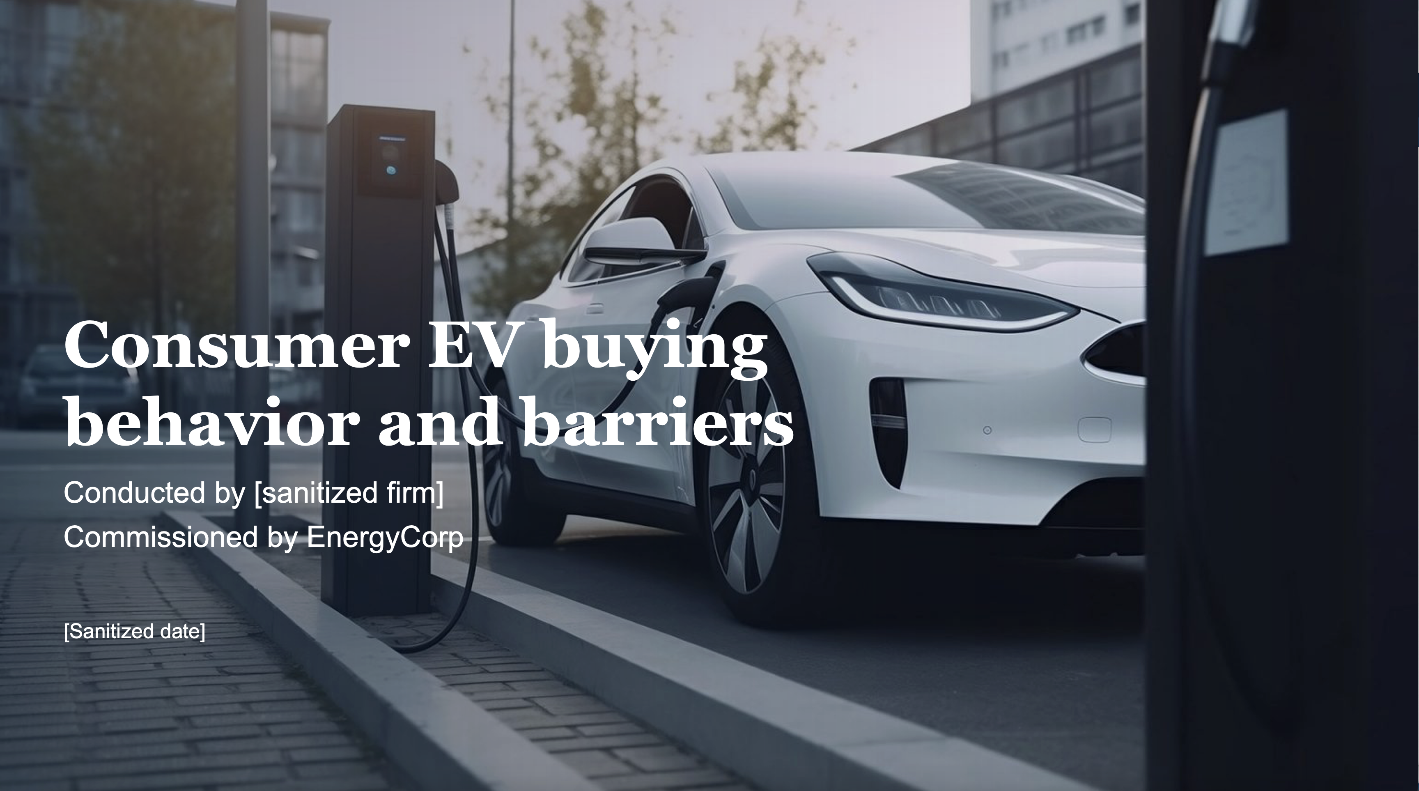
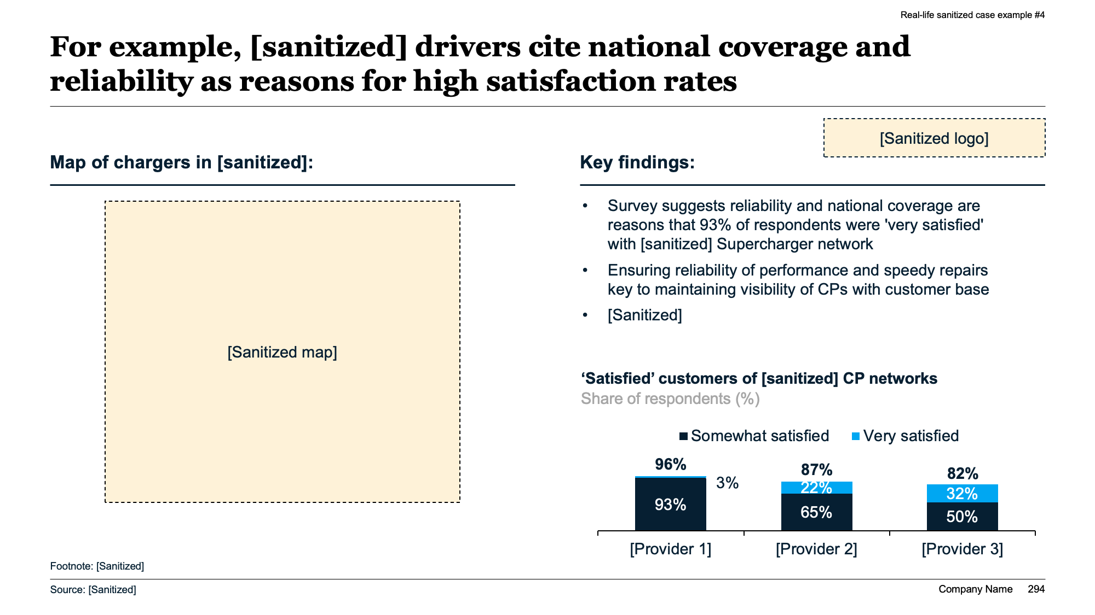
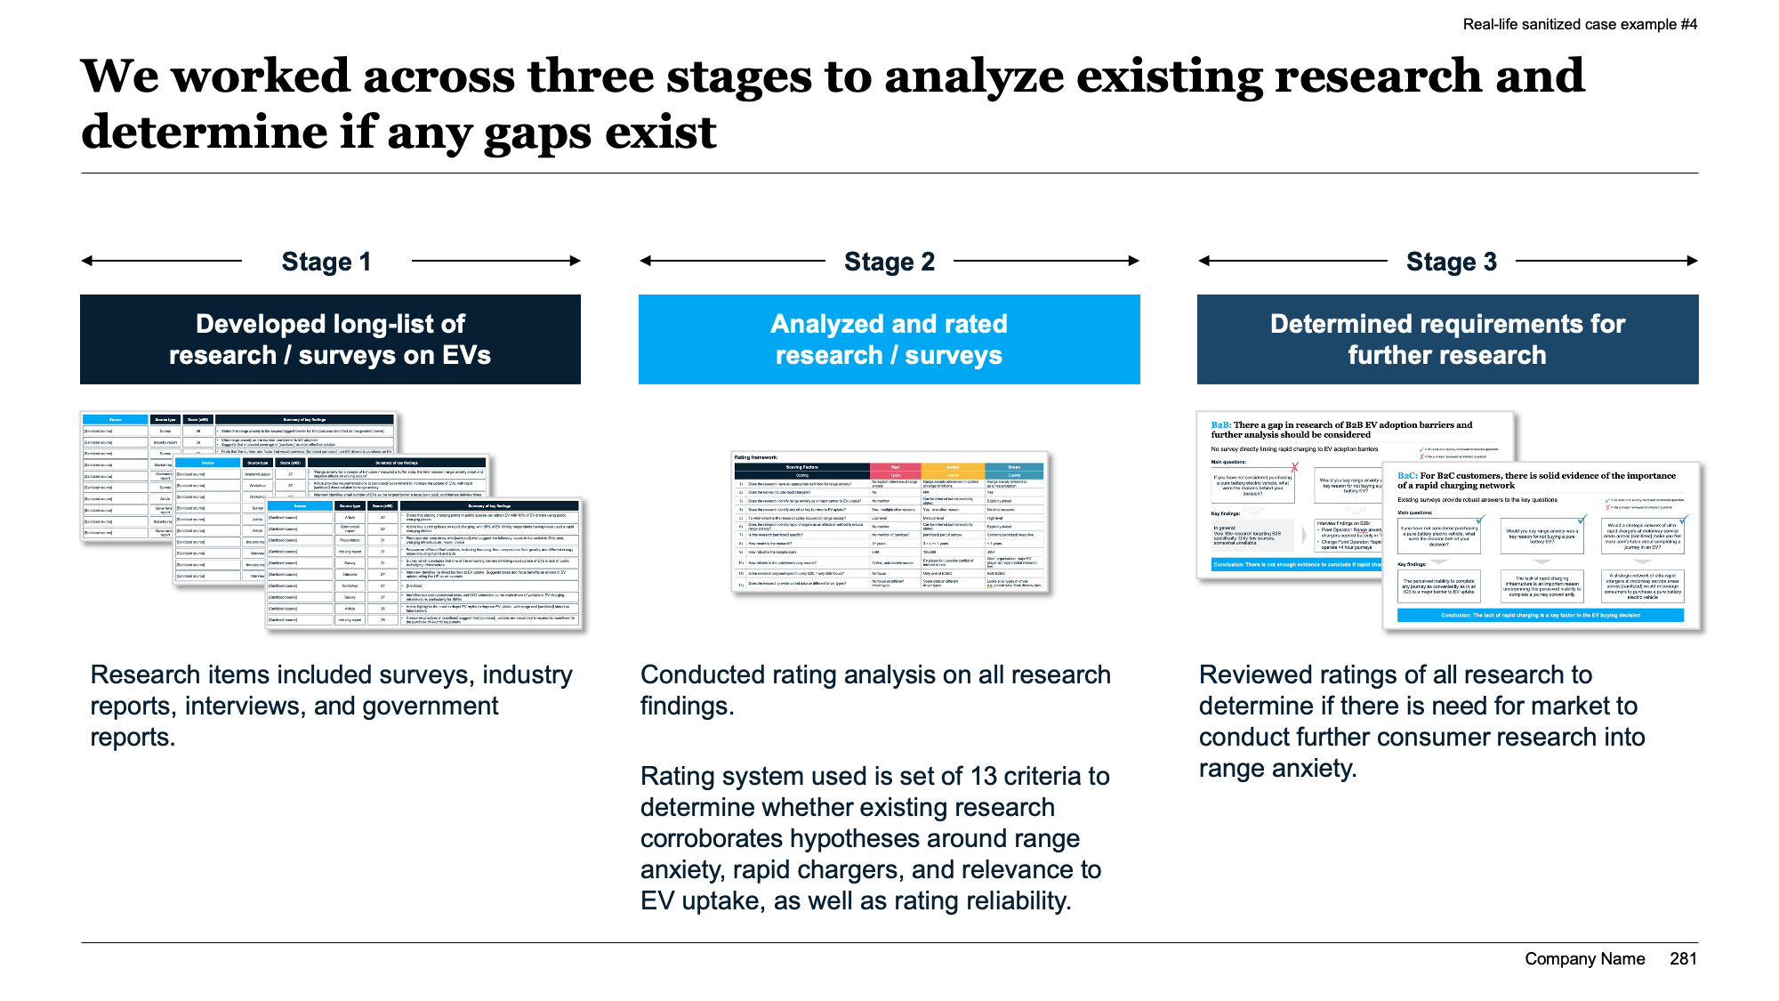
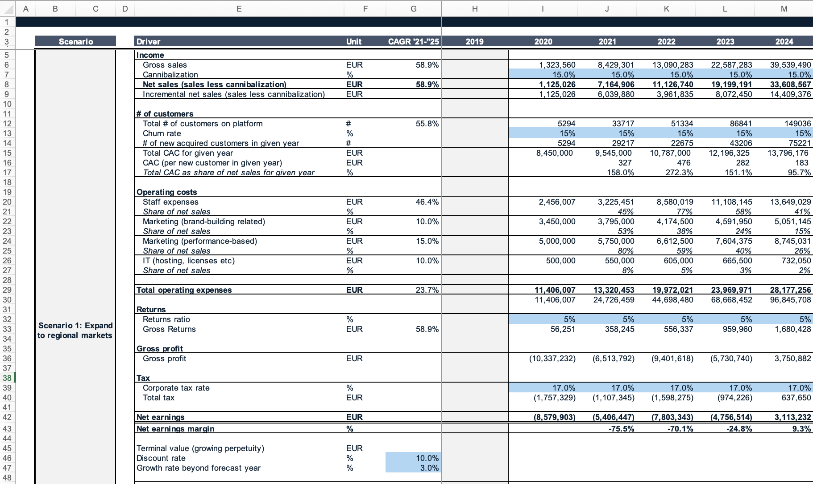
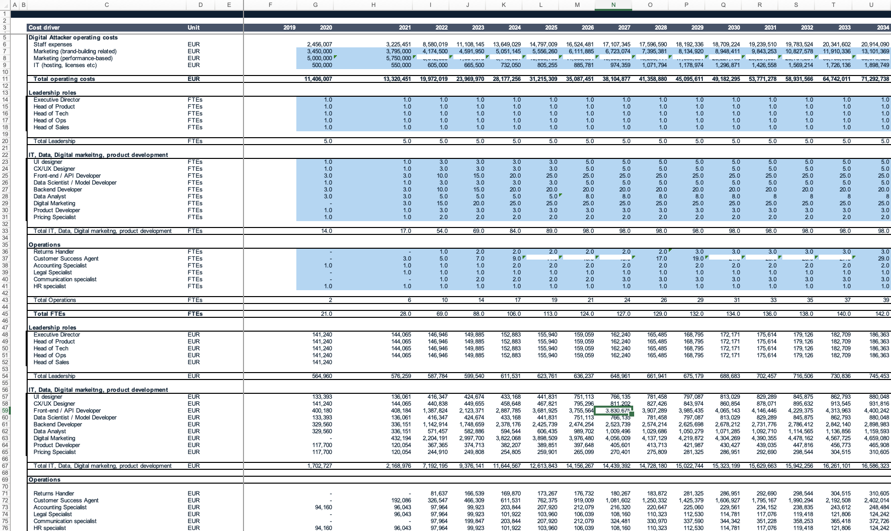
Main [project/phase x] deliverables
Main objectives
[Insert main objectives with project or phase]
[Insert main objectives with project or phase]
[Insert main objectives with project or phase]
Examples of deliverables
[Insert deliverable e.g., report on potential efficiency gains]
[Insert deliverable e.g., detailed financial models]
Key activities and milestones
[Insert key activities during project or phase]
[Insert key activities during project or phase]
[Insert key activities during project or phase]
[Insert main milestones]
[Insert main milestones]
[Insert main milestones]
Key deliverables and outcomes
[Insert main deliverables and/or key outcomes of project or phase]
[Insert main deliverables and/or key outcomes of project or phase]
[Insert main deliverables and/or key outcomes of project or phase]
Footnote: 1. xx
Source: xx

Slide 152
[Insert area/people] expected to feel highest impact from suggested changes
Expected impact:
Low
Moderate
Medium
High
Very high
What will be impacted by change?
Who will be impacted by change?
Area
Description
Impact
Team
Description
Impact
People
[Insert description of how this area is affected, e.g., No layoffs expected]
[Insert team/ person]
[Insert description of how this team/person is affected]
Systems
[Insert description of how this area is affected]
[Insert team/ person]
[Insert description of how this team/person is affected]
Processes
[Insert description of how this area is affected]
[Insert team/ person]
[Insert description of how this team/person is affected]
Roles
[Insert description of how this area is affected]
[Insert team/ person]
[Insert description of how this team/person is affected]
Org structure
[Insert description of how this area is affected]
[Insert team/ person]
[Insert description of how this team/person is affected]
Culture
[Insert description of how this area is affected]
[Insert team/ person]
[Insert description of how this team/person is affected]
Source: xx

Slide 153
Change impact: Highest change impact expected from [insert areas/changes]
Complexity of change
Expected impact:
Low
Moderate
Medium
High
Very high
Very high
High
Medium
[Insert change, e.g., streamline cards for purchasing]
Moderate
[Insert change, e.g., new expense management software]
Low
One team
One business unit
One division
Half of company
Entire company
Footnote: 1. xx
Extent of change
Source: xx

Slide 154
Change impact: Highest change impact expected from [insert areas/changes]
Low
High
Type of change | Description |  | Complexity of change | Size of change | Impact
People | [Insert description] |  | [Insert complexity] | [Insert estimated quantitative change]
Process | [Insert description] |  | [Insert complexity] | [Insert estimated quantitative change]
Roles | [Insert description] |  | [Insert complexity] | [Insert estimated quantitative change]
Structure | [Insert description] |  | [Insert complexity] | [Insert estimated quantitative change]
Culture | [Insert description] |  | [Insert complexity] | [Insert estimated quantitative change]
System | [Insert description] |  | [Insert complexity] | [Insert estimated quantitative change]
Source: xx

Slide 155
Risks and mitigations
8

Slide 156
Risks and mitigations
What:
1-5 slides with a list of risks and uncertainties pertaining to your proposed solution, their deemed severity, and mitigation plans
Why: Give stakeholders security that you have thought through any potential risks and have a plan for avoiding or mitigating those risks
Slideworks guide
How:
Focus on the most important risks (you don't need to account for every potential scenario). These typically include those affecting cost, benefits, and schedule, but they can also include risks to the team, technology, scope, and performance
Be realistic when you write this section. Transparency will gain the confidence of stakeholders and will demonstrate your foresight and capability
Consider ranking your identified risk areas according to "likelihood of risk" and "impact of risk”
Propose mitigation strategies to manage and minimize risks

Slide 157
Potential risks and mitigations for each solution option
Solution options | Risks | Severity | Potential mitigations
Option 1: [Insert name of option 1 e.g., “Fully outsourced”] | [Insert risk e.g., cost overrun] |  | [Insert mitigation strategy e.g., weekly budget checks]
 | [Insert risk] |  | [Insert mitigation strategy]
 | [Insert risk] |  | [Insert mitigation strategy]
 | [Insert risk] |  | [Insert mitigation strategy]
 | [Insert risk] |  | [Insert mitigation strategy]
Option 2: [Insert name of option 2] | [Insert risk] |  | [Insert mitigation strategy]
 | [Insert risk] |  | [Insert mitigation strategy]
 | [Insert risk] |  | [Insert mitigation strategy]
 | [Insert risk] |  | [Insert mitigation strategy]
 | [Insert risk] |  | [Insert mitigation strategy]
Option 3: [Insert name of option 3] | [Insert risk] |  | [Insert mitigation strategy]
 | [Insert risk] |  | [Insert mitigation strategy]
 | [Insert risk] |  | [Insert mitigation strategy]
 | [Insert risk] |  | [Insert mitigation strategy]
 | [Insert risk] |  | [Insert mitigation strategy]
Source: xx

Slide 158
We have scored each risk based on impact and likelihood
 | Impact | Impact
Likelihood |  | 1: Negligible | 2: Marginal | 3: Serious | 4: Major | 5: Catastrophic
 | 5: Frequent | Serious | Severe | Severe | Critical | Critical
 | 4: Likely | Serious | Disruptive | Severe | Severe | Critical
 | 3: Occasional | Serious | Serious | Disruptive | Severe | Severe
 | 2: Remote | Controlled | Serious | Serious | Disruptive | Severe
 | 1: Unlikely | Controlled | Controlled | Serious | Serious | Serious
Footnote: 1. xx
Source: xx

Slide 159
We estimate risks mainly tied to [insert]
Risk assessment matrix
Most important risks
# | Risk Name | Priority
 | [Insert risk]
 | [Insert risk]
 | [Insert risk]
 | [Insert risk]
 | [Insert risk]
 | [Insert risk]
 | [Insert risk]
Very likely
2
1
1
Very high
2
High
Probability
6
5
3
3
High
Possible
4
Medium
Unlikely
7
4
5
Medium
6
Medium
Marginal
Serious
Major
Catastrophic
Impact
7
Low
Source: Team analysis

Slide 160
We have developed mitigation plans for the most serious risks
 | Risks | Assessment | Mitigation plan
1 | [Insert risk e.g., cost overrun] | Critical | [Insert mitigation strategy e.g., weekly budget checks]
2 | [Insert risk] | Severe | [Insert mitigation strategy]
3 | [Insert risk] | Severe | [Insert mitigation strategy]
4 | [Insert risk] | Severe | [Insert mitigation strategy]
5 | [Insert risk] | Disruptive | [Insert mitigation strategy]
6 | [Insert risk] | Disruptive | [Insert mitigation strategy]
7 | [Insert risk] | Disruptive | [Insert mitigation strategy]
8 | [Insert risk] | Disruptive | [Insert mitigation strategy]
9 | [Insert risk] | Disruptive | [Insert mitigation strategy]
10 | [Insert risk] | Disruptive | [Insert mitigation strategy]
11 | [Insert risk] | Serious | [Insert mitigation strategy]
12 | [Insert risk] | Serious | [Insert mitigation strategy]
13 | [Insert risk] | Serious | [Insert mitigation strategy]
14 | [Insert risk] | Serious | [Insert mitigation strategy]
15 | [Insert risk] | Serious | [Insert mitigation strategy]
Source: xx

Slide 161
Risk assessment and mitigation plan
 | Risks | Impact | Probability | Mitigation plan
1 | [Insert risk e.g., cost overrun] | High | High | [Insert mitigation strategy e.g., weekly budget checks]
2 | [Insert risk] | High | High | [Insert mitigation strategy]
3 | [Insert risk] | High | High | [Insert mitigation strategy]
4 | [Insert risk] | High | Medium | [Insert mitigation strategy]
5 | [Insert risk] | High | Low | [Insert mitigation strategy]
6 | [Insert risk] | Medium | Medium | [Insert mitigation strategy]
7 | [Insert risk] | Medium | Medium | [Insert mitigation strategy]
8 | [Insert risk] | Medium | High | [Insert mitigation strategy]
9 | [Insert risk] | Medium | Low | [Insert mitigation strategy]
10 | [Insert risk] | Medium | Low | [Insert mitigation strategy]
11 | [Insert risk] | Medium | Low | [Insert mitigation strategy]
12 | [Insert risk] | Medium | High | [Insert mitigation strategy]
13 | [Insert risk] | Low | Medium | [Insert mitigation strategy]
14 | [Insert risk] | Low | Medium | [Insert mitigation strategy]
15 | [Insert risk] | Low | High | [Insert mitigation strategy]
Source: xx

Slide 162
Risks mainly around [insert]
[Insert risk] | [Insert description of risk]
[Insert risk] | [Insert description of risk]
[Insert risk] | [Insert description of risk]
[Insert risk] | [Insert description of risk]
[Insert risk] | [Insert description of risk]
[Insert risk] | [Insert description of risk]
[Insert risk] | [Insert description of risk]
[Insert risk] | [Insert description of risk]
[Insert risk] | [Insert description of risk]
[Insert risk] | [Insert description of risk]
Source: xx

Slide 163
Risks mainly around [insert]
[Category 1]
[Category 2]
[Category 3]
Risk
Description
Assessment of risks
[Insert risk]
[Insert description of risk]
Likelihood of risk
A
High
A
[Insert risk]
[Insert description of risk]
B
D
C
[Insert risk]
[Insert description of risk]
C
[Insert risk]
[Insert description of risk]
E
D
F
G
[Insert risk]
[Insert description of risk]
B
E
[Insert risk]
[Insert description of risk]
F
[Insert risk]
[Insert description of risk]
Low
G
Low
Impact of risk
High
Source: xx

Slide 164
We have outlined mitigation strategies for each risk
[Category 1]
[Category 2]
[Category 3]
Risk
Potential mitigation strategy
[Insert risk]
[Insert description of mitigation strategy]
[Insert description of mitigation strategy]
A
[Insert risk]
[Insert description of mitigation strategy]
[Insert description of mitigation strategy]
B
[Insert risk]
[Insert description of mitigation strategy]
[Insert description of mitigation strategy]
C
[Insert risk]
[Insert description of mitigation strategy]
[Insert description of mitigation strategy]
D
[Insert risk]
[Insert description of mitigation strategy]
[Insert description of mitigation strategy]
E
[Insert risk]
[Insert description of mitigation strategy]
[Insert description of mitigation strategy]
F
[Insert risk]
[Insert description of mitigation strategy]
[Insert description of mitigation strategy]
G
Source: xx

Slide 165
Project is dependent on [insert e.g., ”accurate data from department x”]
Dependency |  | Description | Potential impact on project | Actions | Responsible
 | [Insert dependency] | [Insert brief description] | [Insert estimated impact on project] | [Insert potential actions, if relevant] | [Insert person responsible for ensuring there is no block]
 | [Insert dependency] | [Insert brief description] | [Insert estimated impact on project] | [Insert potential actions, if relevant] | [Insert person responsible for ensuring there is no block]
 | [Insert dependency] | [Insert brief description] | [Insert estimated impact on project] | [Insert potential actions, if relevant] | [Insert person responsible for ensuring there is no block]
 | [Insert dependency] | [Insert brief description] | [Insert estimated impact on project] | [Insert potential actions, if relevant] | [Insert person responsible for ensuring there is no block]
 | [Insert dependency] | [Insert brief description] | [Insert estimated impact on project] | [Insert potential actions, if relevant] | [Insert person responsible for ensuring there is no block]
1
2
3
4
5
Footnote: 1. xx
Source: xx

Slide 166
There are some constraints around [insert] that must be taken into consideration
Constraint |  | Description | Mitigation
 | [Insert constrain] | [Insert brief description] | [Insert potential mitigation, if relevant]
 | [Insert constrain] | [Insert brief description] | [Insert potential mitigation, if relevant]
 | [Insert constrain] | [Insert brief description] | [Insert potential mitigation, if relevant]
 | [Insert constrain] | [Insert brief description] | [Insert potential mitigation, if relevant]
 | [Insert constrain] | [Insert brief description] | [Insert potential mitigation, if relevant]
 | [Insert constrain] | [Insert brief description] | [Insert potential mitigation, if relevant]
 | [Insert constrain] | [Insert brief description] | [Insert potential mitigation, if relevant]
 | [Insert constrain] | [Insert brief description] | [Insert potential mitigation, if relevant]
1
2
3
4
5
6
7
8
Footnote: 1. xx
Source: xx

Slide 167
Governance and monitoring
9

Slide 168
Governance and monitoring
What:
1-3 slides outlining who is involved in the project and how the project will be managed
Why: Demonstrate how your proposed solution will be governed so stakeholders are confident the implementation plan will not get derailed by either bad management or lack of proper involvement of the rest of the organization
Slideworks guide (I/II)
How:
Establishing a clear governance structure ensures that there is a defined hierarchy of authority, responsibilities, and accountability (see list of typical groups and roles on the following page)
You may also want to define what monitoring and reporting mechanisms will be used to track the project's progress, identify issues early, and ensure accountability, which often include specific project management tools, ongoing status reports, and meetings.

Slide 169
Governance and monitoring
How:
A definition of the following groups and roles are often included:
Steering Committee: A group of senior executives or stakeholders who provide overall strategic direction, make high-level decisions, and ensure that the project aligns with organizational goals
Project Sponsor: An individual or group with the authority to provide resources, make critical decisions, and support the project at the highest level. The sponsor is often a senior executive
Project Manager: The person responsible for day-to-day management of the project, ensuring that the project stays on track, within budget, and meets its objectives. The project manager reports to the steering committee and project sponsor
Project Team: A group of individuals with various skills and expertise necessary to carry out project tasks. The team may include internal staff and external consultants
Slideworks guide (II/II)

Slide 170
We will go through four high-level steps, with majority of time spent on [insert phase]
Slideworks note: This slide is connected in a continuous story with the next three slides
Step 1
Preparation and planning
Step 2
[Insert phase e.g., Solution design]
Step 3
[Insert phase e.g., Solution iteration]
Step 4
[Insert phase e.g., Roll-out preparation]
[Insert main activities e.g., “Assemble and onboard project team”]
[Insert main activities e.g., “Gather data”]
[Insert main activities e.g., “Book key experts and stakeholders”]
[Insert main activities e.g., “Validate identified problem with wider group”]
[Insert main activities e.g., “Explore solution options in detail”]
[Insert main activities e.g., “Develop proof-of-concept of chosen option”]
[Insert main activities e.g., “Test POC with selected group”]
[Insert main activities e.g., “Iterate on solution based on feedback”]
[Insert main activities e.g., “Stress-test solution”]
[Insert main activities e.g., “Summarize findings”]
[Insert main activities e.g., “Develop roll-out plan”]
[Insert main activities e.g., “Get backing for solution roll-out from Steering Group”]
Source: xx

Slide 171
The project is estimated to take [insert] weeks
Slideworks note: This slide is connected in a continuous story with the previous and next two slides
High-level project plan:
WEEK 1 | 2 | 3 | 4 | 5 | 6 | 7 | 8 | 9 | 10 | 11 | 12 | 13
Preparation and planning
Solution design
Develop initial solution
Solution iteration
Continuously test and iterate solution to ensure feasibility and viability at larger scale
Prepare roll-out plan
Summarize findings and develop roll-out plan
Present Present findings to SG
Footnote: 1. xx
Source: xx

Slide 172
We suggest two sounding board meetings, as well as weekly touchpoints with project management team to ensure alignment
Slideworks note: This slide is connected in a continuous story with the previous two and next slide
High-level project plan:
WEEK 1 | 2 | 3 | 4 | 5 | 6 | 7 | 8 | 9 | 10 | 11 | 12 | 13
Preparation and planning
Solution design
Solution iteration
Prepare roll-out plan
Present
Kickoff workshop with project team to align on overall plan
Sounding board to discuss solution proof-of-concept
Sounding board to discuss final solution
Steering Group to get approval for roll-out
Footnote: 1. xx
Source: xx

Slide 173
To maintain momentum in the right direction we need an engaged core team and a broad sounding board from [insert company]
Slideworks note: This slide is connected in a continuous story with the previous three slides
Core team
Purpose: Execute day-to-day activities of project including [insert]
People: [Insert named resources]
Est. time commitment:
1.5-5 days a week depending on role
Kickoff workshop
Purpose: Gather all info on the problem/opportunity so far co-shape the initial hypotheses about the project going forward
People: Core team + [Insert named resources]
Est. time commitment:
0.5-1 day workshop
Sounding board
Purpose: Give feedback on findings and help shape the overall direction of the project
People: [Insert named resources]
Est. time commitment:
2 hours per meeting + 1 hour pf preparation time
Footnote: 1. xx
Source: xx

Slide 174



Key success factors and KPIs
Category | KPI | Current state | Target state
Financials | [insert key performance indicator or success factor to measure e.g., “Gross margin per sale”] | [Insert current state e.g., “37%”] | [Insert target state e.g., “42%”]
 | [insert key performance indicator or success factor to measure] | [Insert current state] | [Insert target state]
 | [insert key performance indicator or success factor to measure] | [Insert current state] | [Insert target state]
Customers | [insert key performance indicator or success factor to measure] | [Insert current state] | [Insert target state]
 | [insert key performance indicator or success factor to measure] | [Insert current state] | [Insert target state]
 | [insert key performance indicator or success factor to measure] | [Insert current state] | [Insert target state]
Operations | [insert key performance indicator or success factor to measure] | [Insert current state] | [Insert target state]
 | [insert key performance indicator or success factor to measure] | [Insert current state] | [Insert target state]
Footnote: 1. xx
Source: xx

Slide 175
Project will be led by [insert name] and include [x] people in total
Project structure
[Insert name]
Project Manager
[Insert name]
[Insert role on project]
[Insert name]
[Insert role on project]
[Insert name]
[Insert role on project]
[Insert name]
[Insert role on project]
[Insert name]
[Insert role on project]
[Insert name]
[Insert role on project]
[Insert name]
[Insert role on project]
[Insert name]
[Insert role on project]
Footnote: 1. xx
Source: xx

Slide 176
Project is divided into [x] workstreams
Steering committee
[Name], [Name], [Name]
[Insert main decisions and responsibilities]
[Insert main decisions and responsibilities]
[Insert expected time commitment]
Project management
Lead: [Name]
[Insert main decisions and responsibilities]
[Insert main decisions and responsibilities]
[Insert expected time commitment]
Tracks
1
2
3
4
5
6
[Workstream/track]
Owner: [Name]
[Workstream/track]
Owner: [Name]
[Workstream/track]
Owner: [Name]
[Workstream/track]
Owner: [Name]
[Workstream/track]
Owner: [Name]
[Workstream/track]
Owner: [Name]
Footnote: 1. xx
Source: xx

Slide 177
Project governance and team structure
Steering committee
[Name], [Name], [Name]
External stakeholders
Project team
Lead: [Name]
[Insert name or organization]
[Insert name], [insert role]
[Insert name], [insert role]
[Insert name or organization]
[Insert name], [insert role]
[Insert name], [insert role]
[Insert name or organization]
…
…
…
Footnote: 1. xx
Source: xx

Slide 178
Project will be run by [insert] with support from [insert]
[Insert team/role]
[Insert team/role]
[Name 1, title, BU/division/role] (chair)
[Name 2, title, BU/division/role]
[Name 3, title, BU/division/role]
[Name 4, title, BU/division/role]
[Name 5, title, BU/division/role]
[Name 6, title, BU/division/role]
[Name 1, title, BU/division/role]
[Name 2, title, BU/division/role]
[Name 3, title, BU/division/role]
[Insert team/role]
[Name 1, title, BU/division/role] (lead)
[Name 2, title, BU/division/role]
[Name 3, title, BU/division/role]
[Insert team/role]
[Insert team/role]
[Name 1, title, BU/division/role]
[Name 2, title, BU/division/role]
[Name 3, title, BU/division/role]
[Name 4, title, BU/division/role]
[Name 5, title, BU/division/role]
[Name 6, title, BU/division/role]
[Group 1]
[Group 2]
[Group 3]
Source: xx

Slide 179
Project team resources
Name | Department / Team | Duration required | Comment
[Insert name] | [Insert department / team they are part of normally] | [Insert duration required] | [Insert additional comments, if needed]
[Insert name] | [Insert department / team they are part of normally] | [Insert duration required] | [Insert additional comments, if needed]
[Insert name] | [Insert department / team they are part of normally] | [Insert duration required] | [Insert additional comments, if needed]
[Insert name] | [Insert department / team they are part of normally] | [Insert duration required] | [Insert additional comments, if needed]
[Insert name] | [Insert department / team they are part of normally] | [Insert duration required] | [Insert additional comments, if needed]
[Insert name] | [Insert department / team they are part of normally] | [Insert duration required] | [Insert additional comments, if needed]
[Insert name] | [Insert department / team they are part of normally] | [Insert duration required] | [Insert additional comments, if needed]
[Insert name] | [Insert department / team they are part of normally] | [Insert duration required] | [Insert additional comments, if needed]
Footnote: 1. xx
Source: xx

Slide 180
Key stakeholders
Name | Role | Contact information
[Insert name] | [Insert title and role, including main connection to/interests in project] | [Insert contact info]
[Insert name] | [Insert title and role, including main connection to/interests in project] | [Insert contact info]
[Insert name] | [Insert title and role, including main connection to/interests in project] | [Insert contact info]
[Insert name] | [Insert title and role, including main connection to/interests in project] | [Insert contact info]
[Insert name] | [Insert title and role, including main connection to/interests in project] | [Insert contact info]
[Insert name] | [Insert title and role, including main connection to/interests in project] | [Insert contact info]
[Insert name] | [Insert title and role, including main connection to/interests in project] | [Insert contact info]
[Insert name] | [Insert title and role, including main connection to/interests in project] | [Insert contact info]
Footnote: 1. xx
Source: xx

Slide 181
Recommendations and next steps
10

Slide 182
Recommenda-tions and next steps
What:
1-2 slides stating the suggested solution and immediate next steps
Why: Summarize the main points to make it easy for stakeholders to say yes to your proposed solution
Slideworks guide
How:
Restate the overall business need (the problem / opportunity)
Summarize key points of the business case and make a final recommendation to decision makers
Remember to Include your ROI/financial number(s) again and repeat how your project aligns with the organization's strategic goals
Consider ending your business case with a final slide outlining the immediate actions required to move forward with the recommended solution

Slide 183
We recommend [insert recommendation e.g., “proceeding with Option 2”]
Problem/opportunity: [Insert brief description of problem or opportunity]
Solution options | Pros | Cons | Est. impact
Option 1: [Insert name of option 1 e.g., “Fully outsourced”] | [Insert pros of option e.g., ”Can start within 1-2 weeks”] [Insert pros of option in bullet points] [Insert pros of option in bullet points] | [Insert cons of option e.g., “High dependency on provider going forward”] [Insert cons of option in bullet points] [Insert cons of option in bullet points] | [Insert estimated financial impact e.g., NPV, cost savings, revenue generation]
Option 2: [Insert name of option 2] | [Insert pros of option in bullet points] [Insert pros of option in bullet points] [Insert pros of option in bullet points] | [Insert cons of option in bullet points] [Insert cons of option in bullet points] [Insert cons of option in bullet points] | [Insert estimated financial impact e.g., NPV, cost savings, revenue generation]
Option 3: [Insert name of option 3] | [Insert pros of option in bullet points] [Insert pros of option in bullet points] [Insert pros of option in bullet points] | [Insert cons of option in bullet points] [Insert cons of option in bullet points] [Insert cons of option in bullet points] | [Insert estimated financial impact e.g., NPV, cost savings, revenue generation]
Recommendation: [Insert recommendation e.g., ”We recommend proceeding with Option 2 since this will give us good balance of cost and speed with control going forward”]
Source: xx

Slide 184
We recommend [insert recommendation e.g., “proceeding with Option B”]
[Insert brief explanation of why you recommend this option]
Recommended option
A
B
C
[Insert “name” of option A e.g., “Complete fix”]
[Insert “name” of option B]
[Insert “name” of option C]
[Insert brief description of option e.g., “100% fix of all leakage”]
[Insert brief description of option]
[Insert brief description of option]
…
[Insert brief description of option]
[Insert brief description of option]
[Insert brief description of option]
…
[Insert brief description of option]
[Insert brief description of option]
[Insert brief description of option]
…
Footnote: 1. xx
Source: xx

Slide 185
Immediate next steps
[Insert step]
[Insert step]
[Insert step]
[Insert step]
[Insert step]
Source: xx

Slide 186
Focus for next [time period] will be [focus area]
[Insert date] [Insert milestone / stage-gate]
[Insert date] [Insert milestone / stage-gate]
[Insert date] [Insert milestone / stage-gate]
[Insert dates]
[Insert dates]
[Insert dates]
[Insert dates]
[Insert dates]
[Insert workstream] [Insert description of key activities or workstream]
[Insert workstream] [Insert description of key activities or workstream]
[Insert workstream] [Insert description of key activities or workstream]
[Insert workstream] [Insert description of key activities or workstream]
[Insert workstream] [Insert description of key activities or workstream]
[Insert workstream] [Insert description of key activities or workstream]
Source: xx

Slide 187
Appendix
11

Slide 188
Assumptions overview
Data sources
Assumptions
[Insert data source]
[Insert data source]
[Insert data source]
…
[Include any relevant assumptions on data, methodology, calculation logic or similar]
[Include any relevant assumptions on data, methodology, calculation logic or similar]
[Include any relevant assumptions on data, methodology, calculation logic or similar]
…
Source: xx

Slide 189
We have used information from [insert e.g., previous cases, trials, projects]
Assumption
Rationale for assumption
[Insert assumption e.g., FTE count can be reduced by 10% for every new system]
[Insert thinking/rationale behind assumption]
[Insert assumption]
[Insert thinking/rationale behind assumption]
[Insert assumption]
[Insert thinking/rationale behind assumption]
[Insert assumption]
[Insert thinking/rationale behind assumption]
[Insert assumption]
[Insert thinking/rationale behind assumption]
[Insert assumption]
[Insert thinking/rationale behind assumption]
[Insert assumption]
[Insert thinking/rationale behind assumption]
[Insert assumption]
[Insert thinking/rationale behind assumption]
[Insert assumption]
[Insert thinking/rationale behind assumption]
[Insert assumption]
[Insert thinking/rationale behind assumption]
Source: xx

Slide 190
Overall assumptions for our model
[Insert assumption]
[Insert any backup logic or rationale, if relevant]
[Insert any backup logic or rationale, if relevant]
[Insert any backup logic or rationale, if relevant]
[Insert assumption]
[Insert any backup logic or rationale, if relevant]
[Insert any backup logic or rationale, if relevant]
[Insert any backup logic or rationale, if relevant]
[Insert assumption]
[Insert assumption]
[Insert assumption]
Footnote: 1. xx
Source: xx

Slide 191
We used several different types of sources
[Insert source or type of source]
[Insert source or type of source]
✓
✓
[Insert source or type of source]
[Insert source or type of source]
✓
✓
[Insert source or type of source]
[Insert source or type of source]
✓
✓
[Insert source or type of source]
[Insert source or type of source]
✓
✓
[Insert source or type of source]
[Insert source or type of source]
✓
✓
[Insert source or type of source]
[Insert source or type of source]
✓
✓
[Insert source or type of source]
[Insert source or type of source]
✓
✓
Source: xx

Slide 192
We have used information from [insert e.g., previous cases, trials, projects]
Source
Source type
Score
Summary of key findings
[Insert source name]
[Insert type]
xx
[Insert main findings from source or comments on source]
[Insert source name]
[Insert type]
xx
[Insert main findings from source or comments on source]
[Insert source name]
[Insert type]
xx
[Insert main findings from source or comments on source]
[Insert source name]
[Insert type]
xx
[Insert main findings from source or comments on source]
[Insert source name]
[Insert type]
xx
[Insert main findings from source or comments on source]
[Insert source name]
[Insert type]
xx
[Insert main findings from source or comments on source]
[Insert source name]
[Insert type]
xx
[Insert main findings from source or comments on source]
[Insert source name]
[Insert type]
xx
[Insert main findings from source or comments on source]
[Insert source name]
[Insert type]
xx
[Insert main findings from source or comments on source]
[Insert source name]
[Insert type]
xx
[Insert main findings from source or comments on source]
Source: xx

Slide 193
List of sources
Source
Source type
Source title
URL
[Insert source name]
[Insert type]
[Insert source title, if relevant]
[Insert source URL, if relevant]
[Insert source name]
[Insert type]
[Insert source title, if relevant]
[Insert source URL, if relevant]
[Insert source name]
[Insert type]
[Insert source title, if relevant]
[Insert source URL, if relevant]
[Insert source name]
[Insert type]
[Insert source title, if relevant]
[Insert source URL, if relevant]
[Insert source name]
[Insert type]
[Insert source title, if relevant]
[Insert source URL, if relevant]
[Insert source name]
[Insert type]
[Insert source title, if relevant]
[Insert source URL, if relevant]
[Insert source name]
[Insert type]
[Insert source title, if relevant]
[Insert source URL, if relevant]
[Insert source name]
[Insert type]
[Insert source title, if relevant]
[Insert source URL, if relevant]
[Insert source name]
[Insert type]
[Insert source title, if relevant]
[Insert source URL, if relevant]
[Insert source name]
[Insert type]
[Insert source title, if relevant]
[Insert source URL, if relevant]
Source: xx

Slide 194
IIIa. Case
Real-life sanitized case example
Business case for purchasing and implementing new software

Slide 195
Disclaimer
The details presented in this case example have been altered intentionally to safeguard any potential confidentiality concerns and ensure the privacy of individuals or entities involved.
The primary purpose of this content is to serve as a source of inspiration, offering guidance on structuring and presenting presentations, particularly in relation to data. It is crucial to emphasize that the content is not intended to be utilized as factual information. Instead, it should be viewed as a creative tool designed to inspire and inform, encouraging users to adapt and apply the principles demonstrated to their unique contexts and needs.
The content in this case example may also have internal inconsistencies due to the altered nature. Slideworks takes no responsibility for inaccuracies, inconsistencies, or similar in the presented content.

Slide 196

Project Rocketship
[Sanitized company logo]
Business case for purchasing and implementing SoftwareMax system
August 15, 2024

Slide 197
Executive summary
Problem
Solution
Recommendation and next steps
IT consultancy services market has changed significantly in last years resulting in both new opportunities and threats
Opportunities:
Digitally-driven process improvements can lead to greater productivity and shorter development times
Upskilling in new technologies expand our market share by 15-20% by allowing us to cater to more complex customers
Threats
Failure to improve capabilities and pick up newest technology will result in further erosion of market share
Failure to reduce product development time will result in continued cost increases
Purchase and implement SoftwareMax system, developed by SoftwareCo
Proposal includes:
42 single-user licenses of SystemMax design module
50 single-user licenses of SystemMax database module
Purchase of Admin package
Training for design engineers
Purchase of installation and integration services
Additional hardware purchases during second and third years of implementation
This will result in an estimated $4.8M of accumulated cash flow by end of year 5 and a simple ROI of 388.6%
We recommend option moving ahead with purchasing and implementing the SoftwareMax system
Project can be implemented over 5-6 months in each department and fully ramped up across company after 5 years
Year 1 and 2 will focus on implementation throughout company
Year 3 and 4 allow for ramp up phase
Fully operational after year 5
Immediate next steps:
Get go-ahead on SoftwareMax system
Sign contract with SoftwareCo
Set project team for implementation/PMO

Slide 198
Background and context
01

Slide 199
This business case was created as a response to market opportunities combined with increasing technological changes
Opportunities:
New efficiency and design software packages coming to market at attractive prices
New software can increase productivity and shorten design times, resulting in saved costs
In addition, new software can contribute to more complex product developments
SoftwareMax is one of the available solutions
Threats:
Changing user preferences require that IT functions be increasingly nimble and adaptive
Increasing adoption of digitization and technology across nearly every facet of operations
Failure to improve design capabilities will result in further erosion of market share
Failure to reduce product development time will result in continued design cost increases
Purpose of this business case:
To provide CompanyCo Board with necessary financial projections, financial metrics, and assessment of contingencies and risks to support a decision either to accept or not accept the SoftwareMax proposal
Source: Team analysis

Slide 200
The process included a broad group of stakeholders that provided contextual knowledge, and helped identify and evaluate opportunities
Idea generation / brainstorming in project group
Initiated data request to all teams and division heads
Conducted multiple CIO working sessions
Utilized Digital Transformation brainstorming notes
Distributed survey to all division heads, team leads, developers
Synthesized opportunities
Applied prioritization framework
Presented and refined with Advisory committee
Advisory committee sounding board
Finalized opportunities presented to Executive Leadership team for consideration
Final ideas for consideration
Source: Team analysis

Slide 201
Several considerations were identified through working sessions, surveys, and discussions with stakeholders
Considerations:
Culture: Divisions have high degree of autonomy, ingrained in culture. Feedback received from stakeholders indicates that this may be very difficult to overcome for certain opportunities identified
Collaboration: Divisions have begun collaborating with respect to IT initiatives, both to improve service and reduce costs
Flexibility: CIOs believe that while centralization may make sense for certain initiatives / opportunities, special consideration should be given to need to remain flexible / sufficiently nimble to respond to organizational and market demands
Trust: Stakeholder discussions and survey results indicate lack of trust with respect to centralization initiatives. Historically, results have been mixed, and corresponding service enhancements and costs reductions have not been achieved
Timing: Timing should be carefully considered as it will have significant impact on change management, available funding, and customer service. Design downtime and disruption during transition to new system must be negligible
Accountability: For any opportunity pursued, there must be clearly articulated service expectations and responsibilities among divisions and HQ
Funding: Funding will be supported by R&D budgets for 2025-2027, which cannot rise more than 10% above current (2024) level
1
2
3
4
5
6
7
Source: Team analysis

Slide 202
Objectives and solution
02

Slide 203
There are three main objectives for implementing a new software system
1
2
3
Cater to more complex customers
Lower costs
Reduce time to market
Reduce costs in targeted areas in product design and manufacturing
Meet the more complex needs of our industry customers through:
More customized designs
Faster response to change requests
Better support customer certification requirements
Reduce product development lead time (time to market)
Source: Team analysis

Slide 204



We have evaluated several options for efficiency software
SoftwareMax
Pros
Easy to implement
Cheap
Has basic features we need
Easy to implement
Fits into current infrastructure
Has all features needed
Best-in-class
Lots of hands-on support
Cons
Limited feature set
Limited support
Mid-tier price point
Need some adjusted ways of working to get maximum usage
Difficult to implement
Expensive
Complicated
Risks
Obsolete in 2-5 years
Change management needed
Overly complicated and thus not used
Doesn’t fit with existing systems
Long lock-in
Ease of implementation
Easy
Easy
Difficult
Business impact
ROI: 245.0%
NPV: $5,311,000
ROI: 388.6%
NPV: $7,288,862
ROI: 356.7%
NPV: $7,101,455
Cost
One-off: $370,000 (+/- $24,000)
Ongoing: $90,000-$120,000
One-off: $500,000
Ongoing: $80,000-$100,000
One-off: $765,000
Ongoing: $90,000-$120,000
Stakeholder score
45%
85%
60%
Source: Team analysis; Calls with companies

Slide 205
Based on our analysis, we recommend moving forward with SystemMax
SoftwareMax
Pros
Easy to implement
Cheap
Has basic features we need
Easy to implement
Fits into current infrastructure
Has all features needed
Best-in-class
Lots of hands-on support
Cons
Limited feature set
Limited support
Mid-tier price point
Need some adjusted ways of working to get maximum usage
Difficult to implement
Expensive
Complicated
Risks
Obsolete in 2-5 years
Change management needed
Overly complicated and thus not used
Doesn’t fit with existing systems
Long lock-in
Ease of implementation
Easy
Easy
Difficult
Business impact
ROI: 245.0%
NPV: $5,311,000
ROI: 388.6%
NPV: $7,288,862
ROI: 356.7%
NPV: $7,101,455
Cost
One-off: $370,000 (+/- $24,000)
Ongoing: $90,000-$120,000
One-off: $500,000
Ongoing: $80,000-$100,000
One-off: $765,000
Ongoing: $90,000-$120,000
Stakeholder score
45%
85%
60%
Source: Team analysis; Calls with companies

Slide 206
Several considerations were identified through working sessions, surveys, and discussions with stakeholders
Purchase and implement SoftwareMax system, developed by SoftwareCo, to enhance design and delivery phases:
Proposal includes:
42 single-user licenses of SystemMax design module
50 single-user licenses of SystemMax database module
Purchase of Admin package
Training for design engineers
Purchase of installation and integration services
Additional hardware purchases during second and third years of implementation
Concept design
Detailed design
Testing and prototype
Production and shipping
Supports digital-first sharing and mockups
Allows for co-creation, predictive analytics etc.
Real-time tweaking, multi-version testing
Versioning, planning
Source: Team analysis

Slide 207
Impact and financials
03

Slide 208
Implementing SoftwareMax will results in several benefits that support the three main objectives
1
Lower cost of inter-divisional collaboration
More efficient variation/change management
Increased personnel productivity
Lower costs
2
New design customization possible
Faster response to customer change requests
Better support of customer certification requirements
Cater to more complex customers
3
Fewer changes
Earlier changes
Simultaneous development phases
Earlier manufacturing set up
Reduce time to market
Source: Team analysis

Slide 209
Example: Implementing SoftwareMax can reduce change request through better communication, resulting in $164000 in annual savings
Initial estimate
 | Current % of change requests | % of change requests with SoftwareMax | Average cost per change request | Net savings per year
Concept design phase | 31% | 47% | $1000 | $10 000
Detailed design phase | 28% | 22% | $1200 | $50 000
Testing and prototype phase | 17% | 15% | $8700 | $4000
Production and shipping phase | 8% | 4% | $28 000 | $120 000
Annual savings: $164 000
Source: Team analysis

Slide 210
Project costs: Costs are mainly tied to software licenses and ongoing training of personnel
Acquisition and ramp up phase
Operational phase
Software
One-time license for data module
One-time license for design module
One-time license for pricing module
Admin package
Maintenance costs
Maintenance costs
Package upgrades, when relevant
Hardware
Server system upgrade
Some transfer to cloud
Server system upgrades
Personnel
Initial training
Hire 1-2 FTEs
Continuous training of experienced and new hires
Services
Installation and integration services from provider
SLA
Source: Team analysis

Slide 211
Project cash flow: Project expected to go break-even within first full year of implementation
Initial estimate
Project cash flow, ´000 US$
System assumed to be fully ramped up by year 5
Source: Team analysis

Slide 212
Payback: Numbers look positive from all angles, with investment paid back in less than a year
Initial estimate
Discounted Cash Flow (DCF) | 2025 | 2026 | 2027 | 2028 | 2029
Net cash flow | -$500,000 | $575,000 | $1,200,000 | $1,700,000 | $1,800,000
Present value of net cash flow | -$500,000 | $564,444 | $1,039,861 | $1,518,320 | $1,696,476
Cumulative present value of net cash flow | -$500,000 | -$64,444 | $1,144,582 | $2,726,263 | $4,229,787
Net present value (NPV) | $7,288,862
Internal rate of return (IRR) | 78%
Discounted payback period (years) | 0.6
Profit to investment ratio | 388.6%
Source: Team analysis

Slide 213
ROI: Return on investment estimated to be 388.6% by 2028
Initial estimate
Total investment needed
$500,000
Additional revenue generated + cost savings achieved
$1,623,000 + $820,000 = $2,443,000
Return on investment (ROI)
($2,443,000 - $500,000) /$500,000 x 100 = 388.6%
Source: Team analysis

Slide 214
Sensitivity analysis: NPV most impacted by assumptions around increased market scope and how much can be captured of that
Initial estimate
Impact on NPV by change in assumptions, % change
Source: Team analysis

Slide 215
Plan
04

Slide 216
Plan: Project expected to start on October 1st, pending approval
Project week | 1 | 2 | 3 | 4 | 5 | 6 | 7 | 8 | 9 | 10 | 11 | 12 | 13 | 14 | 15 | 16 | 17 | 18
Date | 10/1 | 10/8 | 10/15 | 10/22 | 10/29 | 11/5 | 11/12 | 11/19 | 11/26 | 12/3 | 12/10 | 12/17 | 12/24 | 12/31 | 1/7 | 1/14 | 1/21 | 1/28
Project approved
Detailed brief completed
SystemMax purchased and implementation begun
Roll-out of SystemMax to all teams
Training
Official green light
Final contract signed
SystemMax tested and ready for roll-out
SystemMax installed 100%
100% 1.01 training complete
Source: Team analysis

Slide 217
Risks: We estimate risks mainly tied to ability to use SystemMax effectively in sales, as well as culture push-back in some teams
Risk assessment matrix
Most important risks
# | Risk Name | Priority
 | Effective rebranding of sales externally
 | Training salespeople in SystemMax
 | Push-back from Team X and Team Y
 | Reconfiguring workflows to match new WoW
 | Software package not adequate
 | Not enough personnel skilled in SystemMax
 | Unexpected server upgrade issues
Very likely
2
1
1
Very high
2
High
Probability
6
5
3
3
High
Possible
4
Medium
Unlikely
7
4
5
Medium
6
Medium
Marginal
Serious
Major
Catastrophic
Impact
7
Low
Source: Team analysis

Slide 218
Recommendation and next steps
Based on the business case analysis presented here:
We recommend that the Executive Leadership team vote to fund the SystemMax proposal from SoftwareCo
Immediate next steps are:
Get final approval on business case
Work with SoftwareCo consultants immediately to plan integration project
Appoint transition manager responsible for ensuring that existing customer projects are completed on time without disruption during transition
Ensure that IT staff and resources are committed to SoftwareMax installation and integration
Finalize KPIs are tracking project implementation

Slide 219
IIIb. Case
Real-life sanitized case example
Business case for three new HR initiatives

Slide 220
Disclaimer
The details presented in this case example have been altered intentionally to safeguard any potential confidentiality concerns and ensure the privacy of individuals or entities involved.
The primary purpose of this content is to serve as a source of inspiration, offering guidance on structuring and presenting presentations, particularly in relation to data. It is crucial to emphasize that the content is not intended to be utilized as factual information. Instead, it should be viewed as a creative tool designed to inspire and inform, encouraging users to adapt and apply the principles demonstrated to their unique contexts and needs.
The content in this case example may also have internal inconsistencies due to the altered nature. Slideworks takes no responsibility for inaccuracies, inconsistencies, or similar in the presented content.

Slide 221

Lifting our employees
[Sanitized company logo]
Business case for implementing employee initiatives to improve performance after COVID-19
October 2024
Prepared by [Name Namesen], CHRO and [Name Namesen], Head of People and Culture

Slide 222
Executive summary
Problem
Employee absenteeism has increased since COVID-19, resulting in build up of backloaded tickets by 53.6% and an increase in costs per customer of 30.1% in 2024 YTD compared to 2020 levels
Business case objectives
Three primary objectives:
Improve productivity and efficiency in the work processes
Improve employee satisfaction
Develop employee performance measurements
Solution
Plan and execute advancements to encourage employee involvement and participation
Develop performance improvement plan to educate and encourage employees to allow them to discover all their potential and encourage teamwork among employees
Foster culture of gratitude, appreciation, and feedback
Sponsor
[Name Namesen], CHRO

Slide 223
The problem
1

Slide 224
Since COVID-19, we have seen an increase in employee absenteeism
Employee absenteeism, FTEs (full-year equivalent)
COVID-19
16.6%
8.2%
Source: Employee database

Slide 225
This has resulted in a build up of backloaded tickets and rising costs per customer, risking both customer satisfaction and BigCo’s bottom line
Ticket backlog has risen by 53.6% since 2020, which is dramatically more than historic levels
Serving each customer has also become drastically more expensive since COVID-19
Ticket backlog, #of open tickets
Avg. cost per customer, kUSD
+53.6%
+30.1%
Source: Finance; JIRA

Slide 226
Our analysis shows absenteeism is driven by five main factors
Lower job satisfaction
Job satisfaction has been steadily declining since COVID-19
57% of employees report feeling less happy in current role than a year ago
Feeling is across teams and divisions
Higher rates of burnout /stress
Increase in stress-related sick days from 5% pre-COVID-19 to 14% after COVID-19
Survey data shows decreased productivity due to feeling stressed, even if not reporting in sick
Managers report not knowing what to do
Lack of team spirit
67% of employees report not feeling connection to company and/or team (up from 34% pre-COVID-19)
Survey answers site reasons like “not feeling like people will miss me”, “not knowing who will show up in office”, “no personal/face-to-face time when starting” as reasons for this
Inefficient WoW
Increase in mistakes and communications both within and between teams
Managers report much more time spent aligning internally than before
Mismatch between skill and role
35% of employees report feeling that their skill set is not a right match for their role
Survey answers site reasons like “role has changed since before COVID”, “unclear expectations” and similar as reasons for this
Source: Survey data; Interviews

Slide 227
The vision
2

Slide 228

Vision
We want to create a better, more productive BigCo workforce where:
Active engagement of all employees is increased, including new professionals
Productivity goes back to pre-COVID levels
Employees stay longer
…so we can move to an environment where fewer personnel contribute to a greater commitment.

Slide 229
We have three main objectives with this business case
Improve productivity and efficiency in the work processes
Metrics used to measure it:
Revenue per employee
Ticket backload level
Cost of employee promotions
Improve employee satisfaction
Metrics used to measure it:
Engagement score per employee
Turnover rates
Employee satisfaction index
Develop employee performance measurements
Metrics used to measure it:
Success rate of performance system
Number of promoted employees
360-degree performance tool

Slide 230
The solution
3

Slide 231
We have looked at over 20 different solution options and narrowed the list to three recommend initiatives
Funnel for evaluation of ideas
Recommendation
What can we think of to improve this?
Which ideas have the highest impact?
Which ideas can we implement within the next 6-12 months?
20+ initial ideas
Invest in office “toys”
Develop PIPs
Reward good attendance
More office parties and trips
Encourage cross-team collaboration
Switch to a matrix structure
Foster culture of gratitude
Offer flexible work options
Review attendance policy
…
10 high-impact ideas
Process improvements
Develop PIPs
Reward good attendance
Magnify recognition
Foster culture of gratitude
Offer flexible work options
Review attendance policy
Create succession programs
Tie bonuses to attendance
Increase bonus shares
5 most feasible ideas
Plan and execute process improvements to encourage more efficiency and effectiveness
Develop better PIPs
Foster cultures of gratitude, appreciation, and feedback
Offer flexible work options to invest in employee well-being
Magnify recognition (acknow-ledge work milestones etc.)
Final list of 3 initiatives
Plan and execute process improvements to encourage more efficiency and effectiveness
Foster cultures of gratitude, appreciation, and feedback
Develop a performance improvement plan

Slide 232
Our three recommended initiatives collectively address all five factors contributing to employee absenteeism while in line with strategic goals
1
2
3
Initiative:
Process improvements
Plan and executive improvements of processes throughout organization to help burnout etc.
Performance improvement plans
Develop hyper-tailored performance improvement plan to educate and encourage employees
More recognition
Foster cultures of gratitude, appreciation, and feedback to create more social and prosocial interaction
Strategic objective:
Objective of more efficient customer handling and less burnout
Objective of improving performance metrics
Objective of higher employee satisfaction and associated metrics

Slide 233
Process improvements
1
WHAT
Plan and executive improvements of processes throughout organization to help burnout etc.
HOW
[Sanitized description]
WHY
Burnout and feeling unmotivated have been some of the biggest contributors to absenteeism.

Slide 234
Performance improvement plans
2
WHAT
Develop hyper-tailored performance improvement plans to educate and encourage employees
HOW
Stop doing | Start doing
One-size-fits-all PIPs | Individual PIPs
PIPs only for level 3+ employees | PIPs for all employees, initiated max 6 months after start
PIP structure depending on team | Common PIP structure/categories
Promotions based on tenure | Promotions based on skills and results
Leadership roles picked by tenure | Leadership roles picked by enthusiasm for role
Unspoken rules and hierarchies | Each team works out own reporting structure and fills out one-pager
WHY
Performance metrics have been deteriorating and feedback from employees shows this is highly linked to unclear roles, mismatch between skills and tasks, and fuzzy hierarchy structures in teams

Slide 235
More recognition
3
WHAT
Foster cultures of gratitude, appreciation, and feedback to create more social and prosocial interaction
HOW
Create an employer brand that supports appreciation, acknowledgement, and feedback and showcase through promotional videos, posters etc.
Adding “thank you” to all corporate email templates
Keeping a central calendar of employee highlights/milestones in HR e.g., birthday, work anniversary etc. and setting up automatic reminders and workflow to procure flowers, gift or similar
Give all managers and team leads courses on how to give feedback and recognize employees
Bring back “employee of the month”
1
2
3
WHY
Surveys and anecdotal feedback shows employee satisfaction highly correlated to feeling recognized and appreciated. We have no formal frameworks to encourage this at the moment
4
5

Slide 236
The financials
4

Slide 237
Business case focuses on cost savings only, although there are many intangible benefits connected to the initiatives as well
Three areas of benefits
Focus for business case
1
Improved top and bottom line
Cost savings from customer handling
Reduced compensation for sick-leave
Reduced other compensations and help packages
Improved absenteeism
Improved presenteeism
Business case focuses on financial implications of implementing recommendations:
Direct cost savings from improved processes
Required investments
Required operating expenses
Business case shows that cost savings alone unambiguously justify investment
2
Better employee experience
More connection to work
Improved sense of ownership
Higher feeling of togetherness
Improved work-life balance
Better morale
3
Better customer experience
Faster turnaround times
More consistent customer service

Slide 238
High-level business case shows 10.8x return on investment and ~50 mUSD net cash flow from just process improvements
Logic for business case
High-level results
Cost reduction from improved processes
15% of operational costs eliminated by end of 2034
Multiple of money: 10.8x
Annual net cash flow by 2034: ~50 mUSD
NPV 2025-2034 ~34 mUSD
Total NPV ~250 mUSD
Investment required: 0.3% of annual opex
Accumulated spend: 3.0% of 2023 opex
Cost savings
x
Number of processes
Incremental reduction in costs
Overhaul of roles and structures
-
+
Employee training
Investment needs
+
Development of new KPIs, processes etc.
+
PIP development and implementation

Slide 239
Backup: Logic for estimated cost for process improvement initiatives
Operational activities
IT costs
IT-supply
2.6 – 2.9 mUSD
Development updates
Licenses/software
Misc. costs
Process mapping
Personnel cost
Metrics definition and data capture
0.8 – 1.5 mUSD
Provide data analysis services
Coordinate outcome improvements across teams
Other costs
PMO
0.3 – 0.5 mUSD
Legal
Contingency (10%)
3.7 – 4.9 mUSD

Slide 240
Backup: Logic for estimated cost for PIP and recognition initiatives
HR personnel
Program development
Internal training
Personnel costs
Improvement support
5.5 – 7.0 mUSD
Cross-divisional initiatives
Stakeholder management
Legal support
Financial support
Contingency (20%)
Training costs
Training specialists
1.0 – 1.3 mUSD
Training programs
Office costs
Rent
0.4 – 0.5 mUSD
Hardware and software
Other
6.9 – 8.8 mUSD

Slide 241
Proposed investments with >10x payback in cost savings by 2034
Annual savings of ~3% in operational costs...
...equaling >10x direct operational cost payback
Expected costs, mUSD
Approx. 56 mUSD in total savings over 10 years:
Driven by improved efficiency through smaller backlog and smaller team size
Total required investment of <5 mUSD over same period:
Software
Personnel
Process mapping etc.
-15%
10.8x ROI over next 10 years from operations alone
Est. value from PIP and recognition initiatives ~2-4x higher

Slide 242
The plan
5

Slide 243
Some key milestones will make 10-year plan a reality
Lay foundation
Expansion
Full value capture
2025-2026
2027-2028
2029-2034
Ramp-up phase completed | Well into expansion phase | Realizing full value capture
Process improvement: Data background complete POCs completed | Process improvement: POCs expanded to key divisions Efficiency FTE measures started | Process improvement: Full implementation “New normal” FTE structure in place
PIP: Solid understanding of current situation Inputs gathered from all stakeholders Outlines of new plans tested in POCs | PIP: New PIP implemented across all teams | PIP: Iterative improvements based on feedback Data-driven approach to back up anecdotal input
Recognition: Org onboarded POCs completed | Recognition: New initiatives implemented across all teams | Recognition: Iterative improvements based on feedback Data-driven approach to back up anecdotal input
Overall: Effective PMO established Strategic and cultural buy-in | Overall: Systematic follow-up and tie-in to strategy work | Overall: “New normal” standard

Slide 244
Several actions will secure momentum in next 6-8 months and lay foundation for realizing value
Dec 2024
Mar 2025
Jun 2025
Sep 2025
Dec 2025
Mar 2026
Mid-2026
Program management office (PMO)
Establish PMO
Oversee key implementation projects
Prepare decision material for steering committee
Follow up and provide guidance in key initiatives
Executive body handling permanent tasks
Assessment, follow-up
Decision-support for steering committee
Process improvement initiatives
Gather data
Map all processes
Prepare org
Outline strategy
Implement efficiency initiatives
Run IT framework project
Implement new integrated IT solution
Paced implementation according to provider capabilities
PIP and recognition initiatives
Gather inputs from teams
Begin implementation
Co-create PIP and recognition initiatives

Slide 245
Project will be led by [Name Namesen] and split into two dedicated streams for process improvement and people topics
Project structure
[Name Namesen]
Project Manager,
Head of People and Culture
[Name Namesen]
Lead on process improvement
[Name Namesen]
Lead on PIP and recognition
[Name Namesen]
Analyst
[Name Namesen]
HR assistant
[Name Namesen]
Ops expert
[Name Namesen]
HR manager
[Name Namesen]
HR assistant
[Name Namesen]
Team representative

Slide 246
Key stakeholders include all department managers, as well as employee representatives
Name | Role | Contact information
[Name Namesen] | COO, final sign-off on operations improvements | [email@email.com]
[Name Namesen] | CHRO, final sign-off on people improvements | [email@email.com]
[Name Namesen] | Head of TeamX, get his ideas on alternatives and share information about methods to be followed for TeamX | [email@email.com]
[Name Namesen] | Head of TeamY, get her ideas on alternatives and share information about methods to be followed for TeamY | [email@email.com]
[Name Namesen] | Head of TeamZ, get her ideas on alternatives and share information about methods to be followed for TeamZ | [email@email.com]
[Name Namesen] | CFO, input on financial calculations | [email@email.com]
Employees from each department (TBD) | All employees are stakeholders and part of this process, but individuals responsible for each department can be identified to evaluate alternatives | -

Slide 247
Immediate next steps
Get green light from Board on this business case
Set final project team (dependent on availability)
Send out update to org
Kickoff!

Slide 248

Thank you

Slide 249
IIIc. Case example
Case example
Business case for refurbishing an energy plant, adapted from “HBR Tools for Building Your Business Case”

Slide 250
Disclaimer
The details presented in this case example have been altered intentionally to safeguard any potential confidentiality concerns and ensure the privacy of individuals or entities involved.
The primary purpose of this content is to serve as a source of inspiration, offering guidance on structuring and presenting presentations, particularly in relation to data. It is crucial to emphasize that the content is not intended to be utilized as factual information. Instead, it should be viewed as a creative tool designed to inspire and inform, encouraging users to adapt and apply the principles demonstrated to their unique contexts and needs.
The content in this case example may also have internal inconsistencies due to the altered nature. Slideworks takes no responsibility for inaccuracies, inconsistencies, or similar in the presented content.

Slide 251
Business case
EnergyCo
November 2024

Slide 252
Content
Executive summary
Business need
Background and context
What is the problem?
Solution options
Options analysis
Recommended solution (details, benefits, cost analysis)
Financials
Costs
ROI
Plan
Implementation plan
Risks and mitigations
Recommendations and next steps

Slide 253
Executive summary
Problem:
EnergyCo is at risk of losing client due to complaints about ongoing power fluctuations. Fluctuations are caused by equipment failure and unplanned downtime. Operations and maintenance costs have risen as a result. To avoid loss of customers and revenue, EnergyCo must repair all or part of the power unit.
Solutions:
Options | Details | Benefits | NPV
1. Complete fix | Refurbish combustion chamber Replace all sensors and relays | $2.1M/year in savings No power fluctuations | $2.5M
2. Partial fix | Refurbish combustion chamber | $1.6M/year in savings 1-2 power fluctuations/day (down from ~100/day) | $2.9M
3. Do nothing | Do nothing | Protect short-term cash flow by delaying project cost | N/A
Recommendation:
We recommend option 2. This is the most cost-effective opportunity to minimize customer and revenue loss and to lower operations and maintenance costs.

Slide 254
Business need
Current situation: Our customers experience power fluctuations up to ~100 times per day
Why is this important: Fixing the power fluctuations is essential to meeting our 2025 strategic goal ”Deliver quality service to all customers, achieving a 93% satisfaction rate”.
We have already begun to hear complaints from key customers and risk losing their business.
In addition, our operations and maintenance costs have increased 17% over the last three years due to unplanned downtime, equipment failures etc.

Slide 255
Power fluctuations are caused by three main things; sensor failures, uneven combustion, and slow relay response time
Problem
Operational issues
Root causes
Solutions
Inconsistent fuel flow to the turbine
Intermittent sensor failures
Replace all sensors
Power fluctuates up to 100 times daily over the past 12 months
Uneven combustion in combustion chamber
Combustion chamber lining wear has created hot spots
Refurbish combustion chamber
Slow switching performance in transformers
Relay response time is not compatible with current technology
Replace all relays

Slide 256
We have three options to solve these issue
1
2
3
Complete fix
Partial fix
Do nothing
100% solution that incorporates the most up-to-date software and controls:
Replace all sensors
Replace all relays
Refurbish combustion chamber incl. upgrading turbine controls, replacing all components, updating system software
Will eliminate all power fluctuations
Approx. 80% solution that focuses on main issue of combustion chamber:
Refurbish combustion chamber incl. upgrading turbine controls, replacing all components, updating system software
Will result in far fewer power fluctuations ~1-2/day
0% solution where nothing is replaced or refurbished
Power fluctuations will continue at current rate ~100/day

Slide 257
Benefits: There are several benefits in both power quality and productivity savings when implementing options 1 and 2
Goal: Protect against customer and revenue loss by decreasing power fluctuations
Solution options | Power quality | Productivity savings
1. Complete fix | No fluctuations | $0.4M/year in turbine maintenance costs - less combustion wear and improved response to fluctuations $1M/year in IT data center productivity loss due to unplanned shutdowns and startups $0.8M/year in engineering operations - less fuel and improved capacity, reducing grid buys
2. Partial fix | 1-2 fluctuations/day | $0.2M/year in turbine maintenance costs - less combustion wear $0.7M/year in IT data center productivity loss due to unplanned shutdowns and startups $0.7M/year in engineering operations - less fuel and improved capacity, reducing grid buys
3. Do nothing | ~100 fluctuations/day | N/A

Slide 258
Risks: Option 1 and 3 carry the highest risks
Risks mainly around cost overrun and delays, while doing nothing risks revenue loss and cost increases
Solution options | Risks | Severity | Potential mitigations
1. Complete fix | Cost overrun: Project costs already high May be higher if relay and sensor design reveal need for higher-resolution components Complexity of rebuilding combustion chamber Increase in cost of power grid |  | Small POC on sensors and relays to determine price Weekly budget meetings Stage-gated rebuilding process
 | Delay in schedule: Availability of parts and personnel |  | Check with suppliers on current timeline for parts Plan refurbishment at periods with historically lower levels of fixes
2. Partial fix | Cost overrun: Complexity of rebuilding combustion chamber Increase in cost of power grid |  | Weekly budget meetings Stage-gated rebuilding process
 | Delay in schedule: Availability of parts and personnel |  | Plan refurbishment at periods with historically lower levels of fixes
3. Do nothing | Customer and revenue loss (estimates up to $3 in 2026) |  | Pre-empt customer loss with better pricing and service
 | Continued high operations and maintenance costs |  | Build into budgets
 | Continued unplanned downtime |  | Better contingency plans

Slide 259
Timeline: Both option 1 and 2 expected to take 11 months to complete
Project schedule
Solution options | Duration | Milestones | Outage time | Cost of grid power
1. Complete fix | 11 months | Jul: Project start Nov: Design complete Feb: Turbine, relay, and sensor components available Apr: Turbine rebuild complete Apr: Sensors and relays replaced and tested Jun: Software integration and testing complete | 40 days | $1M
2. Partial fix | 11 months | Jul: Project start Nov: Design complete Feb: Turbine, relay, and sensor components available Apr: Turbine rebuild complete Jun: Software integration and testing complete | 35 days | $0.8M
3. Do nothing | N/A | N/A | N/A | N/A

Slide 260
Cost: Option 1 will be most expensive at $11.5M, while option 2 is estimated to cost $7.1M to implement
Solution options | Cost estimate | Risks to costs
1. Complete fix | $11.5M | High-resolution relays and sensors required Rebuild complexity Cost of grid power
2. Partial fix | $7.1M Reduced cost from option 1 due to simpler design, simpler testing, and elimination of relay, sensor, and some grid power costs | Rebuild complexity Cost of grid power
3. Do nothing | $2.2M/year in operation and maintenance costs | Operations and maintenance costs may escalate if fluctuations increase

Slide 261
ROI: Option 2 has the highest return on investment with a payback period of 5.3 years and an IRR of 21.3%
Solution options | Net present value (NPV) | Payback period | Internal rate of return (IRR)
1. Complete fix | $2.5M | 6 years | 13%
2. Partial fix | $2.9M | 5.3 years | 21.3%
3. Do nothing | N/A | N/A | N/A
Assumption for calculations:
Discount rate: 8%
Periods used for NPV and IRR: 10 years

Slide 262
Recommendation: Based on our analysis, we recommend moving forward with Option 2
Problem:
EnergyCo is at risk of losing client due to complaints about ongoing power fluctuations. Fluctuations are caused by equipment failure and unplanned downtime. Operations and maintenance costs have risen as a result. To avoid loss of customers and revenue, EnergyCo must repair all or part of the power unit.
Solutions:
Options | Details | Benefits | NPV
1. Complete fix | Refurbish combustion chamber Replace all sensors and relays | $2.1M/year in savings No power fluctuations | $2.5M
2. Partial fix | Refurbish combustion chamber | $1.6M/year in savings 1-2 power fluctuations/day (down from ~100/day) | $2.9M
3. Do nothing | Do nothing | Protect short-term cash flow by delaying project cost | N/A
Recommendation:
We recommend option 2. This is the most cost-effective opportunity to minimize customer and revenue loss and to lower operations and maintenance costs.

Slide 263
Appendix
Checklist and best practices for presentations

Slide 264
Presentation checklist
Appendix: Checklist
Content
Is the objective of this presentation clear and does the presentation achieve that objective?
Is there a short and structured executive summary that accurately summarizes that objective?
Does the structure of the presentation follow a clear and logical storyline?
Is each slide title an action title?
Can a reader read through only the titles of the slides and understand the full story?
Does the content on each slide support the title of that slide? (rule of thumb: no content on a slide that does not relate to the title)
Is each slide it’s own message and follows the “one message per slide rule”? (tip: if you cannot explain the full slide in a two-line title you should split it into two)

Slide 265
Presentation checklist
Appendix: Checklist
Formatting
Are all small section headers (the top left corner) correct and aligned to each section?
Are there consistent page numbers on each page?
Is the font type the same all the way through?
Is the font size consistent on each slide and all the way through? (Rule of thumb: only two font sizes in the content area of each slide and best if the sizes are two points apart, e.g., section headers font size 16 and text font size 14)
Are the colors consistent all the way through?
Does every graph/data point have a source?
Does every graph have axes titles?
Is there an “end” slide in the presentation (e.g., colored slide with e.g., company logo or names or slogan)?
Are all text boxes, graphs, subtitles etc. aligned and centered?
Are there any spelling mistakes or grammatical errors?
Is there anywhere where there are two or more spaces or the text looks strange?
Does it look correct as pdf?

Slide 266
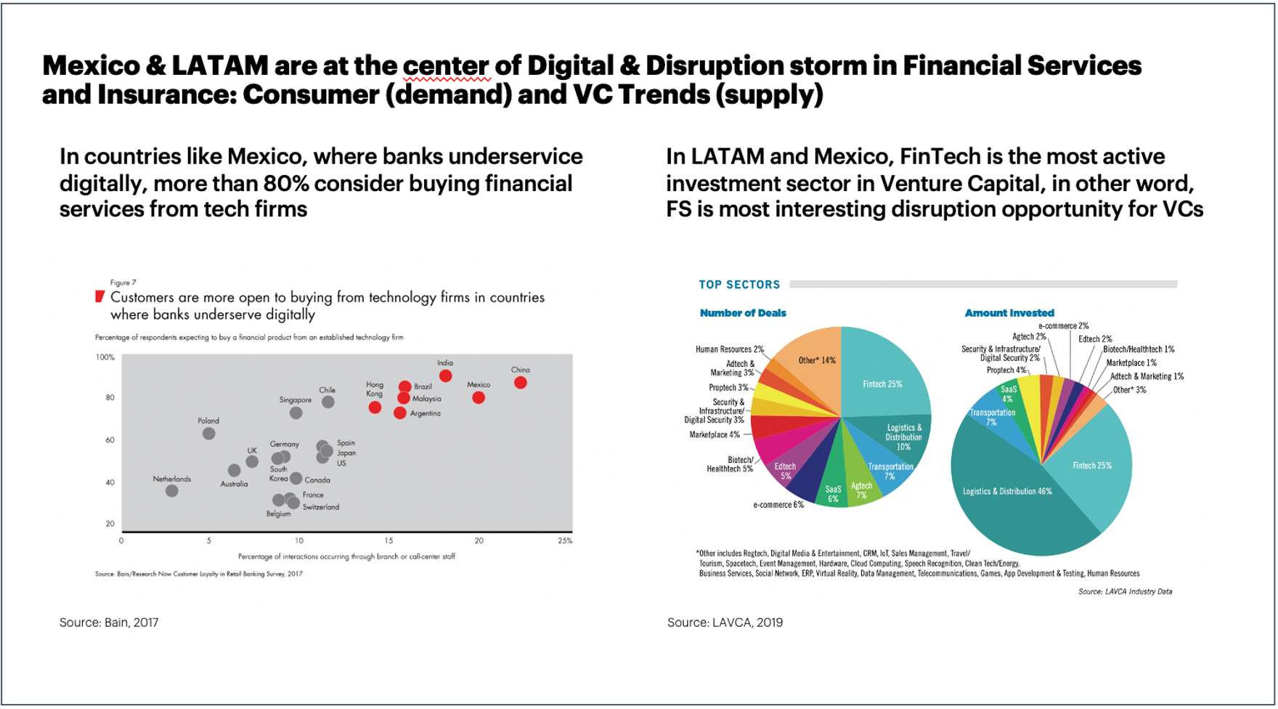
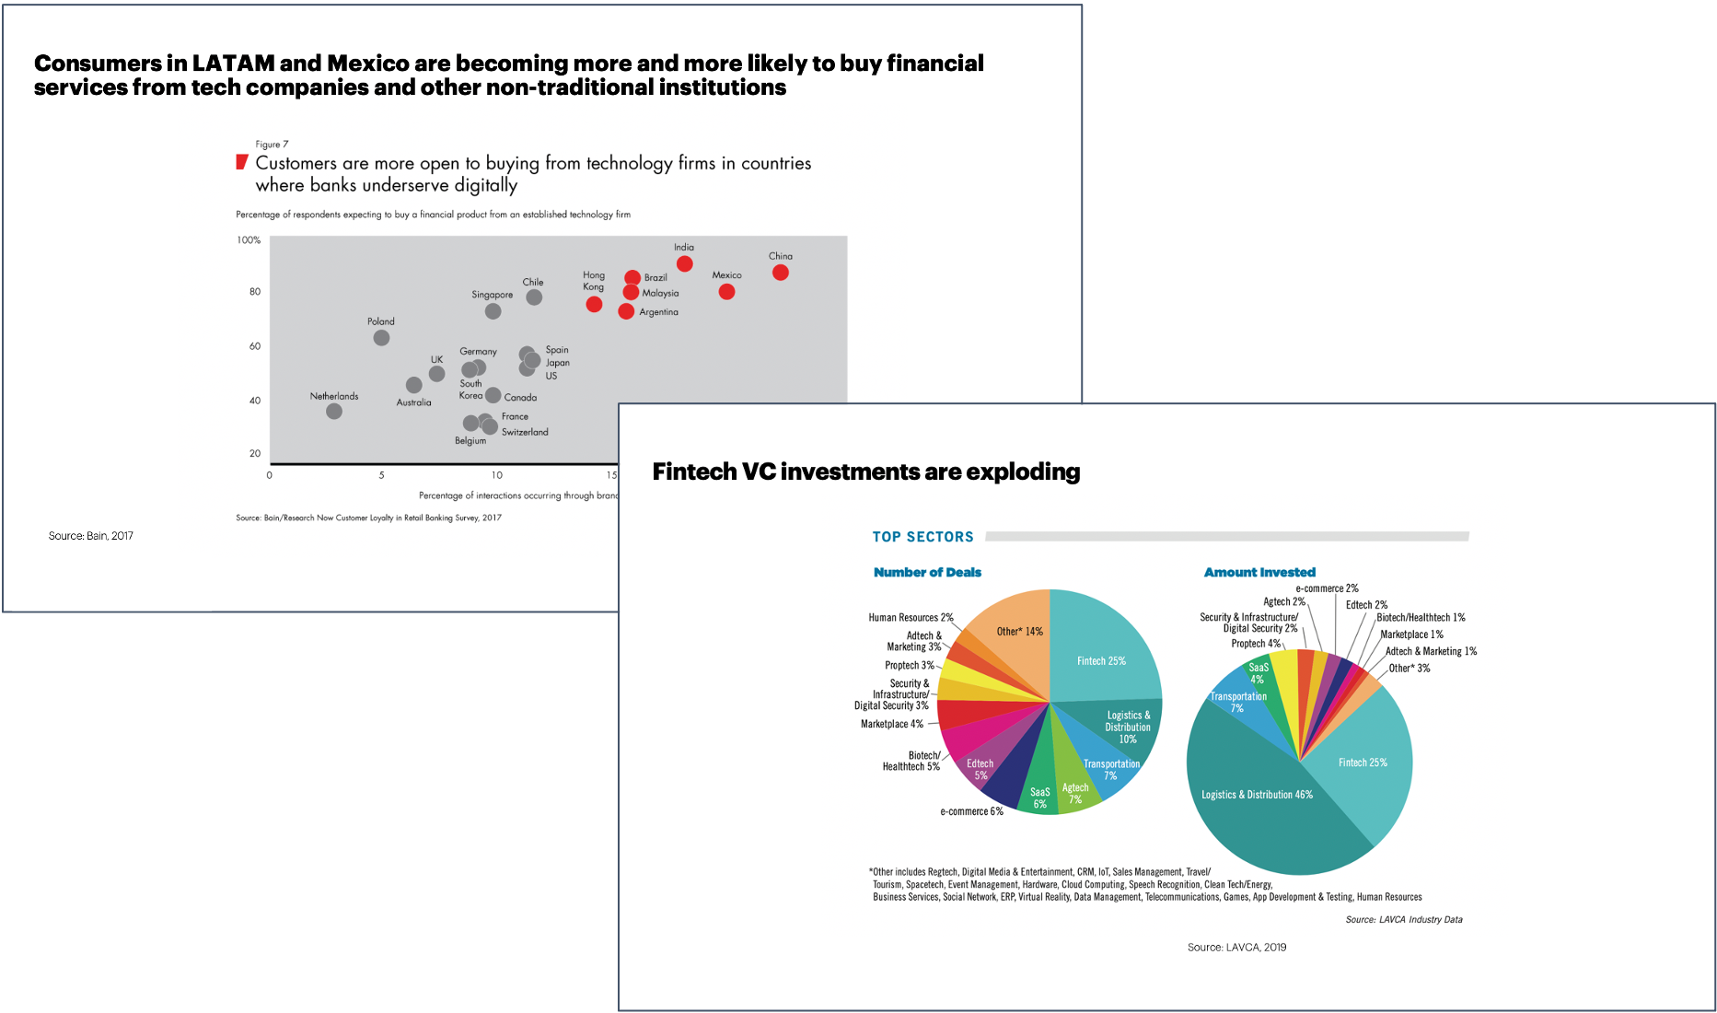
Best practice tip: Keep it to one message per slide
Appendix: Checklist
Look at your slide title and content – what is the one message you want the reader to take away from this slide? Delete all the content (even if it looks nice) that doesn’t support this message. Alternatively, split it into several slides.
Several messages in one slide make it difficult to read
One message in each slide gets the points across clearly

Slide 267
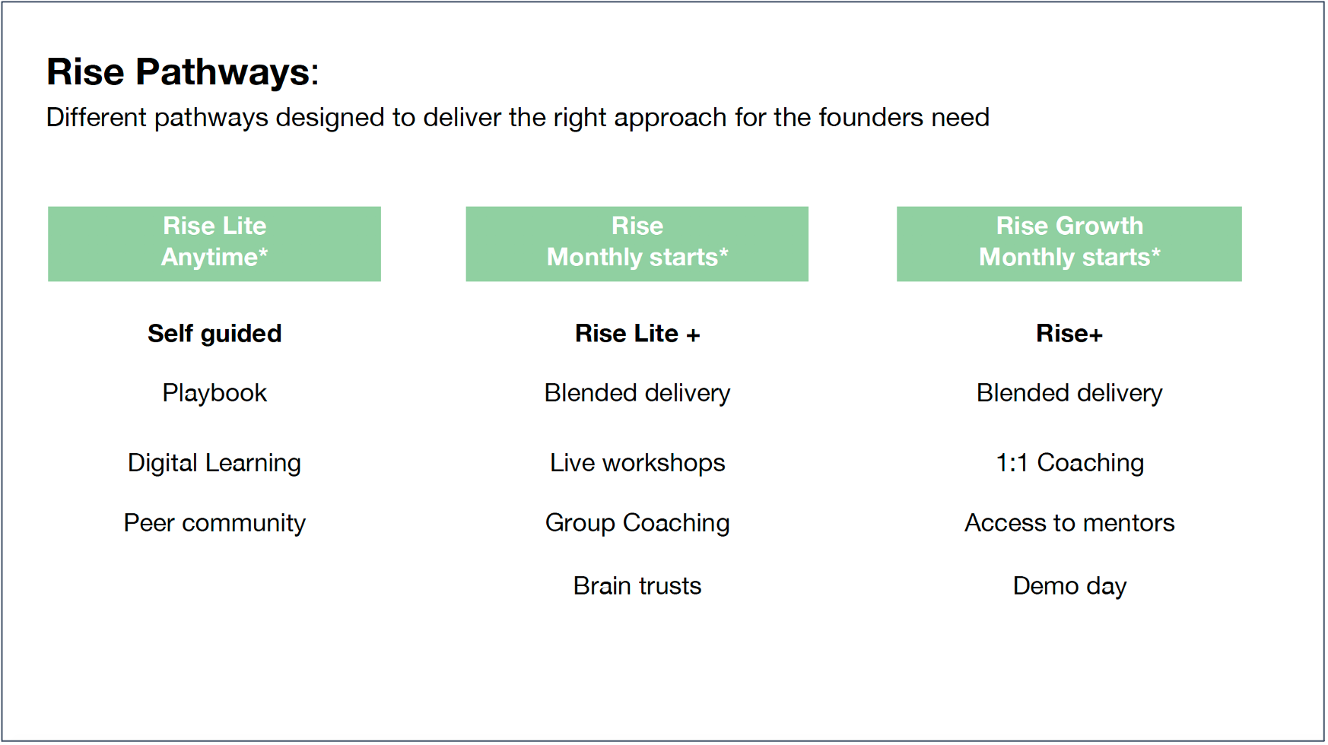
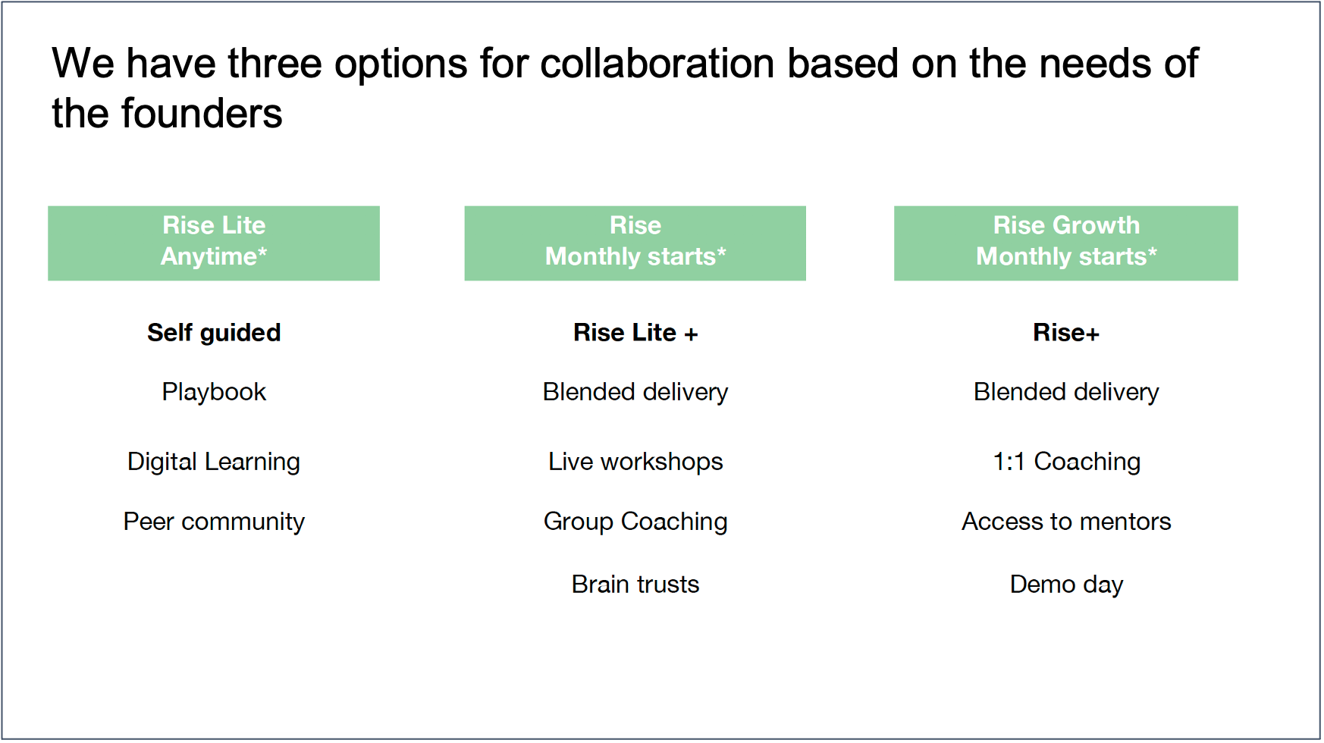
Best practice tip: Use action titles
Appendix: Checklist
Think about the most important thing you want the reader to know when reading the slide. How would you say that if you had to do a voice-over? Write that voice-over down as the action title.
A descriptive title leaves the reader to interpret the message on their own
An action title guides the reader and helps them focus on what’s most important

Slide 268
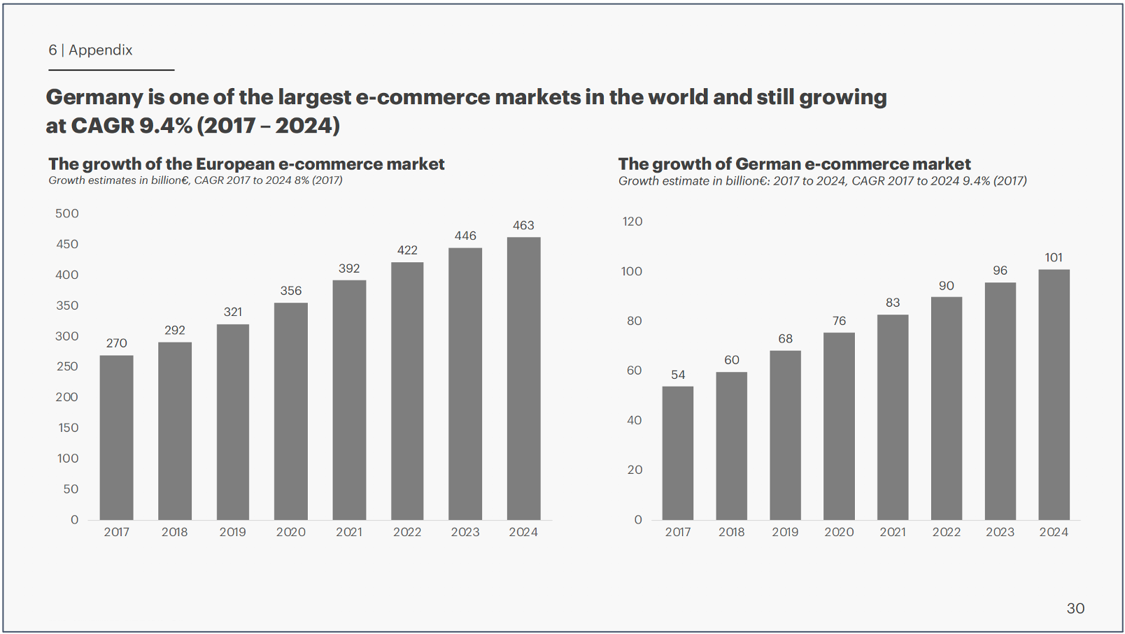
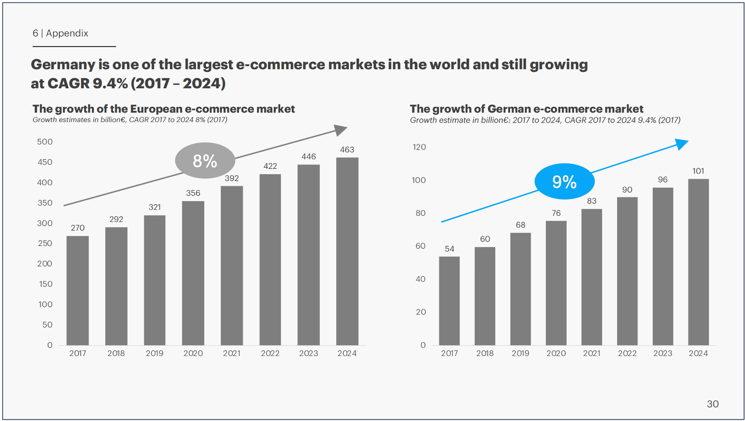
Best practice tip: Use visuals and color to highlight your message
Appendix: Checklist
Look at the message you want to say with your slide and the content that supports this. Is there anything you can put a box around, make a different color, or add a visual to to make that content stand out and support the message?
Without colors or call-outs it is more time-consuming for the reader to understand why the graph is there
With simple highlights you can call attention to the point you want the graphs to make
8%

Slide 269
Best practice tip: Read only titles and see if overall story is coherent
Appendix: Checklist
Zoom out on your slides and only read the titles. Does the story make sense and create a compelling case?
Titles that don’t tell a story are difficult to navigate and retell:
Coherent titles easily deliver the main points:
Why we believe in the mission
Solutions along the healthcare customer journey
Project based on a proven methodology
Run over a 3 month period
To get a prioritized list of actions
Engagement channel building
Innovation project
Pilot and MVP
Questions
[Company] is building the national virtual care platform, transforming healthcare in [region] from 202x
[Company] faces one urgent challenge: How to populate the platform with high quality solutions
To solve this big challenge, [Company] needs to answer two key questions
The solution is to run a 3 month strategy and execution roadmap phase – followed by execution programs
An initial $500k investment will save millions later, reduce mistakes and radically speed up execution

Slide 270
Best practice tip: Use the Pyramid Principle
Appendix: Checklist
Look at how you have structured your slides and storyline. Can the reader or audience understand what the main answer/ conclusion/recommendation is within the first slide(s) or title, or do they need to read many slides before getting there?
Starting with the detailed arguments or facts drowns out the main conclusion
Starting with the main conclusion focuses your audience and makes it easier to understand how this conclusion is supported by the facts
Supporting fact
Supporting fact
We love taking walks but just forget
Daily walks will be good for us
Main conclusion
We should get a dog
Arguments
We both love dogs
Daily walks will be good for us
We have the time and money now
Main conclusion
Argument
We should get a dog
If we had a dog we would remember to take walks
Supporting facts
We don’t get enough exercise right now
We love taking walks but just forget

Slide 271


